Slide 1



EU PROGRAMMES
– AN OVERVIEW-

Slide 2
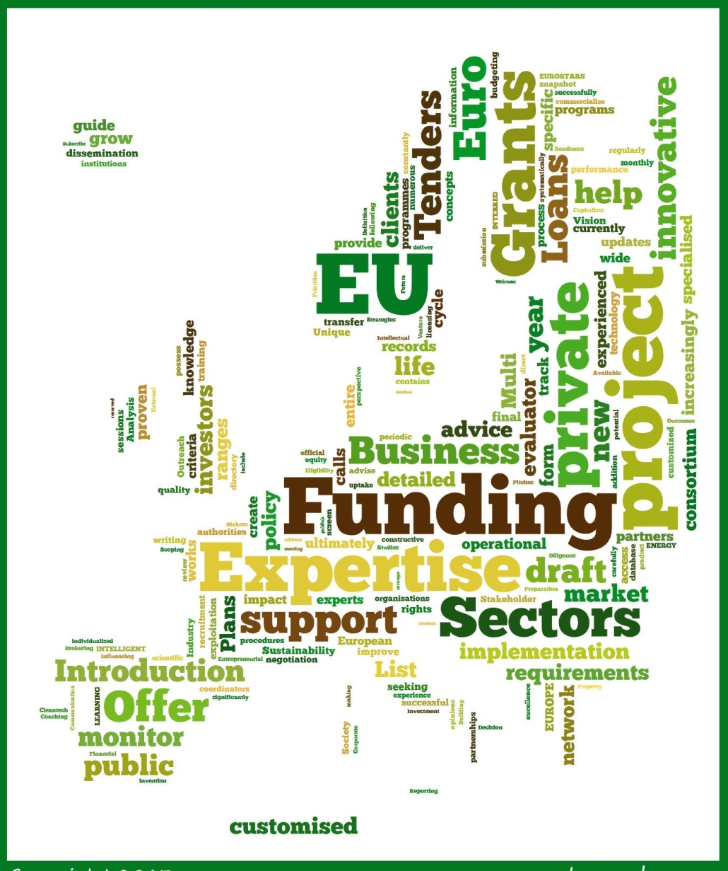
EU Union Programmes are programmes
financed directly from the EU’s budget in the form
of grants and cover priorities, as defined by the EU
and aimed at contributing to the implementation
of EU policies. They are administrated by the
European Commission and are competitive and
transnational, thus participation of partners from
more than one member states is often required
in order to submit a proposal.

Slide 3
Participating countries in the Programmes are usually divided into two groups: Programme Countries and Partner Countries.
Programme Countries include the 28 Member States, the European Free Trading Association Countries/European Economic Area – EFTA/ EEA (Iceland, Liechtenstein, Norway) and Candidate Countries including Serbia under Framework Agreement.
Partner Countries include third countries that are contributing financially to the programmes’ budget and have signed in this respect a Memorandum of Understanding.
Neighbouring Partner Countries may also participate in certain programmes, as defined in the Annual Work Programmes, subject to conditions. (South East Europe, Eastern Europe and Caucasus, Mediterranean Partner Countries)

Slide 4

Main types of EU funding ;
Grants are awarded to implement specific projects, usually following a public announcement known as a ‘call for proposals.
The EU provides Loans, guarantees and equity as forms of financial assistance to support its policies and programmes.
Prizes are rewards to winners of contests from Horizon 2020. The winner of a contest will receive cash, publicity coverage or promotion as reward.
Public contracts are awarded through calls for tender (a procedure known as public procurement). They cover a wide range of areas including studies, technical assistance and training, consultancy, conference organisations, IT equipment and many others. The contracts' purpose is to buy services, goods or works to ensure the smooth functioning of EU institutions or programmes. PRAG Practical Guide explains the contract procedures for all EU external action financed from the EU budget. They are selected via calls for tenders and not considered a form of EU funding.

Slide 5
Potential applicants
National Government
State / Region / City / Municipality / Local Authority
Public Bodies/Services
Associations / Foundations
Enterprise (more than 250 employees or not defined)
NGOs / NPOs
Small and Medium Sized Enterprises(including social enterprises);
Microenterprises (fewer than 10 employees)
International Organization
Universities and Higher Education Institutions
Research Institution
A school/institute/education or training centres
Individuals/Youths/Students....

Slide 6











The EU provides funding for a broad range of projects and programmes

Slide 7
EU Framework Programme "Horizon 2020"

Slide 8
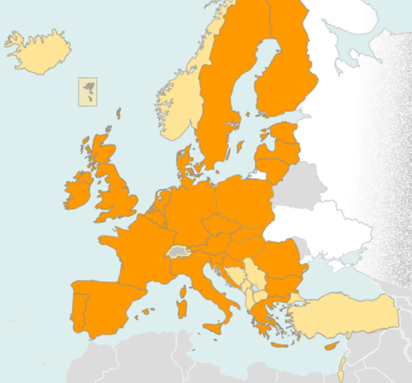
EU Framework Programme "Horizon 2020"
Nearly 80 billion EUR funding programme
Coupling research with innovation - from lab to market
Focus on societal challenges: health, clean energy, transport, etc.
Open to the World !
Participation of companies, universities, institutes in EU and beyond.
28 Member-States (MS) and
15 Associated Countries to the framework programme
Open to the world
EU MS
Associated Countries
Notes:
Research and innovation is at the centre of the Europe 2020 strategy aiming at developing a smart, sustainable and inclusive European society by 2020.
Therefore Horizon 2020, the main instrument for Research and Innovation in Europe, is at the heart of the European budget for the period between 2014-20. this is a concrete implementation of the fact that the EU leaders believe strongly that research and innovation will create the economic opportunities of tomorrow. And as you know, this approach is the same approach of the Chinese leadership.
Horizon 2020, the new programme for research and innovation has been allocated a budget of almost 80 billion euros over the next seven years.
Horizon 2020 is designed to address societal challenges through funding excellent science, technology and innovation.
Horizon 2020 is fully open to ALL Chinese researchers and innovators, from the private and the public sector.

Slide 9
EU Framework Programme "Horizon 2020"
Total Budget: €77,03 billion
Thematic Categories: Research, Innovation, Technologies, Social affairs, Energy, Environment, Health, Industry, Information and Communication Technologies, Justice, Security, Human Rights, Space, Telecommunications, Transport, Youth, Economic growth and competitiveness
Beneficiaries: University, Faculty, Research Institute, Education and Training Centres, Professional Association/Trade Union, State/Region/City/Municipality/ Local Authority, International Organization, Small and Medium Sized Enterprises- SMEs (10 - 249 employees), Microenterprises (< 10 employees), NGO/NPO, Public Services, Start-up Company, Enterprise (> 250 employees), Association, National Government

Slide 10
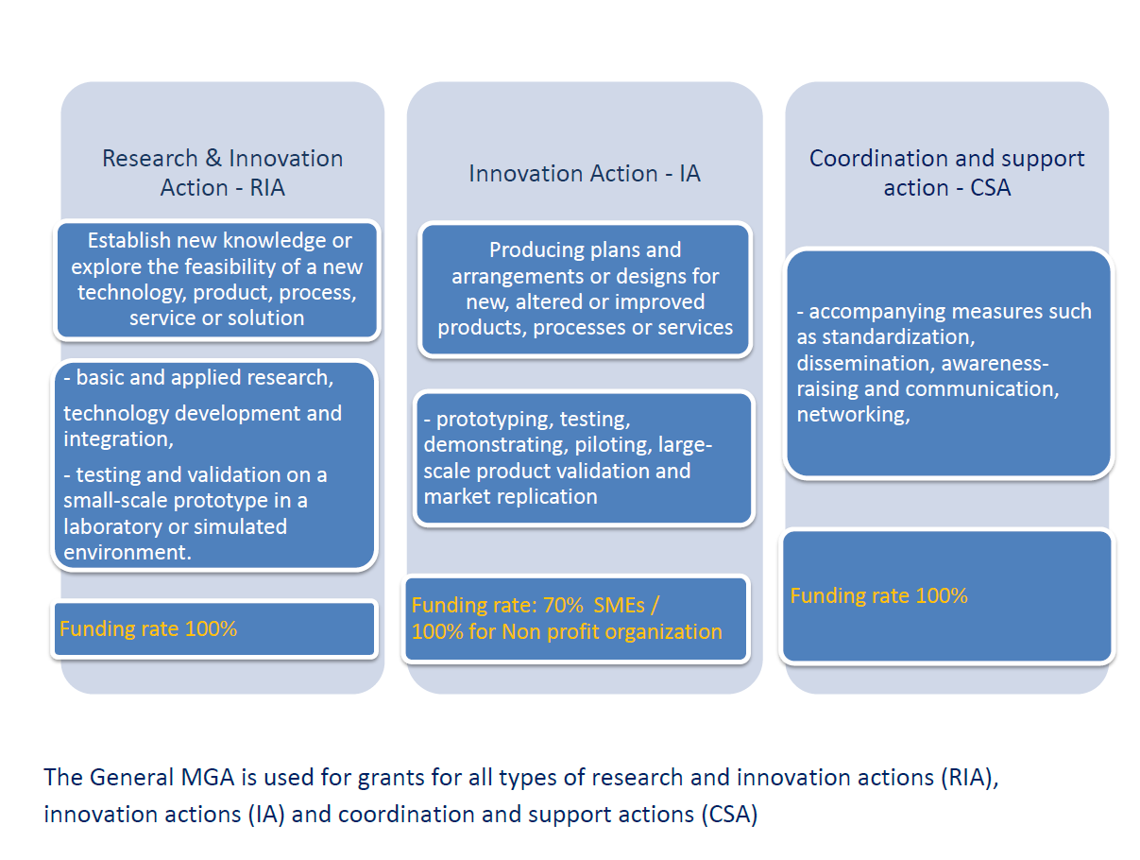
Type of actions – funding rates
Open to the world
Notes:
Research and innovation is at the centre of the Europe 2020 strategy aiming at developing a smart, sustainable and inclusive European society by 2020.
Therefore Horizon 2020, the main instrument for Research and Innovation in Europe, is at the heart of the European budget for the period between 2014-20. this is a concrete implementation of the fact that the EU leaders believe strongly that research and innovation will create the economic opportunities of tomorrow. And as you know, this approach is the same approach of the Chinese leadership.
Horizon 2020, the new programme for research and innovation has been allocated a budget of almost 80 billion euros over the next seven years.
Horizon 2020 is designed to address societal challenges through funding excellent science, technology and innovation.
Horizon 2020 is fully open to ALL Chinese researchers and innovators, from the private and the public sector.

Slide 11
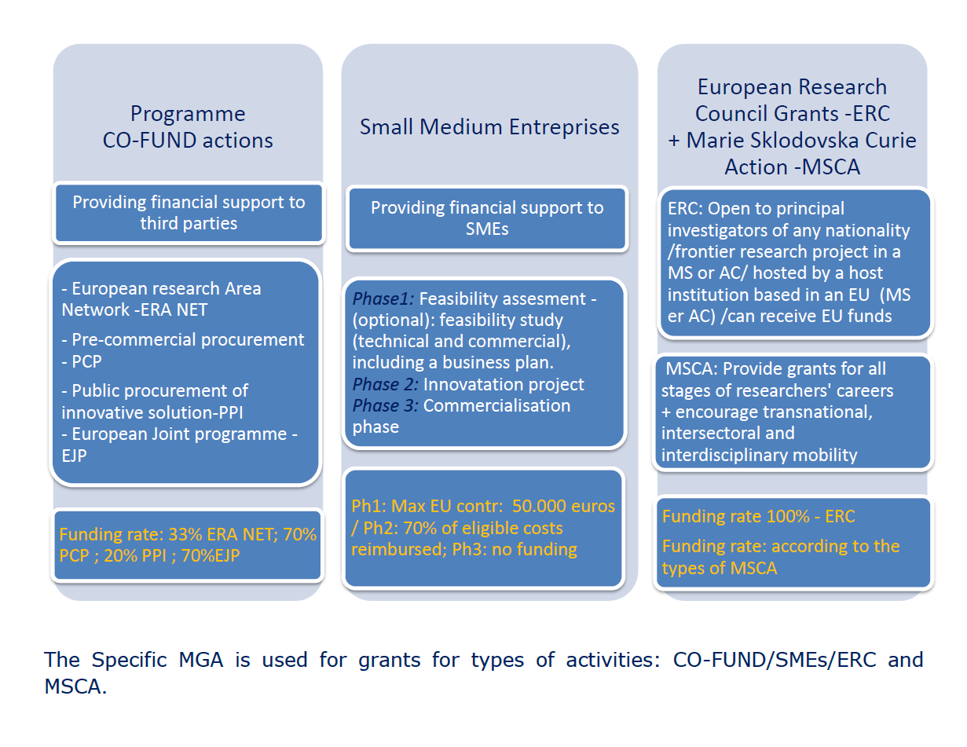
Type of actions – funding rates
Open to the world
Notes:
Research and innovation is at the centre of the Europe 2020 strategy aiming at developing a smart, sustainable and inclusive European society by 2020.
Therefore Horizon 2020, the main instrument for Research and Innovation in Europe, is at the heart of the European budget for the period between 2014-20. this is a concrete implementation of the fact that the EU leaders believe strongly that research and innovation will create the economic opportunities of tomorrow. And as you know, this approach is the same approach of the Chinese leadership.
Horizon 2020, the new programme for research and innovation has been allocated a budget of almost 80 billion euros over the next seven years.
Horizon 2020 is designed to address societal challenges through funding excellent science, technology and innovation.
Horizon 2020 is fully open to ALL Chinese researchers and innovators, from the private and the public sector.

Slide 12

Priorities
Researchers driven:
Excellent science is the foundation of tomorrow’s technologies, jobs and wellbeing
Industry driven:
Strategic investments in key technologies
Support to innovative companies
1- Excellent science
€24.4 billion
Society driven:
Address concerns of citizens and society/EU policy objectives
Multidisciplinary collaborations
2- Industrial leadership
€17 billion
3- Societal challenges
€29.7 billion
Open to the world
Notes:
Horizon 2020 is focused on three priorities: excellent science, industrial leadership and societal challenges. These are all open for international participation, in particular to Chinese participation.
***CLICK for animation***
Priority 1: Excellent Science
Objectives are:
World class science is the foundation of tomorrow’s technologies, jobs and wellbeing
Europe needs to develop, attract and retain research talent
Researchers need access to the best infrastructures
Funding:
European Research Council (ERC): 13 billion Euros
Future and Emerging Technologies (FET): 2.7 billion Euros
Marie Sklodowska-Curie actions (MSCA): 6.2 billion Euros)
***CLICK for animation***
Priority 2: Industrial Leadership
Objectives are:
Strategic investments in key technologies (e.g. advanced manufacturing, micro-electronics) underpin innovation across existing and emerging sectors
Europe needs to attract more private investment in research and innovation
Europe needs more innovative small and medium-sized enterprises (SMEs) to create growth and jobs
Funding:
Leadership in enabling and industrial technologies (LEITs): 13.6 billion Euros
Access to risk finance: 2.9 billion Euros
Innovation in SMEs: 0.7 billion Euros
***CLICK for animation***
Priority 3: Societal Challenges
Objectives are:
Concerns of citizens and society/EU policy objectives (climate, environment, energy, transport, etc.) cannot be achieved without innovation
Breakthrough solutions come from multi-disciplinary collaborations, including social sciences & humanities
Promising solutions need to be tested, demonstrated and scaled up
Funding:
Health, demographic change and wellbeing: 7.5 billion Euros
Food security, sustainable agriculture, marine and maritime research & the Bio-economy: 3.9 billion Euros
Secure, clean and efficient energy: 5.9 billion Euros
Smart, green and integrated transport: 6.3 billion Euros
Climate action, resource efficiency and raw materials: 3.1 billion Euros
Inclusive and reflective societies: 1.3 billion
Secure societies: 1.7 billion
Science with and for society: 0.5 billion
Spreading excellence and widening participation : 0.8 billion Euros

Slide 13
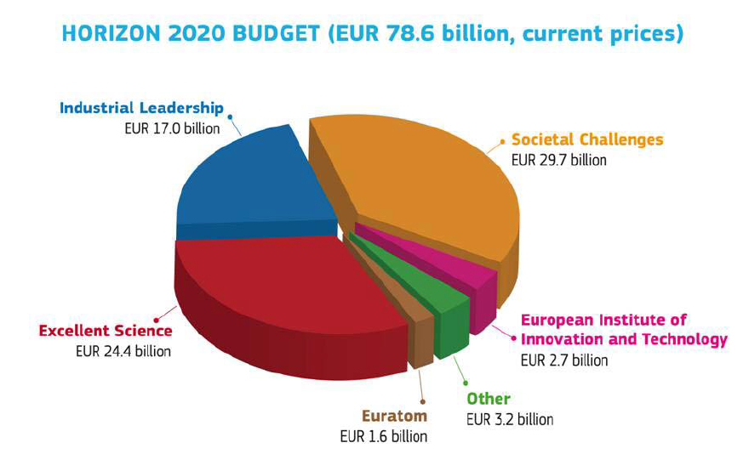
H2020 budget - breakdown
Open to the world
Notes:
Research and innovation is at the centre of the Europe 2020 strategy aiming at developing a smart, sustainable and inclusive European society by 2020.
Therefore Horizon 2020, the main instrument for Research and Innovation in Europe, is at the heart of the European budget for the period between 2014-20. this is a concrete implementation of the fact that the EU leaders believe strongly that research and innovation will create the economic opportunities of tomorrow. And as you know, this approach is the same approach of the Chinese leadership.
Horizon 2020, the new programme for research and innovation has been allocated a budget of almost 80 billion euros over the next seven years.
Horizon 2020 is designed to address societal challenges through funding excellent science, technology and innovation.
Horizon 2020 is fully open to ALL Chinese researchers and innovators, from the private and the public sector.

Slide 14
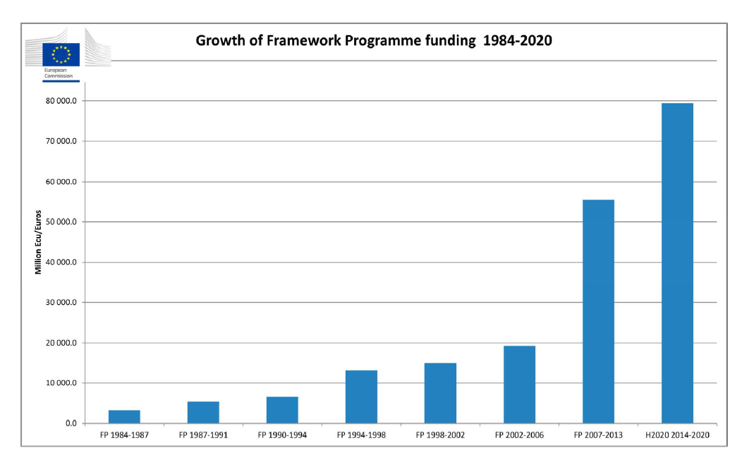
H2020 budget - breakdown
Open to the world
Notes:
Research and innovation is at the centre of the Europe 2020 strategy aiming at developing a smart, sustainable and inclusive European society by 2020.
Therefore Horizon 2020, the main instrument for Research and Innovation in Europe, is at the heart of the European budget for the period between 2014-20. this is a concrete implementation of the fact that the EU leaders believe strongly that research and innovation will create the economic opportunities of tomorrow. And as you know, this approach is the same approach of the Chinese leadership.
Horizon 2020, the new programme for research and innovation has been allocated a budget of almost 80 billion euros over the next seven years.
Horizon 2020 is designed to address societal challenges through funding excellent science, technology and innovation.
Horizon 2020 is fully open to ALL Chinese researchers and innovators, from the private and the public sector.

Slide 15
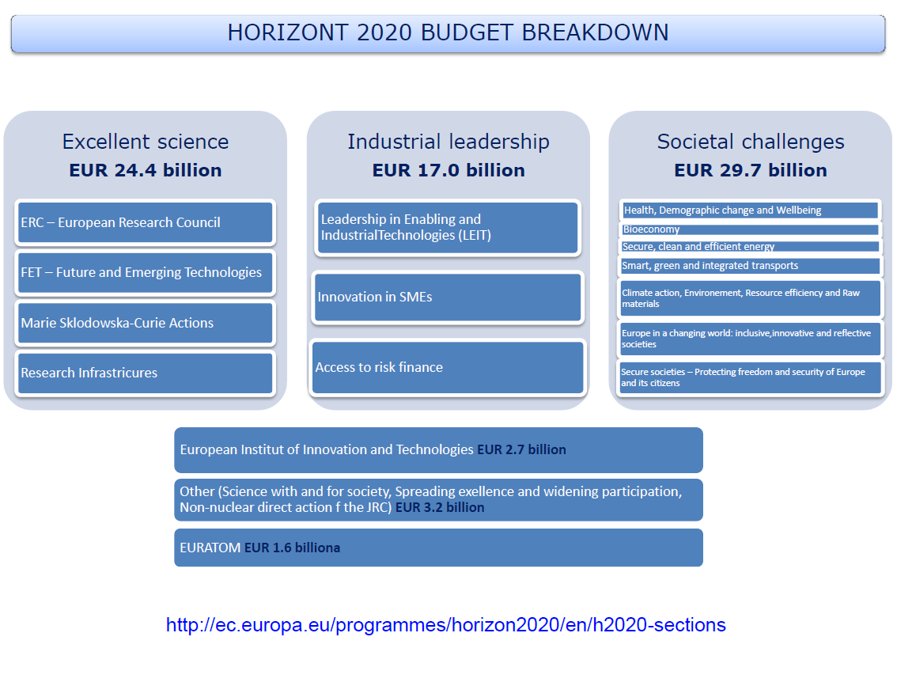
H2020 budget - breakdown
Open to the world
Notes:
Research and innovation is at the centre of the Europe 2020 strategy aiming at developing a smart, sustainable and inclusive European society by 2020.
Therefore Horizon 2020, the main instrument for Research and Innovation in Europe, is at the heart of the European budget for the period between 2014-20. this is a concrete implementation of the fact that the EU leaders believe strongly that research and innovation will create the economic opportunities of tomorrow. And as you know, this approach is the same approach of the Chinese leadership.
Horizon 2020, the new programme for research and innovation has been allocated a budget of almost 80 billion euros over the next seven years.
Horizon 2020 is designed to address societal challenges through funding excellent science, technology and innovation.
Horizon 2020 is fully open to ALL Chinese researchers and innovators, from the private and the public sector.

Slide 16
Priority 1. Excellent science
World class science is the foundation of tomorrow’s technologies, jobs and well-being
Europe needs to develop,
attract and retain
research talent
Researchers need access
to the best infrastructures
€24.4 Billion
European Research Council (ERC) Frontier research by the best individual teams | 13.095
Future and Emerging Technologies (FET) Collaborative research to open new fields of innovation | 2.696
Marie Sklodowska Curie Actions* (MSCA) Opportunities for training and career development | 6.162
Research Infrastructures (RI) (including e-infrastructures) Ensuring access to world-class facilities | 2.488

Slide 17
Priority 1. Excellent science - European Research Council (ERC)
Frontier research by the best individual teams
The European Research Council (ERC) provides attractive and flexible funding to enable talented and creative individual researchers and their teams to pursue the most promising avenues at the frontier of science, on the basis of Union-wide competition
Project types:
  Starting Grant (2-7 years from dissertation, ≤1.5 M€ over 5 years )
  Consolidator Grant (8-12 years from dissertation, ≤2 M€ over 5 years)
  Advanced Grant (≤2,5 (3,5) M€ over 5 years)
  Proof of Concept Grant (≤150 k€ over 1 year - for ERC Grant holders to investigate innovation potential)

Slide 18
Priority 1. Excellent science – Future and Emerging Technologies (FET)
Collaborative research to open new fields of I nnovation
Future and emerging technologies (FET) – priority supports collaborative research in order to extend Europe’s capacity for advanced and paradigm - changing innovation
  FET OPEN - Early-stage, visionary new ideas (bottom-up)
  FET Proactive - Based on challenges
  FET Flagship - Large Scale Initiatives

Slide 19
Priority 1. Excellent science - Marie Sklodowska Curie Actions (MSCA)
Opportunities for training and career development
Marie Skłodowska-Curie Actions provide excellent and innovative research training as well as attractive career and knowledge exchange opportunities. Can be used as recruitment instrument from any country.
  IF – Individual Fellowships – Researcher
    Research in an (another) EU country (1-2 years)
    Research outside EU (1-2 years) and within EU again (1 year)
  ITN – Innovative Training Networks - PhD student, Researcher
    European “Research Training school” (5 – 10 partners) - ETN
    Joint doctorate between Universities - EJD
    Industry doctorate (in conjunction with university) - EID
  RISE – Research and Innovation Staff Exchange - PhD student, Researcher, Lab staff
    Knowledge exchange by two-way secondments

Slide 20
Priority 1. Excellent science - Research Infrastructures (RI)
(including e-infrastructures)
Ensuring access to world-class facilities
Research infrastructure (including e-infrastructures) – priority develops European research infrastructure for 2020 and beyond, foster their innovation potential and human capital, and complement this with the related Union policy and international cooperation

Slide 21
Priority 2. Industrial leadership
Strategic investments in key technologies (e.g. advanced manufacturing, micro-electronics etc.) underpin innovation across existing and emerging sectors
Europe needs to attract more private investment in research and innovation
Europe needs more innovative SMEs to create growth and jobs
€17 Billion
Leadership in enabling and industrial technologies (ICT, nanotechnologies, materials, biotechnology, manufacturing, space) | 13.557
Access to risk finance Leveraging private finance and venture capital for research and innovation | 2.842
Innovation in SMEs Fostering all forms of innovation in all types of SMEs | 616

Slide 22
Priority 2. Industrial leadership –
Leadership in enabling and industrial technologies
(ICT, nanotechnologies, materials, biotechnology, manufacturing, space)
Leadership in enabling and industrial technologies” provides dedicated support for research, development and demonstration and, where appropriate, for standardization and certification, on
  information and communication technologies (ICT),
  nanotechnology,
  advanced materials,
  biotechnology,
  advanced manufacturing and processing and
  space.

Slide 23
Priority 2. Industrial leadership - Access to risk finance
Leveraging private finance and venture capital for research and innovation
“Access to risk finance” aims to overcome deficits in the availability of debt and equity finance for R&D and innovation-driven companies and projects at all stages of development
Helps companies and other types of organization engaged in research and innovation (R&I) to gain easier access, via financial instruments, to loans, guarantees, counter-guarantees and hybrid, mezzanine and equity finance, which are be most importantly boosted under the new Commission initiative VentureEU.

Slide 24

Priority 2. Industrial leadership - Innovation in SMEs
Fostering all forms of innovation in all types of SMEs
“Innovation in SMEs” provides SME-tailored support to stimulate all forms of innovation in SMEs, targeting those with the potential to grow and internationalize across the single market and beyond
Aimed at highly innovative SMEs with the ambition to develop their growth potential.
It offers lump sums for feasibility studies, grants for an innovation project’s main phase (demonstration, prototyping, testing, application development...); lastly, the commercialization phase is supported indirectly through facilitated access to debt and equity financial instruments
The SME Instrument becomes the EIC Accelerator, offering optional equity investment in addition to a grant.
Innovative companies can apply for a grant only or up to 17.5 million in combined grant and equity financing to scale-up quickly and effectively.

Slide 25
Priority 2. Industrial leadership - Innovation in SMEs
Fostering all forms of innovation in all types of SMEs
The EIC Accelerator Pilot offers small and medium-sized businesses the following:
Business innovation grants for feasibility assessment purposes (optional phase I): EUR 50,000 (lump sum) per project (70% of total cost of the project) – this ended on 5 September 2019;
Business innovation grants for innovation development & demonstration purposes: an amount in the indicative range of EUR 500,000 and 2,5 million (70% of total cost of the project as a general rule);
Equity of up to €15 million per company (€100 million total budget for equity in 2019-2020 pilot phase)
Free-of-charge business coaching (optional) in order to support and enhance the firm’s innovation capacity and help align the project to strategic business needs;
Access to a wide range of other business acceleration services and facilitated access to risk finance, to facilitate the commercial exploitation of the innovation.

Slide 26
Priority 3. Societal Challenges
€29.7 Billion
Health, demographic change and wellbeing | 7.472
Food security, sustainable agriculture, marine and maritime and inland water research and the bioeconomy | 3.851
Secure, clean and efficient energy | 5.931
Smart, green and integrated transport | 6.339
Climate action, environment, resource efficiency and raw materials | 3.081
Inclusive, innovative and reflective societies | 1.310
Secure societies | 1.695
Science with and for society | 462
Spreading excellence and widening participation | 816
Concerns of citizens and society
EU policy objectives (climate, environment, energy, transport etc.) cannot be achieved without innovation
Breakthrough solutions come from multi-disciplinary collaborations, including social sciences & humanities
Promising solutions need to be tested, demonstrated and scaled up

Slide 27
Priority 3. Societal Challenges
Funding will focus on the following challenges:
Health, demographic change and well-being.
Food security, sustainable agriculture and forestry, marine, maritime and inland water research, and the bioeconomy.
Secure, clean and efficient energy.
Smart, green and integrated transport.
Climate action, environment, resource efficiency and raw materials.
Europe in a changing world - Inclusive, innovative and reflective societies.
Secure societies - Protecting freedom and security of Europe and its citizens.

Slide 28
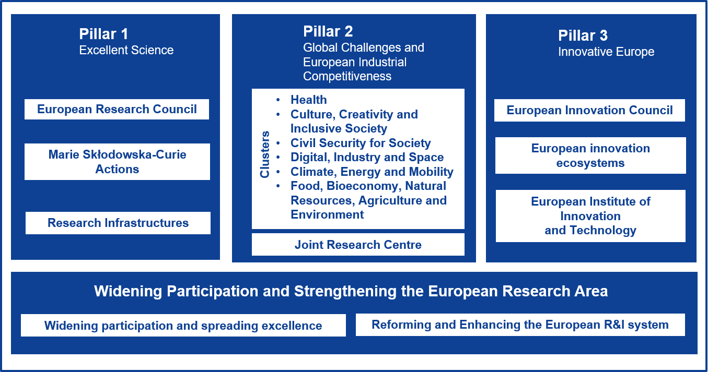
Horizon Europe - the next research and innovation framework programme
The Commission's proposal for Horizon Europe is an ambitious €100 billion research and innovation programme to succeed Horizon 2020.
The European Parliament and the Council of the EU reached in March and April 2019 a provisional agreement on Horizon Europe.
The European Parliament endorsed the provisional agreement on 17 April 2019.
Presentation outlining Horizon Europe in 23 languages.

Slide 29
Link; https://ec.europa.eu/programmes/horizon2020/en
The next Framework Programme;
https://ec.europa.eu/info/horizon-europe-next-research-and-innovation-framework-programme_en
Find a Call;
https://ec.europa.eu/info/funding-tenders/opportunities/portal/screen/programmes/h2020
Work Programme;
https://eur-lex.europa.eu/legal-content/EN/TXT/?uri=CELEX%3A32013R1291
Regulation;
https://eur-lex.europa.eu/legal-content/EN/TXT/PDF/?uri=CELEX:32013R1291&from=EN

Slide 30

Building on the Competitiveness and Innovation framework Programme (CIP)

Slide 31
Equity instruments: Two complementary facilities working together to support access to risk capital and stimulate the development of the European venture capital market.
Equity Facility for R&I (H2020): focus on early stage.
Equity Facility for Growth for SMEs (COSME): focus on growth stage.
Multi-stage funds: contributions from COSME and H2020 on a pro-rata basis (based on a fund’s investment policy)
Debt instruments.
Loan Guarantee Facility (COSME): Guarantees for loans to SMEs up to € 150 000. Securitisation of SME debt finance portfolios.
SMEs & Small Midcaps Guarantee Facility (H2020): Guarantees for loans over € 150 000 for R&I activities.

Slide 32

H2020 INTERIM EVALUATION
Interim evaluation – published in 2017
Covers the first 3 years of the programme
Assesses progress and provides guidelines for the future
Relevance / Effectiveness / Efficiency / Coherence / EU added value

Slide 33
H2020 INTERIM EVALUATION - HIGHLIGHTS
EUR 20.4 billion – just about one fourth of the total Horizon 2020 budget - allocated to 11,108 signed grants
EUR 7.5 billion had been allocated to 'Excellent science' (36.8%), EUR 4.5 billion to 'Industrial leadership' (22%), EUR 7.4 billion to 'Societal challenges' (36.3%) and EUR 944.1 million to additional priorities.
The main beneficiaries of Horizon 2020 are higher education and research organisations, which together received 64.9% of the funding.
Three quarters of funding going to instruments supporting collaborative research and innovation.
Participants from 131 different countries.
Participants in EU-28 countries received 92.9% of the funding, participants from Germany and the UK being the most frequent.

Slide 34
H2020 INTERIM EVALUATION
STAKEHOLDER´S REASONS FOR PARTICIPATING IN H2020
Financial support;
Access to new knowledge and know how;
Unique collaboration opportunities with existing or new European partners;
Interdisciplinary work and the opportunity to work with other types of actors.

Slide 35
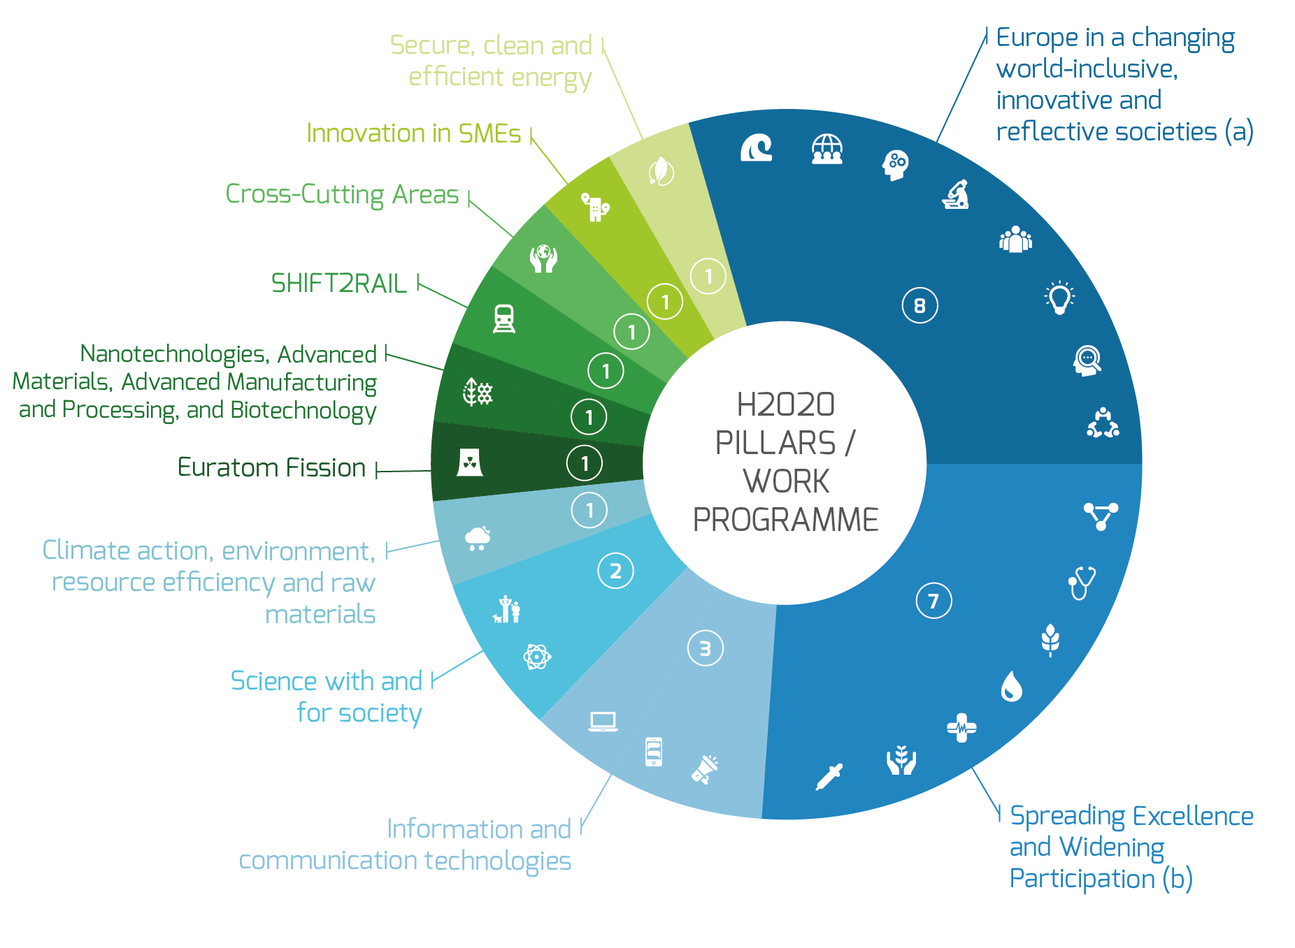
SPI – H2020 PROJECTS
SPI is active as consortium leader, partner or major sub-contractor in over 35 H2020 approved projects.
These projects include those across a range of Societal Challenges and Industrial Leadership areas, and include Research and Innovation Actions, Innovation Actions, and Coordination and Support Actions.
These projects can be grouped under different H2020 pillars / work programme as shown in the graphic illustration.
Research and innovation cooperation – China (1); Black Sea (1); Eastern Europe (1); Brazil (1); USA (1); European Research Innovation Centre of Excellence in China (1); Brazil (1); USA (1)
Health (3); Agriculture & Forestry (1); Advanced Functional Materials & Nanotechnologies (1); Water (1); Environment (1)

Slide 36
NANO2ALL – Societal engagement on responsible nanotechnology
NANO2ALL - Societal Engagement on Responsible Nanotechnology – aims to establish a European-wide sustainable platform for mutual learning and informed dialogue among all stakeholders to improve transparency and societal engagement in responsible nanotechnology.
SPI was the project coordinator and Work package leader - Engagement and communication and project and quality management
Budget: 1 M€
Project duration: 2015-2018
http://nano2all.eu/

Slide 37

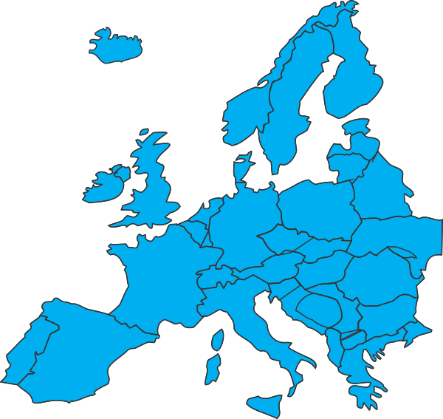








NANO2ALL – Societal engagement on responsible nanotechnology
European Union's Horizon 2020 Research and Innovation programme | Grant Agreement Number 685931
NANO2ALL in a nutshell
Horizon 2020 initiative with 12 partners, started in 2015, ending in 2019
Aim: to support the development of nanotechnology RRI policy and governance in Europe
Focus: Enable a better reflection of societal perspectives in nanotech R&I via increased societal engagement

Slide 38

NANO2ALL – Societal engagement on responsible nanotechnology
NANO2ALL main results
NANO2ALL Roadmap on recommended actions and interactions for better identifying and integrating societal perspectives in nanotechnology R&I in Europe
Establishment of 2 Joint Stakeholder Undertakings:
Working Group for Societal Engagement within Nanofutures European Technology Integrating and Innovation Platform
Working Group for Societal Engagement within EMR-S – European Materials Research Society

Slide 39
NANO2ALL – Societal engagement on responsible nanotechnology
NANO2ALL highlighted activities
NANO2ALL works together with different societal groups to discuss important issues which arise from the use of nanotechnologies
National citizen dialogues
Mapping values, needs and concerns of citizens regarding nanotechnologies in Italy, Spain, France, Sweden, Poland and Israel (April-June, 2017)
National Multi-stakeholder dialogues
Discussing citizen values, needs and concerns and actions and interactions required in national contexts to better identify and integrate societal perspectives in nanotechnology R&I in Italy, Spain, France, Sweden, Poland and Israel (October-December, 2017)
European Multi-stakeholder dialogues
Discussing citizen values, needs and concerns and actions and interactions required in the European context to better identify and integrate societal perspectives in nanotechnology R&I (2018)

Slide 40








NANO2ALL – Societal engagement on responsible nanotechnology
NANO2ALL dialogues

Slide 41



NANO2ALL – Societal engagement on responsible nanotechnology
NANO2ALL national citizen dialogues
6 national dialogues x 12-16 citizens
4-hour dialogue format, collaborative construction of scenarios - 1) a future object; 2) narratives surrounding the object
Allowed exploring possible future directions of a specific nano application field and discuss potential impacts of these future directions and their desirability
Nano application fields addressed:
Image: Imperial College of London - http://www.imperial.ac.uk/hamlyn-centre/research/robotics/brain-computer-interface/
Image: https://steemit.com/nanotech/@dafahd/nanotechnology-in-smart-textiles-and-wearables-market/
Brain-Computer Interfaces
Smart Textiles
Nanomedicine

Slide 42
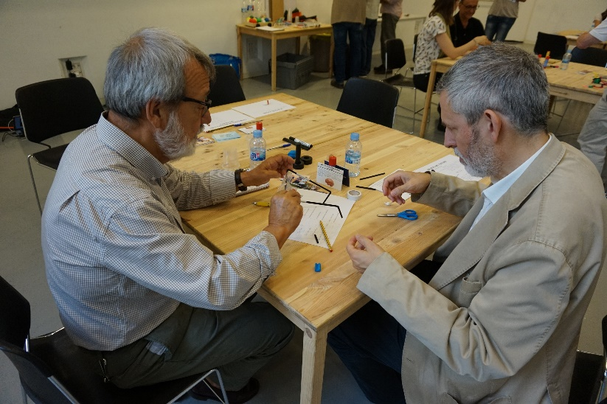
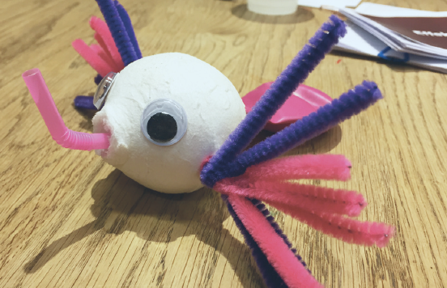
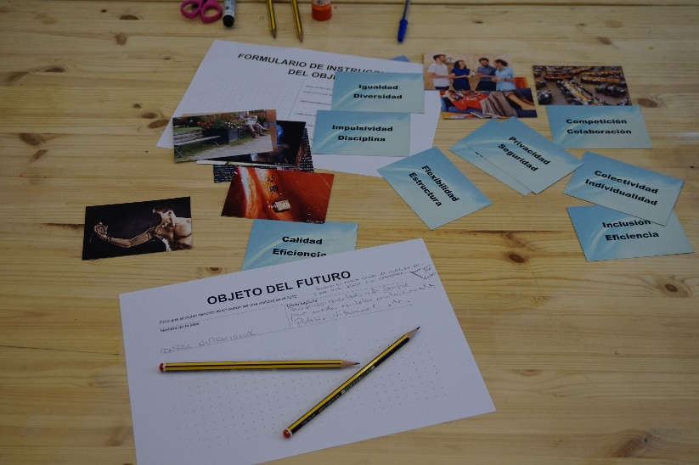
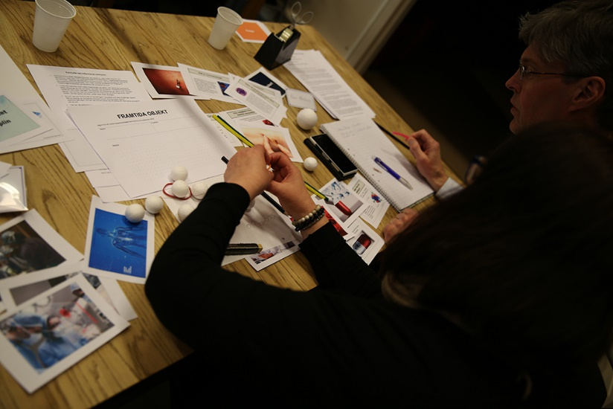
NANO2ALL – Societal engagement on responsible nanotechnology
NANO2ALL national citizen dialogues

Slide 43
NANO2ALL – Societal engagement on responsible nanotechnology
NANO2ALL national multi-stakeholder dialogues
6 dialogues X 12 stakeholders
Aim: produce a report on national perspectives on what is needed to better identify and integrate societal needs, concerns and values in R&I in specific nanotechnology application fields
7-hour dialogue format
Methodology: 3 blocks
Block 1: What is important?
Block 2: Scenario exploration
Block 3: What (inter)actions are needed and what are their preconditions

Slide 44
NANO2ALL – Societal engagement on responsible nanotechnology
NANO2ALL national multi-stakeholder dialogues
Block 1: What is important?

Slide 45
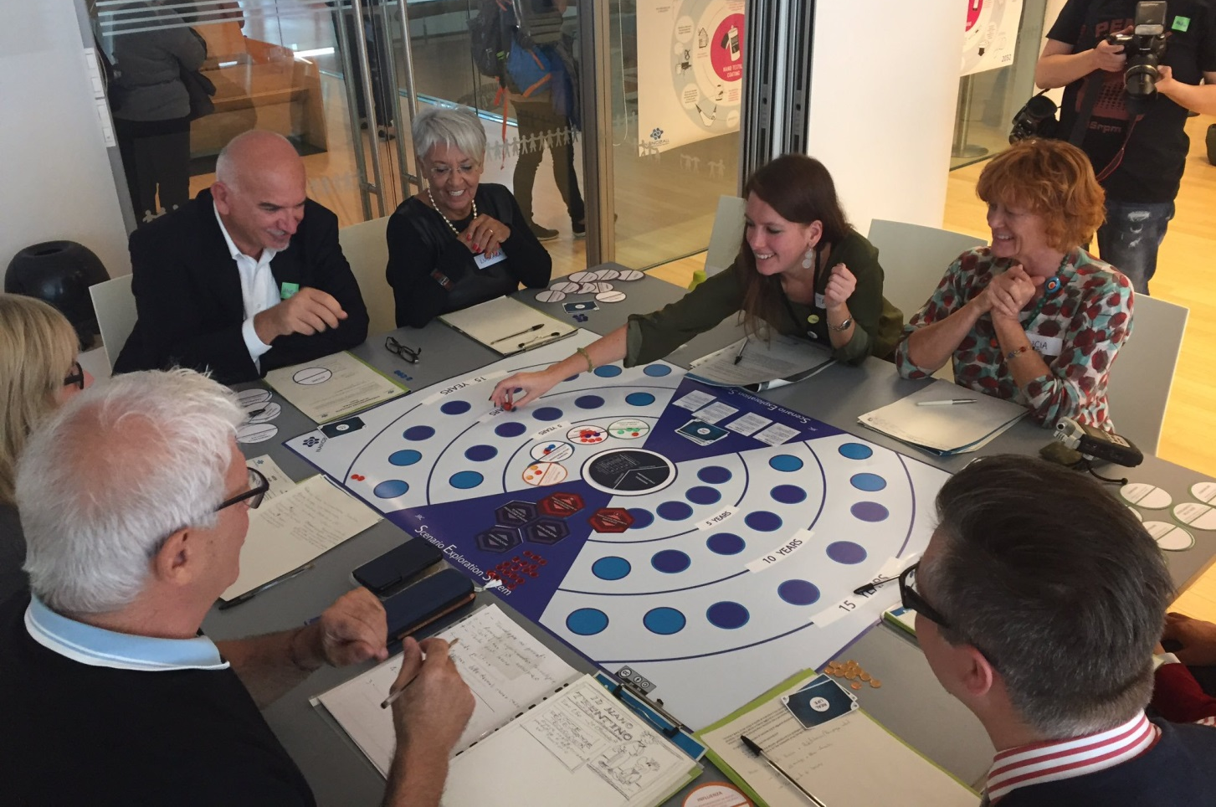
NANO2ALL – Societal engagement on responsible nanotechnology
NANO2ALL national multi-stakeholder dialogues
Block 2: Scenario exploration

Slide 46
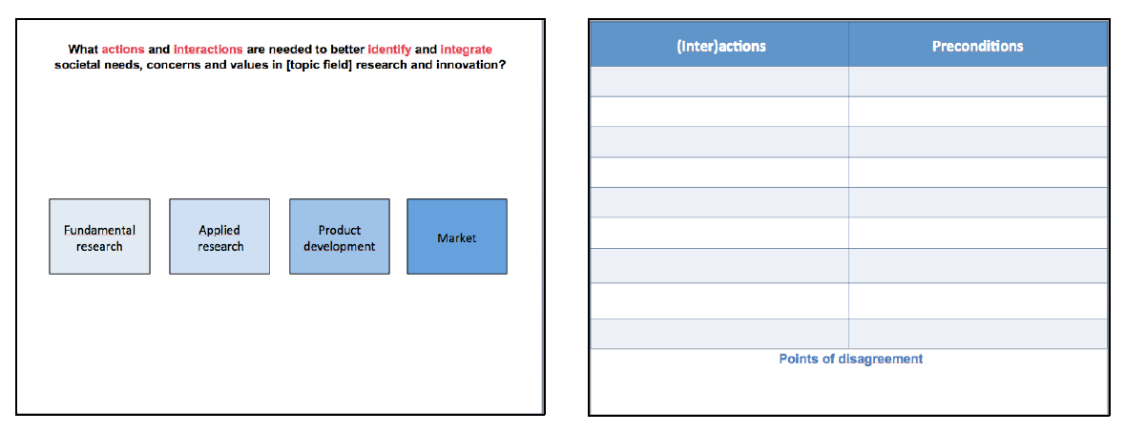
NANO2ALL – Societal engagement on responsible nanotechnology
NANO2ALL national multi-stakeholder dialogues
Block 3: What (inter)actions are needed and what are their preconditions

Slide 47
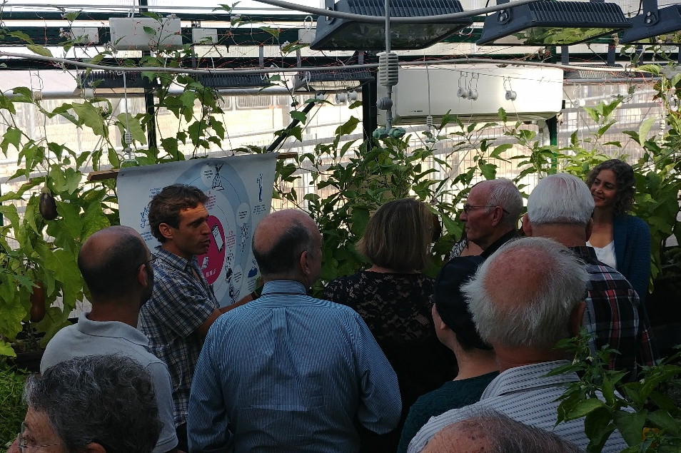
NANO2ALL – Societal engagement on responsible nanotechnology
NANO2ALL multistakeholder dialogues – preliminary results - nanomedicine
Jerusalem, Israel, 19 October 2017
In order to enhance RRI and better reflect societal perspectives in R&I in nanomedicine, stakeholders highlighted as needs:
Public exposure at early stages of basic research through cooperation between education system and academia
The establishment of a database with information on S&T developments in the area (especially that received public R&I funding) that can be consulted by citizens
More news in media of solutions and products released to the market

Slide 48

NANO2ALL – Societal engagement on responsible nanotechnology
NANO2ALL multistakeholder dialogues – preliminary results - nanomedicine
Creation of a continuing platform to meet 1x / 2x a year for an ongoing dialogue that can include companies, patient organisations, citizen representatives, science community members, policy makers, etc
Developing new methods for assuring patient privacy which will increase public confidence in new healthcare products
Image: The Scientist - http://www.the-scientist.com/?articles.view/articleNo/40598/title/Nanomedicine/

Slide 49
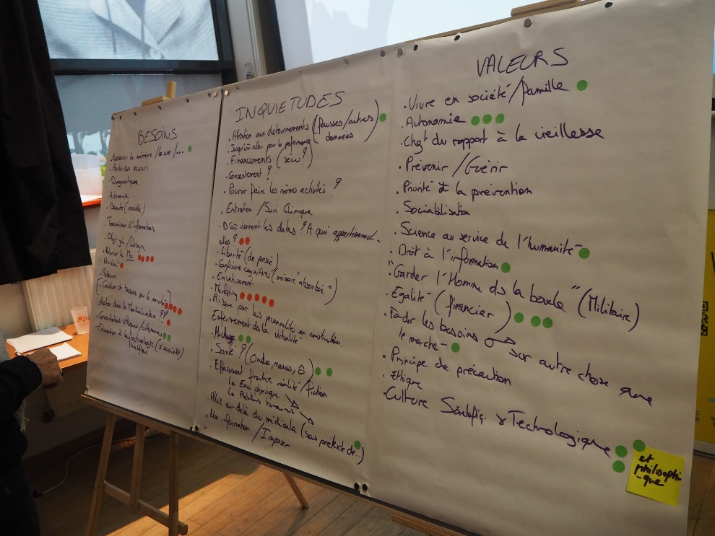
NANO2ALL – Societal engagement on responsible nanotechnology
NANO2ALL – more information
Learn more about the NANO2ALL at www.nano2all.eu and follow us on:
Twitter: https://twitter.com/Nano2AllProject
Facebook: https://www.facebook.com/nano2all/
Read more about NANO2ALL findings: www.nano2all.eu/resources

Slide 50
BINGO – Bringing INnovation to onGOing water management – a better future under climate change
BINGO aims at providing practical knowledge and tools to end users, water managers, decision and policy makers affected by climate change to enable them to better cope with all climate projections, including droughts and floods.
The project provides demand-driven solutions for specific climate related challenges, in particular for highly vulnerable water resources of strategic importance. All solutions are co-produced, tested and validated by a range of key end users at six research sites across Europe.
Budget: 8 M€
Project duration: 2015-2019
http://www.projectbingo.eu/

Slide 51

BINGO – Bringing INnovation to onGOing water management – a better future under climate change
http://www.projectbingo.eu/

Slide 52
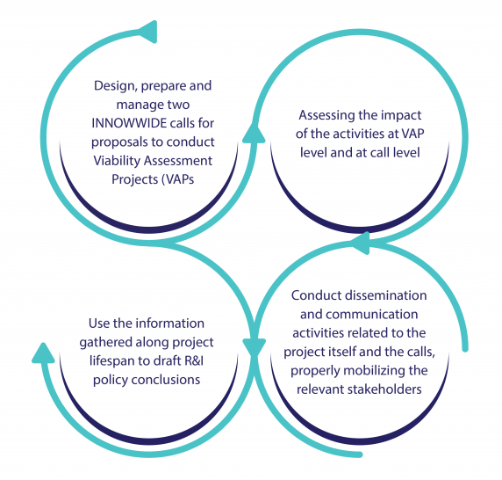
INNOWWIDE - Viability assessment of collaborative and INNOvative business solutions in WorldWIDE markets
INNOWWIDE – Viability assessment of collaborative and INNOvative business solutions in WorldWIDE markets is a Horizon 2020 project that aims to fund at least 120 European innovative SMEs and start-ups to conduct Viability Assessment Projects (VAPs) in markets outside of Europe.
Project Timeline: January 2019 – June 2021 (30 Months)

Slide 53











INNOWWIDE - Viability assessment of collaborative and INNOvative business solutions in WorldWIDE markets
Meet the Team
INNOWWIDE’s project consortium includes 11 partners from 8 different European countries.
6 national funding agencies
1 international business acceleration network
1 multilateral business led R&I organization
1 innovation public-private partnership organization
2 highly specialised and renowned firms in international R&I management

Slide 54
INNOWWIDE - Viability assessment of collaborative and INNOvative business solutions in WorldWIDE markets
The INNOWWIDE project has four main objectives:
1. To select 120 SMEs to lead Viability Assessment Projects (VAPs) with a funding of 60k€/VAP in order to validate the practical, technological and commercial viability of international, cross-fertilized, innovative businesses solutions along emerging global value chains.
3. To deliver policy recommendations to the EC and other relevant bodies. They will be focused on recommendations in terms of instrument efficacy and efficiency, joint R&I activities to be supported in third countries and other relevant aspects for European SMEs approaching international markets.
2. To make a multilevel impact assessment of the supported VAPs from a European and third-country perspective:
a) VAP level (beneficiaries and third country counterparts): Projected comparison with Business as Usual. Economic aspects will be evaluated from a quantitative point of view (ex-post) while social, strategic, management and network aspects will be analysed from a qualitative point of view;
b) Call level (funding agencies, EC): call response, implementation, suitability, patterns, best practices, framework conditions etc. Aggregated (country, country group, global level) efficacy and efficiency of the instrument and analysis and evaluation of the more macroeconomic outputs of INNOWWIDE project
4. To conduct communication, dissemination and exploitation activities to enhance project impact by:
a) promoting the calls and mobilising applicant SMEs and third country stakeholders to ensure that a high quality, relevant number of proposals is received;
b) spreading project results to different audiences and defining a follow-up set of actions to be conducted after project completion

Slide 55
INNOWWIDE - Viability assessment of collaborative and INNOvative business solutions in WorldWIDE markets
Two Calls
The INNOWWIDE pilot call intends to bring European highly innovative SMEs to the forefront of international markets by opening two calls that will allow them to conduct Viability Assessment Projects (VAPs) in cooperation with local stakeholders.
Two calls will be implemented with a total budget of 7,2M€, allowing to fund 120 VAPs (60k€/VAP), and targeting markets of developing countries, large emerging economies (Brazil, Russia, India, China, Mexico) and developed countries with the same allocation for each of these three country categories.
Total Budget = 7,2M€
Funding to 120 VAPs
(60k€/VAP)
Targeted Markets:
Developing countries
Large emerging economies
Developing countries
The first call was launched on 1/04/2019
The second call will be launched in December 2019

Slide 56
LESSONS LEARNED FROM H2020 PROPOSALS
EVALUATION CRITERIA + RESULTS - Excellence
Clarity and pertinence of the objectives
Soundness of the concept, and credibility of the proposed methodology
Quality of the proposed coordination and/or support measures
Extent that proposed work is beyond the state of the art, and demonstrates innovation potential (e.g. ground-breaking objectives, novel concepts and approaches, new products, services or business and organisational models)
Appropriate consideration of interdisciplinary approaches and, where relevant, use of stakeholder knowledge
KPIs are listed for each objective and links to WPs, addressing specific challenges are described well
Proposed methodology is coherent
Past projects other than the ones that the consortium partners took part in could have been mobilised more extensively.
No clear evidence of the long-term sustainability

Slide 57
LESSONS LEARNED FROM H2020 PROPOSALS
EVALUATION CRITERIA + RESULTS - Impact
The extent to which the outputs of the project would contribute to each of the expected impacts mentioned in the work programme under the relevant topic
Quality of the proposed measures to:
- exploit and disseminate the project results (including management of IPR), and to manage research data where relevant
communicate the project activities to different target audiences
Any substantial impacts not mentioned in the work programme,
Expected impacts are specific and comprehensive and highly relevant to the topic.
Specific details of the target audiences and the detailed project activities, including specific numbers for: marketing, visitors, attendees, conferences and dissemination activities.
The dissemination addresses multiple channels to reach targeted audiences.
Shows examples on how different IPR issues will be managed, although they are presented only generally

Slide 58
LESSONS LEARNED FROM H2020 PROPOSALS
EVALUATION CRITERIA + RESULTS - Quality and efficiency of the implementation
Quality and effectiveness of the work plan, including extent to which the resources assigned to work packages are in line with their objectives and deliverables
Appropriateness of the management structures and procedures, including risk and innovation management
Complementarity of the participants and extent to which the consortium as a whole brings together the necessary expertise
Appropriateness of the allocation of tasks, ensuring that all participants have a valid role and adequate resources in the project to fulfil that role
The tasks and resources are spread out throughout the consortium and the allocation of resources are adequate. All participants have a valid role.
Complementary of partners are not fully clear.
Critical risks have been identified and mitigation measures proposed for each, but these are not elaborated fully

Slide 59

HORIZON EUROPE OVERVIEW
Budget : €100 billion (€3.5 billion to InvestEU Fund)
Timeline : From January 2021 to December 2027
Affirmation
20 March 2019 : EU institutions reached a provisional agreement
17 April 2019 : European Parliament endorsed the provisional agreement
Updates
After the political agreement, the Commission has begun the strategic planning process.
Next step: Setting out a multiannual strategic plan, to prepare the content in the work programmes and calls for proposal for the first 4 years of Horizon Europe.
Notes:
Horizon Europe is the biggest ever research and innovation funding programme with a budget of 100 billion Euros. The programme will start in January 2021 and will have the duration of 7 years – until December 2027.
In terms of recent developments, in March 2019 EU institutions reached a provisional agreement and in April 2019, the European Parliament endorsed the provisional agreement. Thus, the result of the process will be to set out in a multiannual Strategic Plan to prepare the content in the work programmes and calls for proposal for the first 4 years of Horizon Europe.
Horizon Europe will have simpler rules, cutting red tape for beneficiaries.

Slide 60

HORIZON EUROPE VISION
Europe can shape its future through research and innovation.
Tackling climate change (35 % budgetary target)
Helping to achieve Sustainable Development Goals (SDGs)
Boosting the Union’s competitiveness and growth
Notes:
In terms of the vision, the Horizon Europe keeps the same vision of H2020, with a few updates and new aspects.
In particular, there is a focus on climate change (35% of the budgetary target). There is a direct connection with the SDGs and supporting their achievement. And also a focus on competitiveness and growth of businesses in the EU.

Slide 61
HORIZON EUROPE STRUCTURE
Notes:
According to the most recent updates that have been agreed within the EC, the following structure has been agreed. As you can see from the slide, the three pillars are the main part of Horizon Europe, which includes an horizontal programme for widening participation and strengthening the European Research Area as you can see from the bottom.

Slide 62
HORIZON EUROPE BUDGET COMPOSITION
Also includes the € 3.5 billion funding in Invest EU scheme.
*in billions of Euros
Notes:
If we look at it in terms of budget, we can see that the Pillar 2 (Global Challenges & European Industrial Competitiveness) is the one with the most budget (52,7 Billion) more than half of the total budget.
The second part of the programme with the most budget is the Excellent Sciences (one quarter of the total budget), while Innovative Europe has a total of 13.5 billion.

Slide 63
Programme "COSME"

Slide 64
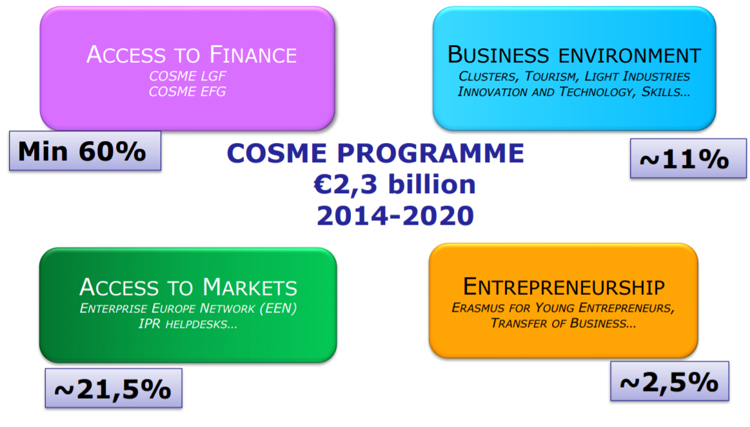
Programme "COSME"
The programme, Competitiveness of enterprises and SMEs (COSME) aims at encouraging the competitiveness of European enterprises. With small and medium-size enterprises (SMEs), current and potential entrepreneurs and business support organisations as its main targets, the programme provides better access to finance, deliver business support services and promote entrepreneurship.
  Strengthening the competitiveness and
  sustainability of the Union’s enterprises,
  particularly SMEs
  Encouraging an entrepreneurial culture and
  promoting the creation and growth of SMEs

Slide 65
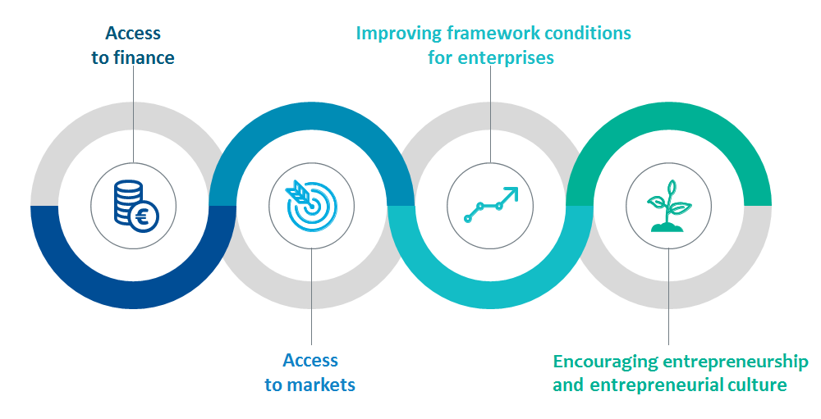
Total Budget: €2,3 billion
Thematic Categories: Trade and Commerce, Economic growth and Competitiveness, Information and Communication Technologies / Education, Finances, Industry, SME, Technologies, Tourism, Environment & biodiversity, Administration, Competitiveness
Beneficiaries: Education and Training Centers, State / Region / City / Municipality / Local Authority, Research Institution, Small and Medium Sized Enterprises, SMEs (between 10 and 249 employees), National Government, Association
Level of Financing (Eu Co-Financing Rate); 40%-90%

Slide 66
COSME facilitates access to finance for SMEs through;
  An Equity Facility for Growth (to invest in SMEs in expansion phase)
  A Loan Guarantee Facility (to provide guarantees to cover loans for SMEs)
  In addition; Analytical tools (e.g. Enterprise Finance Index) and Exchange of good practice (e.g. SME Finance Forum)
    COSME Guarantees; Max. loan amount €150,000, Min. duration of transaction 12 months, Max. guarantee of 10 years,
    COSME Equity Financing: long-term investments (5 to 15 year positions) • 7,5% - 25% of total VC fund capital • max € 30 mln

Slide 67
Implementation of COSME Financial Instruments
EU funding
Entrusted Entity (e.g. European Investment Fund )
Venture capital
investments
Guarantee funds/Loans
Other investors
EIF selects its financial intermediaries based on competence. The selection criteria and the list of intermediaries will be public, and intermediaries should apply directly to the EIF.
Venture
capital
fund
Guarantor
Bank
Venture capital
investment
in SMEs
Lending
to SMEs

Slide 68








Member States
EU Commission
Application to call for expression of interest; demand driven
Entrusted entity
Joint EC/ EIB SME initiative
€
€
€
Financing

Slide 69
Programme | Financial Instrument | Sector | Financial institution www.access2finance.eu
COSME | Loan guarantee | All, Start-up, early stage | Banca Intesa, UniCredit Bank, Erste Bank, Halkbank, OTP Bank, Komercijalna banka
Horizon2020/Inovfin | Loan guarantee, equity capital | R&D, innovation, Start-up, early stage | EIB, ProCredit Bank, Raiffeisen Bank, Erste Bank
EaSI | Loan guarantee | All, Start-up, early stage, Soc. Enterprises | Erste Bank Serbia, Opportunity Bank
WB EDIF | Loan guarantee, equity capital | All sectors, Expansion stage | Local banks, EBRD, South Central Ventures
EIF | Loan guarantee Equity/ Venture capital | All sectors, Expansion stage, ICT, Life Sciences | HBM Partners, 3TS Capital Partners

Slide 70
Supporting internationalization and access to markets; The COSME programme provide SMEs with support to facilitate business expansion in the EU Single Market and in markets outside the EU. International business cooperation will be fostered, in particular, to reduce the differences in regulatory and business environments, between the EU and its main trading partners. 100% financing where applicable as those parts of programme that are accessible to individual organisations mainly concern service contracts through calls for tender
  Enterprise Europe Network (600 business support organisations in 53 countries) - Offices in BELGRADE, NIS and NOVI SAD, https://een.ec.europa.eu
  Analytical tools (studies on mapping of EU business support abroad)
  On-line portals (e.g. Your Europe Business portal, new portal on access to markets outside EU, China IPR helpdesk, https://www.ipr-hub.eu/)
  Awareness raising campaigns, trainings
  Exchange of best practices, workshops (e.g. optimising EU portfolio of business support for SMEs)

Slide 71
Creating an environment favorable to competitiveness; Improving framework conditions;
The Commission will support actions intended to develop new competitiveness and business development strategies. 100% financing where applicable as those parts of programme that are accessible to individual organisations mainly concern service contracts through calls for tender.
  Reducing administrative burden, supporting smart regulation (SBA/SME test, competitiveness proofing, fitness checks), strengthening coordination of MS industrial policies, reinforcing the use of the 'Think Small First' principle
  Statistical analysis, benchmarking, policy monitoring (e.g. Annual EU Competitiveness Report, EU SME Performance Review, SBA country factsheets)
  Workshops and exchanges of best practices between policy makers (e.g. HLG on reduction of administrative burden, SME Envoys)
  Accelerating the emergence of competitive industries. Stimulate development of new markets Competitive business models. Enhance productivity, resource efficiency, sustainability and corporate social responsibility.

Slide 72
Encouraging an entrepreneurial culture; Promoting entrepreneurship;
Entrepreneurship. Support will be given to encourage trans-national networks, to exchange good practices and identify scope for expanding business activities. Level of Financing Varying based on the Calls.
  Workshops and exchanges of best practices (European Network of Mentors for Women Entrepreneurs, on-line Platform for women entrepreneurs https://wegate.eu/)
  Erasmus for Young Entrepreneurs, www.erasmus-entrepreneurs.eu
  Trainings (Erasmus for Young Entrepreneurs exchange programme, trainings for teachers)
  Promotion activities (projects promoting education for entrepreneurship and self-employment at school and university)
  Awareness raising activities (European SME Week)

Slide 73
Public calls
https://ec.europa.eu/easme/en/cosme-0
Access to markets
Awareness actions
Clusters
Enterprise Europe Network
Entrepreneurship
European social economy regions
European Trade Promotion Organisations
Framework conditions for enterprises
Intellectual property
Public procurement
Tourism

Slide 74
Public call : Boosting sustainable tourism development and capacity of tourism SMEs through transnational cooperation and knowledge transfer
A transnational consortium/network of public and private stakeholders organising specific activities for tourism SMEs in different countries.
Direct support to companies to build their capacities to develop and implement sustainable and circular standards/models/strategies in their services and operations.
Eligible: non-profit organisations (private or public), non-governmental organisations, public authorities and their networks or associations at European, international, national, regional and local level, or organisations acting on behalf of a public authority, responsible for or active in the fields of tourism, economic affairs, industry, business support or related fields, international organisations, private and profit making entities including micro, small and medium sized enterprises (SMEs) active in tourism and business support, chambers of commerce and industry, training and educational institutions, including universities and research centres active in tourism and business support
Natural persons are not eligible.

Slide 75
Find a Call https://ec.europa.eu/easme/en/cosme-0
Local financial intermediaries http://www.access2finance.eu
Enterprise Europe Network https://een.ec.europa.eu
Cluster collaboration platform https://www.clustercollaboration.eu
Regulations https://eur-lex.europa.eu/legal-content/EN/TXT/?uri=CELEX%3A32013R1287
Work Programme:
https://ec.europa.eu/research/participants/data/ref/other_eu_prog/cosme/wp-call/cosme-wp-2019_en.pdf
Cosme Data Hub https://cosme.easme-web.eu/
Reference Documents for COSME;
https://ec.europa.eu/info/funding-tenders/opportunities/portal/screen/how-to-participate/reference-documents

Slide 76
3rd EU Health - Health for Growth

Slide 77
THE THIRD HEALTH PROGRAMME 2014-2020
The Health for Growth Programme is the third action supporting the objectives of the EU’s Health strategy.
General objectives of the program:
  To Improve the health of EU citizens and reduce health inequalities,
  Encourage innovation in health and increase sustainability of health systems,
  Focus on themes that address current health issues across Member States and
  Support and encourage cooperation between Member States.
The EU Health Programme outlines the strategy for ensuring good health and healthcare.
It feeds into the overall Europe 2020 strategy which aims to make the EU a smart, sustainable and inclusive economy promoting growth for all – one prerequisite for which is good health.

Slide 78
THE THIRD HEALTH PROGRAMME 2014-2020
The Programme is focusing on major Commission priorities, such as:
Jobs, growth and investment - health of population and health care services as a productive factor for growth and jobs
Internal market - for pharmaceuticals, medical devices, cross-border health care directive, and Health Technology Assessment
Single digital market - including eHealth
Justice and fundamental rights - fighting against health inequalities
Migration policy
Security - preparedness and management of serious cross border health threats

Slide 79
THE THIRD HEALTH PROGRAMME 2014-2020
Total Budget: €449,4 million
Beneficiaries: University, Research Institution, Public Services, State/Region/City/Municipality/ Local Authority, NGO/NPO, Small and Medium Sized Enterprises-SMEs (10 to 249 employees), Microenterprises (< 10 employees), Start-up Company, Enterprise (> 250 employees), Association/Trade Union, National Government, Association
Level of Financing (Eu Co-Financing Rate); 60% (up to 80% in exceptional cases, such as for Member States with a low Gross National Income participating in joint actions)
Financial Mechanisms:
• Actions with MS competent authorities (joint actions) (invited procedure for direct awarding)
• Projects (call for proposals - grants)
• Work of NGOs and Networks (call - operating grants)
• Cooperation with International Organisations (direct grants)

Slide 80
THE THIRD HEALTH PROGRAMME 2014-2020
For the year 2019, Priority areas;
(1) Country specific and cross-country knowledge;
(2) Cross border health threats, preparedness and response, including antimicrobial resistance and vaccination;
(3) Structural support to health systems and link to digital single market;
(4) Promotion of health and prevention of non-communicable diseases.
It focuses on four specific objectives with a strong potential for economic growth through better health:
  • Objective 1: To contribute to the creation of innovative and sustainable health systems (48% of the budget).
  • Objective 2: To increase access to better and safer healthcare for all EU citizens (22% of the budget).
  • Objective 3: To promote good health and prevent diseases by addressing the key risk factors of most diseases, namely smoking, alcohol abuse and obesity (21% of the budget).
  • Objective 4: To protect people from cross-border health threats (9% of the budget).

Slide 81
Link; https://ec.europa.eu/health/home_en
https://ec.europa.eu/health/funding/programme_en
https://ec.europa.eu/chafea/health/index_en.htm
Find a Call;
https://ec.europa.eu/info/funding-tenders/opportunities/portal/screen/programmes/3hp
Work Programme;
https://ec.europa.eu/health/sites/health/files/funding/docs/wp2019_annex_en.pdf
Regulation;
https://eur-lex.europa.eu/legal-content/EN/TXT/?uri=uriserv%3AOJ.L_.2014.086.01.0001.01.ENG

Slide 82

Programme "CREATIVE EUROPE"

Slide 83
https://www.youtube.com/watch?v=qko9icCy62k&feature=youtu.be

Slide 84
Programme "CREATIVE EUROPE"
Total budget: €1,46 billion
Thematic categories: Art and Culture, Media, Competitiveness, Education
Beneficiaries: SMEs (10 - 249 employees), Microenterprises (less than 10 employees), Education and Training Centres, Research Institution, Association / Trade Union, International Organization, NGO / NPO, Public Services, Start Up Company, Enterprise (more than 250 employees), Association, University, State / Region / City / Municipality / Local Authority

Slide 85
The Creative Europe Programme consists of three sub-programmes:
“Culture sub-programme” for cultural & creative sectors
“Media sub-programme” for the audio-visual industries
Cross-sectoral strand for joint projects between the cultural/creative sectors and the audio-visual industries.
The setting of transnational projects and cooperation networks are encouraged.
The European Capitals of culture is also part of the programme.

Slide 86
Sub-Programme: CULTURE
Level of financing (EU co-financing rate): 50%-80%
Budget: At least 31% of the total Creative Europe budget
Funding schemes: supports cultural and creative organisations with a view to helping them operate transnationally and promoting cross-border circulation of works of culture and mobility of cultural players.
Cooperation - Transnational cooperation projects bringing together cultural and creative organizations from different countries to undertake sectoral or cross-sectoral activities
Networks - Activities by European networks of cultural and creative organizations from different countries.
Platforms - Activities by organizations with a European vocation fostering the development of emerging talent and stimulating the transnational mobility of cultural and creative players and circulation of works, with the potential to exert a broad influence on cultural and creative sectors and to provide for lasting effects
Literary translation - literary translation and the further promotion of translated works

Slide 87
Funding schemes - Culture component (details):
Cooperation projects (max 48 months)
  Category 1 - Smaller scale cooperation projects. Project leader + 2 partners from 3 different countries, At least one from EU Member State or EFTA country, EU grant max. 200.000 € - 60% of total eligible budget
  Category 2 - Larger scale cooperation projects, Project leader + 5 partners from 6 different countries, At least one from EU Member State or EFTA country, EU grant max. 2.000.000 € - 50% of total eligible budget,
Networks
  Funding proposals must consist of a minimum of 15-member organisations from at least 10 different countries participating in the programme. At least 5 of which must have their legal seat in 5 different Member States or EFTA countries.
European platforms
  Platforms must consist of a coordinating entity from any of the countries participating in the Culture sub-programme and a minimum of 10 member organisations from at least 10 different countries participating in the Culture sub-programme, including at least 5 from EU member States or EFTA countries.
Literary translation
  Publishers and publishing houses can apply for the translation and the promotion of a "package" of works of fiction from, and into, eligible languages. The maximum grant is EUR 100,000 which is the equivalent to a maximum of 50% of eligible costs.

Slide 88
Sub-Programme: MEDIA
supports the EU film and audiovisual industries financially in the development, distribution and promotion of their work. It helps launch projects with a European dimension and nurtures new Technologies.
Development of European audiovisual works in particular films and television works such as fiction, documentaries, as well as interactive works such as videogames and multimedia with enhanced cross-border circulation potential.
Initiatives presenting and promoting a diversity of European audiovisual works, including short films, such as festivals and other promotional events and activities
Activities helping European and international co-production partners to meet and/or provide indirect support for audiovisual works co-produced by supporting international co-production funds based in a country participating in the Programme.
Development of a comprehensive range of training measures promoting the acquisition and improvement of skills and competences by audiovisual professionals, knowledge sharing and networking initiatives, including the integration of digital technologies.
Facilitating access to professional audiovisual trade events and markets and the use of online business tools inside and outside the Union and facilitate circulation of European films worldwide
The establishment of support systems for the distribution of non-national European films through theatrical distribution
Activities aiming at supporting European audiovisual production companies, in particular independent production companies, with a view to facilitating European and international co-productions of audiovisual works including television works.
Budget: At least 56% of the total Creative Europe budget.
Level of financing (EU co-financing rate): 50%-80%

Slide 89
Sub-Programme: CROSS SECTORAL STRAND
The cross-sectoral Strand includes the Guarantee Fund and the support for Creative Europe Desks which provide assistance to applicants. The cross-sectoral strand also provides support for studies, analysis and better data collection to improve the evidence-base for policy-making, funding for experimental projects to encourage cooperation between the audiovisual and other cultural and creative sectors.
  Support to Creative Europe Desks.
  Support to EU Presidency conferences.
  Policy development activities.
  Studies and evaluations.
  Communication and valorization activities.
  Financial guarantee facility (as of 2016).
Budget: Maximum 13% of the total Creative Europe budget.
Level of financing (EU co-financing rate): 50%-80%

Slide 90

Call for proposals
Call for proposals EACEA 32/2019 'Support for European cooperation projects 2020' (Category 1 – Smaller scale cooperation projects and Category 2 – Larger scale cooperation projects)
27/11/19 - 17:00 (CET/CEST, Brussels time)
https://eacea.ec.europa.eu/creative-europe/funding/support-european-cooperation-projects-2020_enrger scale cooperation projects)
Call for proposals EACEA 17/2019 – Support for Development of Audio-visual Content – Single Project
13/11/19 - 17:00 (CET/CEST, Brussels time), 12/05/20 - 17:00 (CET/CEST, Brussels time)

Slide 91

Links:
https://ec.europa.eu/programmes/creative-europe/node_en
https://eacea.ec.europa.eu/creative-europe
Creative Europe Programme 2021-2027 :
http://www.europarl.europa.eu/RegData/etudes/BRIE/2018/628229/EPRS_BRI(2018)628229_EN.pdf
Find a Call: https://eacea.ec.europa.eu/creative-europe/funding_en
Annual Work Programme: https://ec.europa.eu/programmes/creative-europe/sites/creative-europe/files/library/c-2018-6687.pdf
Regulation: https://eur-lex.europa.eu/legal-content/EN/TXT/PDF/?uri=CELEX:32013R1295&from=EN
Serbia Desk – National Contact Point
Dimitrije Tadic: +381 11 3398 026-+381 11 3398 880
dimitrije.tadic@kultura.gov.rs
Nevena Negojevic: + 381 63 670 378, + 381 11 263 42 53 nevena@media.kreativnaevropa.rs

Slide 92

Employment and Social Innovation Programme - EASI

Slide 93

Programme "Employment and Social Innovation - EASI"
The Employment and Social Innovation (EaSI) programme is a financing instrument at EU level to promote a high level of quality and sustainable employment, guaranteeing adequate and decent social protection, combating social exclusion and poverty and improving working conditions. EaSI is managed directly by the European Commission.

Slide 94
Programme "Employment and Social Innovation - EASI"
Total Budget: €919,47 million
Thematic Categories: Social Affairs and Human Rights, Labor Market, Entrepreneurship
Beneficiaries: Education and Training Centres, State / Region / City / Municipality / Local Authority, Research Institution, Association / Trade Union, Small and Medium Sized Enterprises, SMEs (between 10 and 249 employees), Microenterprises (fewer than 10 employees), NGO / NPO, University, Enterprise (more than 250 employees or not defined), Public Services, Other

Slide 95
The main objectives of EaSI are the following:
Strengthen ownership of EU objectives and coordination of action at EU and national level in the areas of employment, social affairs and inclusion.
Support the development of adequate social protection systems and labour market policies.
Modernize EU legislation and ensure its effective application.
Promote geographical mobility and boost employment opportunities by developing an open labor market.
Increase the availability and accessibility of microfinance for vulnerable groups and micro- enterprises, and increase access to finance for social enterprises.

Slide 96
EASI Programme provide support for the following fields:
The modernization of employment and social policies with the PROGRESS axis (61% of the total budget).
Job mobility with the EURES axis (18% of the total budget).
Access to micro-finance and social entrepreneurship with the Microfinance and Social Entrepreneurship axis (21% of the total budget).

Slide 97

Sub-Programme: EURES
EURES, which is the European network of employment services, should promote the better functioning of the labour markets by facilitating the voluntary transnational cross- border geographical mobility of workers, providing greater transparency on the labour market, ensuring the clearance of vacancies and applications for employment and supporting activities in the areas of placement, recruitment, advice and guidance services at national and cross-border level.
Supported actions
Development and activities of EURES cross- border partnerships where requested by services territorially responsible for border regions;
Provision of information, counselling, placement and recruitment services for cross-border workers;
Development of the multilingual digital platform for the clearance of job vacancies and applications;
Development of targeted mobility schemes, following calls for proposals, to fill job vacancies where labour market shortcomings have been identified, and/or to help workers with a propensity to be mobile, where a clear economic need has been identified;
Mutual learning among EURES actors and training of EURES advisors, including EURES cross-border partnership advisors;
Information and communication activities to raise awareness of the benefits of geographical and occupational mobility in general and of the activities and services provided by EURES.
Level of Financing (EU co-financing rate); 95%

Slide 98

Sub-Programme: PROGRESS PROGRAMME
The PROGRESS programme aims to help EU Member States “modernize” employment and social policies. This programme tackles three specific areas: unemployment (with a key emphasis on youth unemployment, but also addressing other areas in unemployment), working conditions, and social protection against poverty.
Supported actions;
1- Analytical activities such as gathering of data and statistics, surveys, studies, analyses and reports…etc
2- Mutual-learning, awareness and dissemination activities such as exchanges and dissemination of good practice, innovative approaches and experience, peer reviews, benchmarking and mutual learning at European level, Council Presidency events, conferences and seminars, training of legal and policy practitioners…etc
3- Support with regard to the operating costs of key Union-level networks the activities of which relate to and contribute to the objectives of the Progress axis such as capacity-building of national administrations and specialist services, organisation of working groups of national officials…etc
Level of Financing (EU co-financing rate); 80%

Slide 99

Sub-Programme: MICROFINANCE FACILITY & SOCIAL ENTREPRENEURSHIP
This section of EaSI allows more money to be available for vulnerable groups (young people, minorities, women, low-skilled workers, etc.) needing financial support trying to set up their own businesses.
Supported actions
Extend the support given to microcredit providers under the current European Progress Microfinance Facility (launched in 2010).
Provide funding for capacity-building of microfinance institutions.
Support the development of the social investment market and facilitate access to finance for social enterprises.
Level of Financing (EU co-financing rate); Except in the case of joint actions, the financial appropriations allocated to the Microfinance and Social Entrepreneurship axis shall cover the full cost of the actions implemented through financial instruments.

Slide 100
Sub-Programme: MICROFINANCE FACILITY & SOCIAL ENTREPRENEURSHIP - Step by step
Startup companies The company has been operating for less than 2 years No related legal entities Neat Business Bureau and Business Owner Credit Mandatory participation of 10% in the investment Delivering invoices according to the purpose of the loan The owner of the company is a citizen of the Republic of Serbia The company has no more than 9 employees Delivered completed business plan and CV | Civil society organizations and Social enterprises The company has been operating for more than 2 years You have a positive impact on the development of society / community Neat Credit Bureau of Enterprise / Organization No account blocking in the previous 12 months Financial statements submitted

Slide 101
Link;
https://ec.europa.eu/social/main.jsp?catId=1081
Find a Call;
https://ec.europa.eu/social/main.jsp?catId=1081&langId=en&furtherCalls=yes&callType=2
Regulation;
https://eur-lex.europa.eu/legal-content/EN/TXT/?uri=CELEX%3A32013R1296
Work Programme;
https://ec.europa.eu/social/main.jsp?advSearchKey=EaSIannualworkprogramme&mode=advancedSubmit&catId=22&doc_submit=&policyArea=0&policyAreaSub=0&country=0&year=0

Slide 102

Europe for Citizen

Slide 103

Europe for Citizen Programme
Specific objectives are to raise awareness of remembrance, common history and values of the European Union's aim that is to promote peace, its values and the well-being of its peoples by stimulating debate, reflection and development of networks and to encourage democratic and civic participation of citizens at Union level, by developing citizens' understanding of the Union's policy-making process and promoting opportunities for societal and intercultural engagement and volunteering at Union level.
Europe for Citizens aims to promote active European citizenship with the main scope of bridging the gap between citizens and the European Union through financial instruments that promote active European citizenship.

Slide 104

Total budget: € 185,47 million
Thematic categories: European Citizenship, Democracy and Civic Participation / Education, Development Cooperation, European Citizenship, History, Art and Culture (Applicants must be either public bodies or non-profit organisations with legal personality (Please refer to specific eligibility criterion of each strand/measure).
Beneficiaries: State / Region / City / Municipality / Local Authority, NGO / NPO, Public Services, National Government, Association
NOT eligible SMEs, companies, International org, Universities and HE institutions, and Natural persons are under this programme.
National Contact Point: Kancelarija za saradnju sa civilnim društvom
E-mail: europeforcitizens@civilnodrustvo.gov.rs, sanja.atanaskovic@civilnodrustvo.gov.rs
Tel: +381 11 3130 968

Slide 105

The programme consists of the following two strands:
“Remembrance and European citizenship”
support organisations to promote debate and activities on European integration and history at a transnational level or when a clear European dimension is addressed. It will support activities that invite to reflection on common values in the broadest sense, taking into account diversity. Funds may be available for initiatives reflecting on causes of totalitarian regimes in Europe’s modern history (especially but not exclusively Nazism and Stalinism) and to commemorate their victims.
“Democratic engagement and civic participation”
develop citizens’ understanding and capacity to participate in the Union policy making process and to develop opportunities for solidarity, societal engagement & volunteering.
It supports activities that cover civic participation in the broadest sense, with particular focus on structuring methods for long-term sustainability.

Slide 106
Strand 1: European remembrance
• Type of organisations: Public local or regional authorities or non-profit organisations, including civil society organisations, survivors' associations, and youth, educational, cultural, and research organisations; preference is given to projects that will clearly reach out to the younger generation
• Number of involved organisations: A project must involve organisations from at least one Member State, but preference is given to transnational projects
• Maximum grant amount: € 100 000
• Maximum percentage of co-funding: 70%
Maximum duration: 18 months per project
Deadline: every 1 March
Strand 2: Democratic engagement and civic participation
2.1. Town-Twinning:
• Type of organisations: towns/municipalities or their twinning committees or other non-profit organisations representing local authorities
• Number of organisations involved: municipalities from at least 2 eligible countries of which at least one is an EU Member State
• Maximum grant amount: € 25 000 per project
• Maximum percentage of co-funding: 50%
Maximum duration: 21 days per project
Deadline: every 1 March & 1 September

Slide 107
2.2. Networks of Towns:
• Type of organisations: Towns/municipalities or their twinning committees or networks, other levels of local/regional authorities, federations/associations of local authorities and non-profit organisations representing local authorities; the other organisations involved in the project can also be non-profit Civil Society Organisations
• Number of organisations involved: municipalities from at least 4 eligible countries of which at least two are an EU Member State
• Venue and number of activities: The activities must take place in different eligible partner countries. At least 4 events per project have to be foreseen. Maximum grant amount: € 150 000
• Maximum percentage of co-funding: 70%
Maximum duration: 24 months per project
Deadline: every 1 March & 1 September
2.3. Civil Society Projects:
• Type of organisations: non-profit organisations, including civil society organisations, educational, cultural or research institutions; the other organisations involved in the project can also be public local/regional authorities
• Number of organisations involved: organisations from at least 3 eligible countries of which at least two are an EU Member State
• Maximum grant amount: € 150 000
• Maximum percentage of co-funding: 70%
Maximum duration: 18 months per project
Deadline: every 1 March

Slide 108
Supported Actions
  • Citizens’ meetings, town-twinning
  • Creation and operations of transnational partnerships and networks
  • Support for organisations of a general European interest
  • Community building and debates on citizenship issues based on the use of ICT and/or social media
  • Union level events
  • Reflection/debates on common values
  • Initiatives to raise awareness on the EU institutions and their functioning
  • Actions that exploit and further valorize the results of the supported initiatives
  • Studies on issues related to citizenship and civic participation
  • Support of programme information/advice structures in the Member States
  • Debates/studies and interventions on defining moments in European history, in particular to keep the memory alive of the crimes committed under Nazism and Stalinism

Slide 109

Link: https://eacea.ec.europa.eu/europe-for-citizens_en
https://ec.europa.eu/citizenship/about-the-europe-for-citizens-programme/future-programme-2014-2020/index_en.htm
Priorities of the Programme for 2019-2020:
https://eacea.ec.europa.eu/sites/eacea-site/files/priorities_2019-2020_en_0.pdf
WorkProgramme: https://ec.europa.eu/citizenship/pdf/2019_annex-annual-work-programme_en.pdf
Regulation: https://eur-lex.europa.eu/legal-content/EN/TXT/PDF/?uri=CELEX:32019R0788&qid=1565276863695&from=EN

Slide 110

Rights, Equality and Citizenship Programme (REC)

Slide 111
Total Budget: €439,47 million
Thematic Categories: Education, European Citizenship, Equal Rights, Justice, Capacity Building, Youth, Human Rights, Security, Social affairs, Labour Market
Beneficiaries: International Organization, SMEs (10-249 employees), Microenterprises (less than 10 employees), NGO / NPO, Enterprise (more than 250 employees or not defined), Public Services
  Profit organisations must submit applications in partnership with public entities or private non-profit organisations
Level of financing (EU Co-financing rate): 80-90%

Slide 112
Programme; Rights, Equality and Citizenship (REC)
Objective:
To contribute to the creation of an area, where the rights of persons, as enshrined in the Treaty on the Functioning of the EU and in the Charter of Fundamental Rights of the EU, are promoted and protected.
Specific objectives:
Promote non–discrimination
Combat racism, xenophobia, homophobia and other forms of intolerance
Promote rights of persons with disabilities
Promote equality between women and men and gender mainstreaming
Prevent violence against children, young people, women and other groups at risk (Daphne)
Promote the rights of the child
Ensure the highest level of data protection
Promote the rights deriving from Union citizenship
Enforce consumer rights of common methodologies, indicators, surveys, preparation of guides…)

Slide 113
To be eligible, grant applications must comply with all of the following criteria:
project can be either national or transnational
application must involve at least 2 organisations (applicant and partner)
In 2019, the EU grant € 100 000 - € 250 000 (for first 5 priorities indicated above), max duration 12 months, 80% co-financing
EU grant applied cannot be higher than € 65 000 for the priority 6 indicated above. Co –financing 90%
Operating grants: The Commission will invite Framework Partners in writing to submit their proposal announcing the annual priorities. These grants will fund operating costs and those activities of the network which have EU added value and contribute to the implementation of the objectives of the Programme among others: analytical activities, training activities, mutual learning, cooperation, awareness-raising and dissemination activities. Maximum possible pate of co-financing of the eligible costs is 80%

Slide 114

Rights, Equality and Citizenship (REC) – Supported actions
Analytical activities: collection of data and statistics; development of common methodologies and, where appropriate, indicators or benchmarks; studies, researches, analyses and surveys; evaluations and impact assessments; elaboration and publication of guides, reports and educational material; monitoring and assessment of the transposition and application of Union legislation and of the implementation of Union policies; workshops, seminars, experts meetings, conferences.
Mutual learning, cooperation, awareness raising and dissemination activities: identification of, and exchanges on, good practices, innovative approaches and experiences, organisation of peer review and mutual learning; organisation of conferences and seminars; organisation of awareness-raising and information campaigns, media campaigns and events, including corporate communication of the political priorities of the European Union; compilation and publication of materials to disseminate information as well as results of the Programme; development, operation and maintenance of systems and tools using information and communication technologies.
Support for main actors: support for Member States when implementing Union law and policies; support for key European level networks whose activities are linked to the implementation of the objectives of the Programme; networking among specialised bodies and organisations, national, regional and local authorities at European level; funding of experts’ networks; funding of European level observatories.
Training activities: staff exchanges, workshops, seminars, train-the-trainers events, development of online/other training modules.

Slide 115
Link:
https://ec.europa.eu/justice/grants1/programmes-2014-2020/rec/index_en.htm
Find a Call:
https://ec.europa.eu/info/funding-tenders/opportunities/portal/screen/programmes/rec
Work Programme:
https://ec.europa.eu/research/participants/data/ref/other_eu_prog/rec/wp/rec-awp-2019_en.pdf
Regulation:
https://eur-lex.europa.eu/legal-content/EN/TXT/PDF/?uri=CELEX:32013R1381&from=EN

Slide 116
European Instrument for Democracy and Human Rights (EIDHR)

Slide 117
Total budget: €1,332.75 M
Thematic categories: Human Rights, Development Cooperation, Equal Rights, Justice, People with Disabilities, Social affairs
Beneficiaries: State / Region / City / Municipality / Local Authority, Association / Trade Union, International Organization, NGO / NPO, National Government, University, Association, Public Services, Natural persons, when their help is necessary for achieving the aims of the EIDHR
Level of financing (EU co-financing rate): 50% - 95%

Slide 118
European Instrument for Democracy and Human Rights (EIDHR)
The European Instrument for Democracy and Human Rights (EIDHR) is a thematic funding instrument for EU external action aiming to support projects in the area of human rights, fundamental freedoms and democracy in non-EU countries. This instrument is designed to support civil society to become an effective force for political reform and defense of human rights.
The specific objectives and priorities of the EIDHR for the period 2014-2020 are the following:
Support to human rights & human rights defenders in situations where they are most at risk
Support to other priorities of the Union in the field of human rights
Support to democracy
EU election observation missions
Support to targeted key actors and processes, including international and regional human rights instruments and mechanisms

Slide 119
In order to be eligible for a grant, the lead applicant must:
• be a legal person
• be non-profit-making
• be a specific type of organisations such as: civil society organisations, including non-governmental organisations
• be established in a Member State of the EU or any country, as all are eligible for participation in contracts financed under this Instrument, without prejudice to the limitations inherent in the nature and objectives of the action
• be directly responsible for the preparation and management of the action with the co-applicant(s) and affiliated entity(ies), not acting as an intermediary
• In case the lead applicant is not established in Serbia, at least one co-applicant that is established in Serbia is mandatory

Slide 120
Serbian Call for Proposal: The overall amount made available is up to EUR 1,800,000.
The specific objectives:
  1. Support to human rights and human rights defenders most at risk
  2. Support to other EU human rights priorities in line with the set of EU human rights guidelines adopted by the Council of the EU
Indicative allocation of funds by lot:
LOT 1 - EUR 800,000
Project amount: EUR 60,000 - EUR 200,000
LOT 2 - EUR 1,000,000
Project amount: EUR 400,000 - EUR 600,000
Any grant requested under this Call for Proposals must fall between the following minimum and maximum percentages of total eligible costs of the action: 50 % - 95%

Slide 121
Link: https://ec.europa.eu/justice/grants1/programmes-2014-2020/justice/index_en.htm
Enquiries to: europeaid-eidhr@ec.europa.eu
Find a Call:
https://webgate.ec.europa.eu/europeaid/online-services/index.cfm?do=publi.welcome&nbPubliList=15&orderby=upd&orderbyad=Desc&searchtype=AS&pgm=7573843&finpub=&ZGEO=&debpub=
Regulations establishing a financing instrument for development cooperation:
https://eur-lex.europa.eu/LexUriServ/LexUriServ.do?uri=OJ:L:2014:077:0085:0094:EN:PDF
Work Programme:
https://ec.europa.eu/europeaid/commission-implementing-decision-multi-annual-action-programme-2018-2020-european-instrument_en

Slide 122

Programme "ERASMUS +"

Slide 123

Programme "ERASMUS +"
Erasmus+ is EU Programme for Education, Training, Youth and Sport for 2014-2020.
It brings together the previous Lifelong Learning Programme, Youth in Action and five international cooperation programmes, including also sport.
Overall the programme is aimed at supporting the development of actions, cooperation and tools linked to the objectives of the Europe 2020 strategy and its flagship initiatives.
Erasmus+ is designed to support Member States’ efforts
  to use efficiently the potential of Europe’s human capital that remains underexploited,
    while confirming the principle of lifelong learning by
      linking support to formal, non-formal, and informal learning
        throughout the education, training and youth fields.

Slide 124
Programme "ERASMUS +"
  INDIVUDUALS - Erasmus+ has opportunities for people of all ages, helping them develop and share knowledge and experience at institutions and organisations in different countries
      Mobility Projects for Higher Education Students and Staff
      Mobility Projects fo VET Learners and Staff
  ORGANISATIONS - Erasmus+ has opportunities for a wide range of organisations, including universities, education and training providers, think-tanks, research organisations, and private businesses.
      Joint Master Degrees
      Strategic Partnerships
      Knowledge alliances
      Sector Skills Alliances
  SPORT - Actions in the field of sport are designed to promote participation in sport, physical activity, and voluntary activities
      Partnerships
      Not profit sport events
      Small parterships

Slide 125
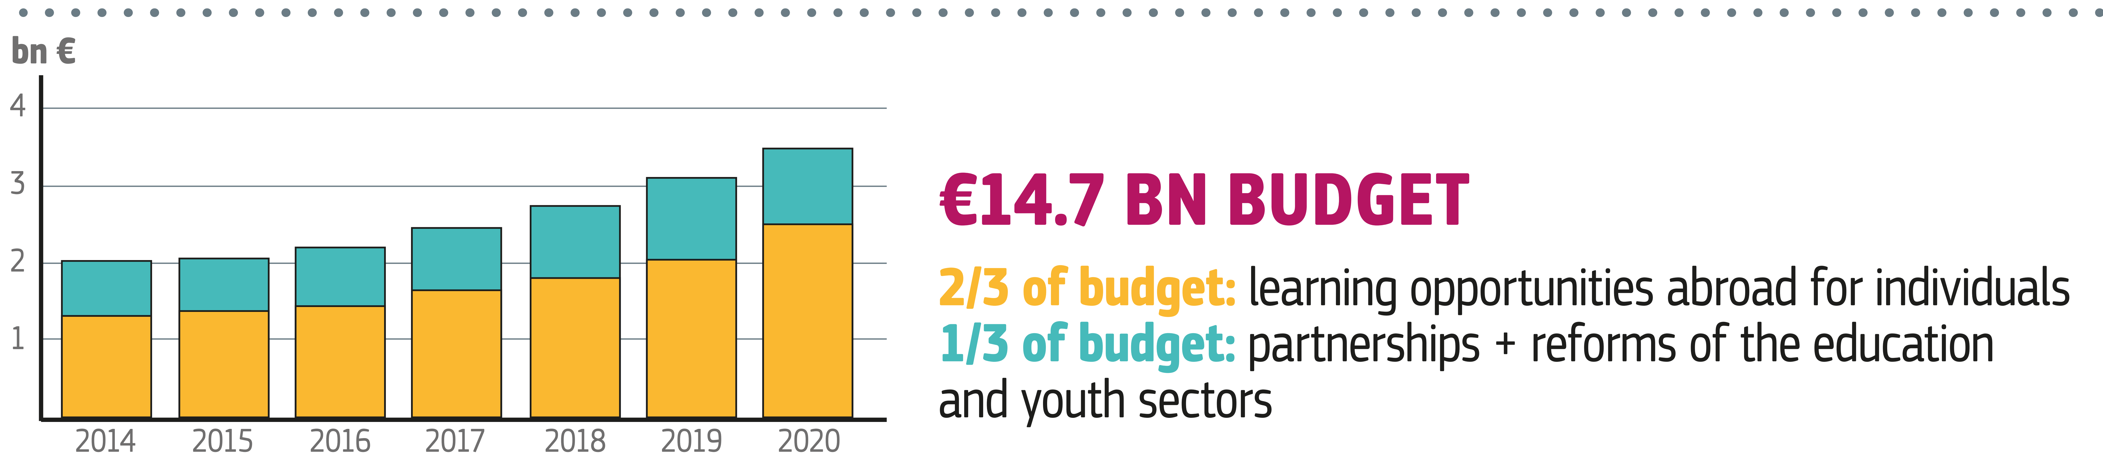
Programme "ERASMUS +"
Total Budget: €14,8 billion
Thematic Categories: Education and Training, Youth, Sport
Beneficiaries: Education and Training Centres, University, Association, State/Region/City/ Municipality/Local Authority, NGO/NPO, National Government, Association/Trade Union, Research Institution, Microenterprises (< 10 employees), Small and Medium Sized Enterprises - SMEs (10 to 249 employees), Start-up Company, Public Services, Enterprise (>250 employees)
The Erasmus+ programme differentiates between programme and partner countries, as regards possible modalities of participation of their institutions.
Programme countries are European Union countries, Macedonia, Island, Lichtenstein, Norway and Turkey.
Republic of Serbia has become a full member of the Erasmus + programme, i.e. a programme country from 2019 call.
Partner countries can be those countries neighbouring the EU, as well as all the other countries in the world.

Slide 126
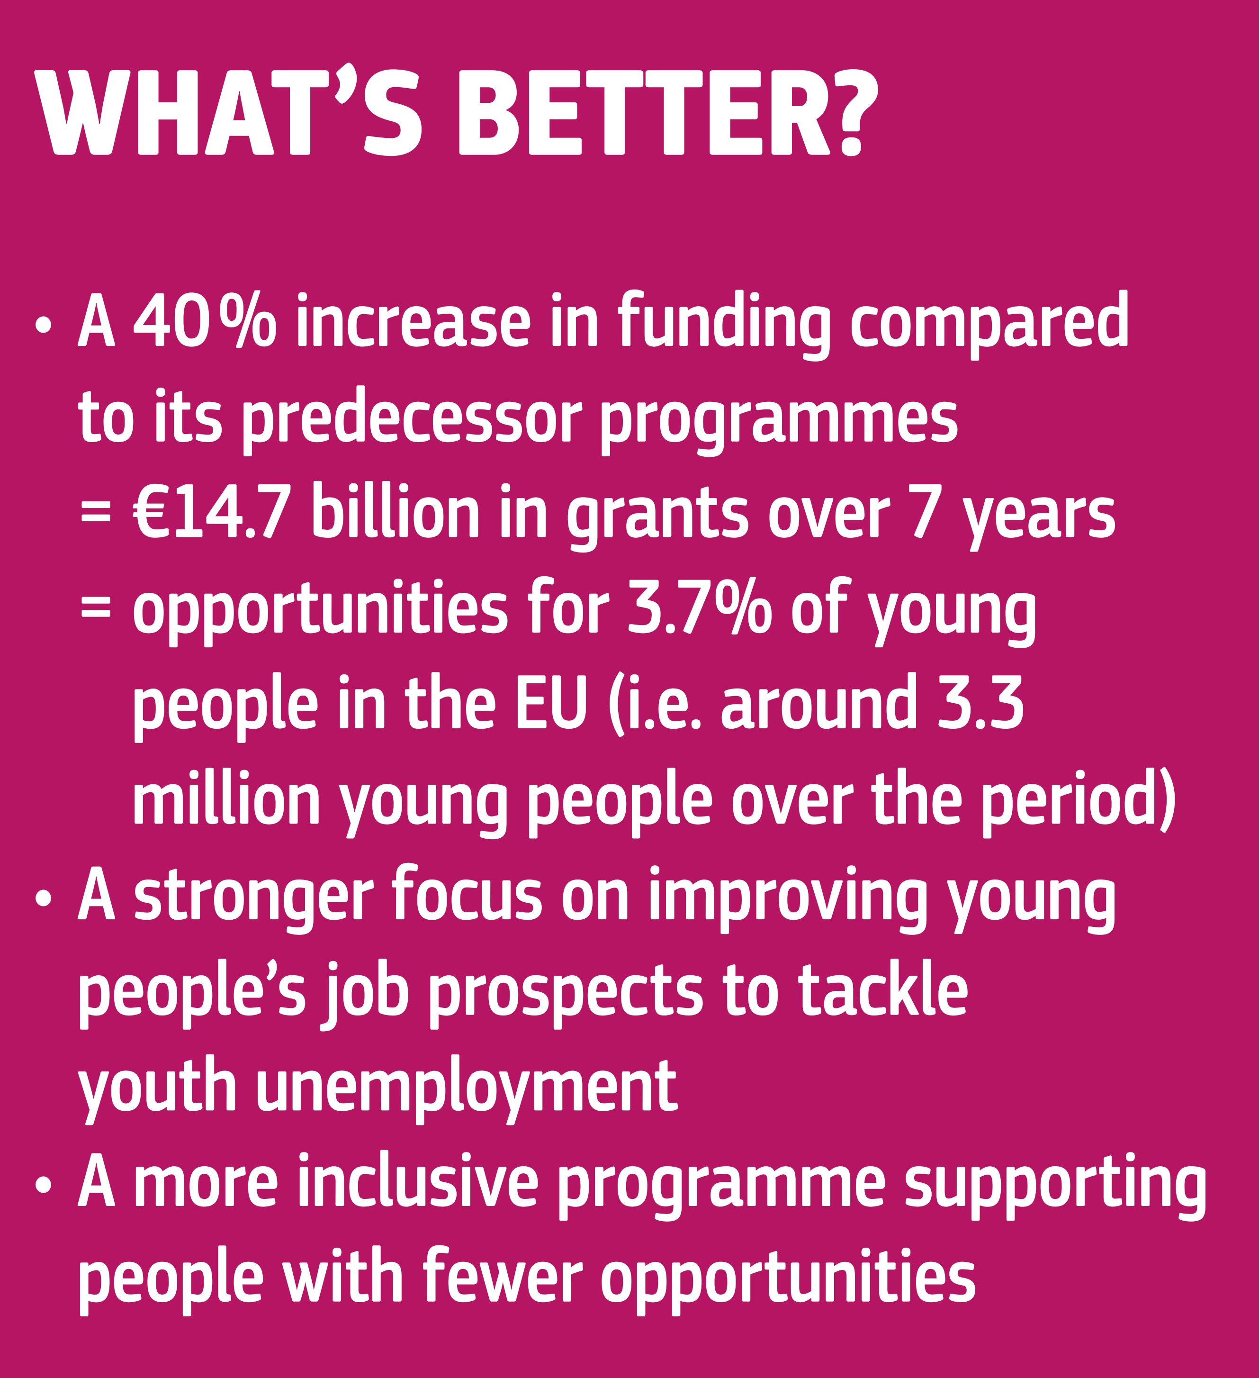
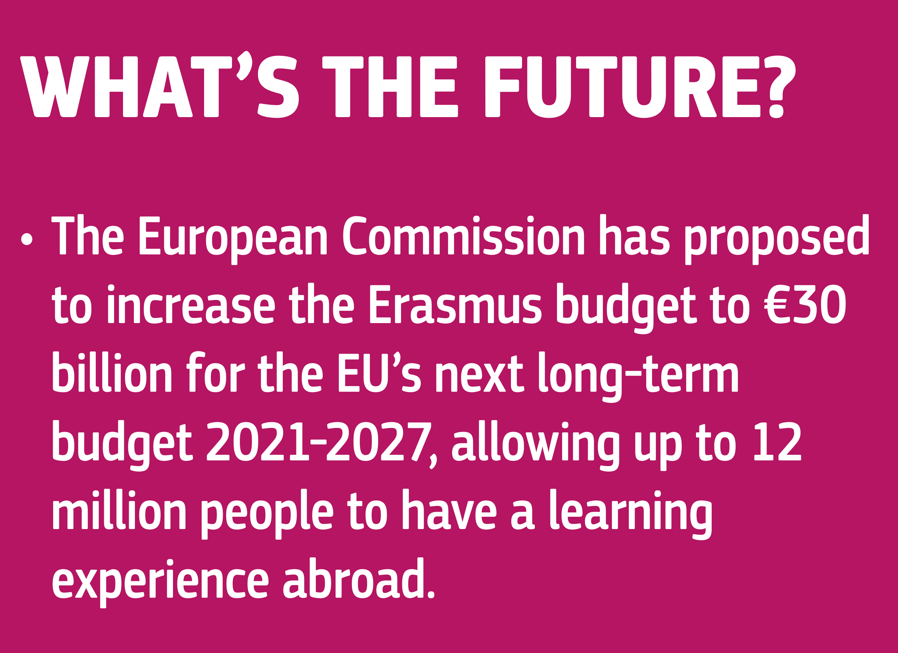

Programme "ERASMUS +"

Slide 127
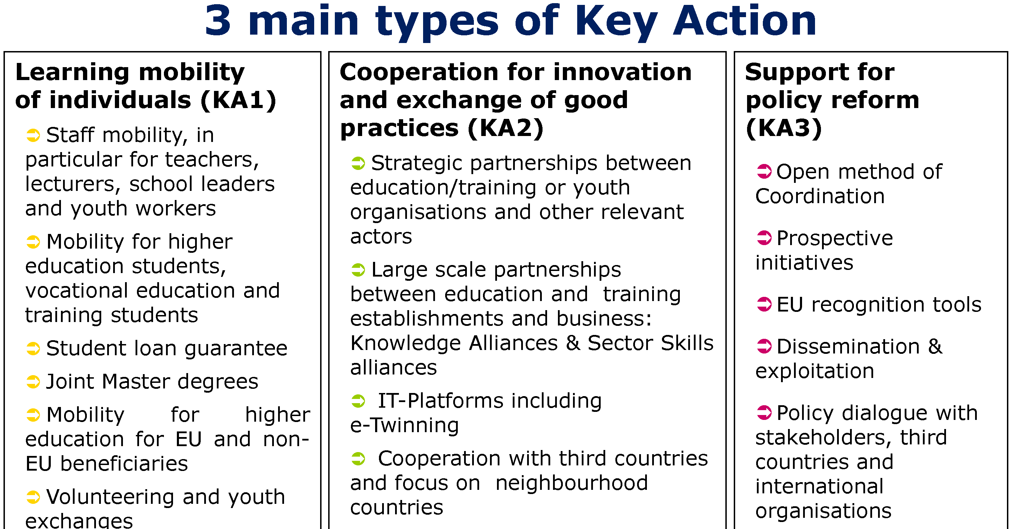
Programme "ERASMUS +"

Slide 128
Sub-Programme: KEY ACTION 1 (KA1) – LEARNING MOBILITY OF INDIVIDUALS
Projects under this Action promote transnational mobility activities targeting learners (students, trainees, apprentices, young people and volunteers), and staff (professors, teachers, trainers, youth workers, and people working in organizations active in the education, training and youth fields).
Supported actions
• Mobility of learners and staff: opportunities for students, trainees, young people and volunteers, as well as for professors, teachers, trainers, youth workers, staff of education institutions and civil society organizations
to undertake a learning and/or professional experience in another country.
• Joint Master Degrees: high-level integrated international study programmes delivered by consortia of higher education institutions that award full degree scholarships to the best master students worldwide.
• Master Student Loan Guarantee: higher education students can get a loan backed up by the Programme to go abroad for a full Master Degree. Students should refer to national banks or student loan agencies.

Slide 129
Sub-Programme: KEY ACTION 2 (KA2) – COOPERATION FOR INNOVATION AND THE EXCHANGE OF GOOD PRACTICES
The actions under Key Action 2 make it possible for organisations from different participating countries to work together, to develop, share and transfer best practices and innovative approaches in the fields of education, training and youth. More specifically, the following types of cooperation are supported:
Strategic Partnerships aim to support the development, transfer and/or implementation of innovative practices at organizational, local, regional, national or European levels.
Knowledge Alliances aim at strengthening Europe’s innovation capacity and at fostering innovation in higher education, business and the broader socio-economic environment.
Sector Skills Alliances aim at tackling skills gaps, enhancing the responsiveness of initial and continuing Vocational, Education and Training (VET) systems to sector-specific labour market needs and demand for new skills with regard to one or more occupational profiles.
Capacity Building projects are transnational cooperation projects based on multilateral partnerships between organisations active in the field of youth in Programme and Partner Countries.
IT support platforms, such as eTwinning, the School Education Gateway, the European Platform for Adult Learning (EPALE) and the European Youth Portal, offering virtual collaboration spaces, databases of opportunities, communities of practice and other online services for teachers, trainers and practitioners

Slide 130
Sub-Programme: KEY ACTION 3 (KA3) – SUPPORT FOR POLICY REFORM
This Key Action supports:
Knowledge in the fields of education, training and youth for evidence-based policy making and monitoring;
Initiatives for policy innovation to stimulate innovative policy development among stakeholders and to enable
public authorities to test the effectiveness of innovative policies through field trials based on sound evaluation
methodologies;
Support to European policy tools to facilitate transparency and recognition of skills and qualifications, as well as
the transfer of credits;
Cooperation with international organisations with highly recognised expertise and analytical capacity (such as
the OECD and the Council of Europe), to strengthen the impact and added value of policies;
Stakeholder dialogue, policy and Programme promotion involving public authorities, providers and stakeholders
in the fields of education, training and youth for raising awareness about the European policy agendas;

Slide 131
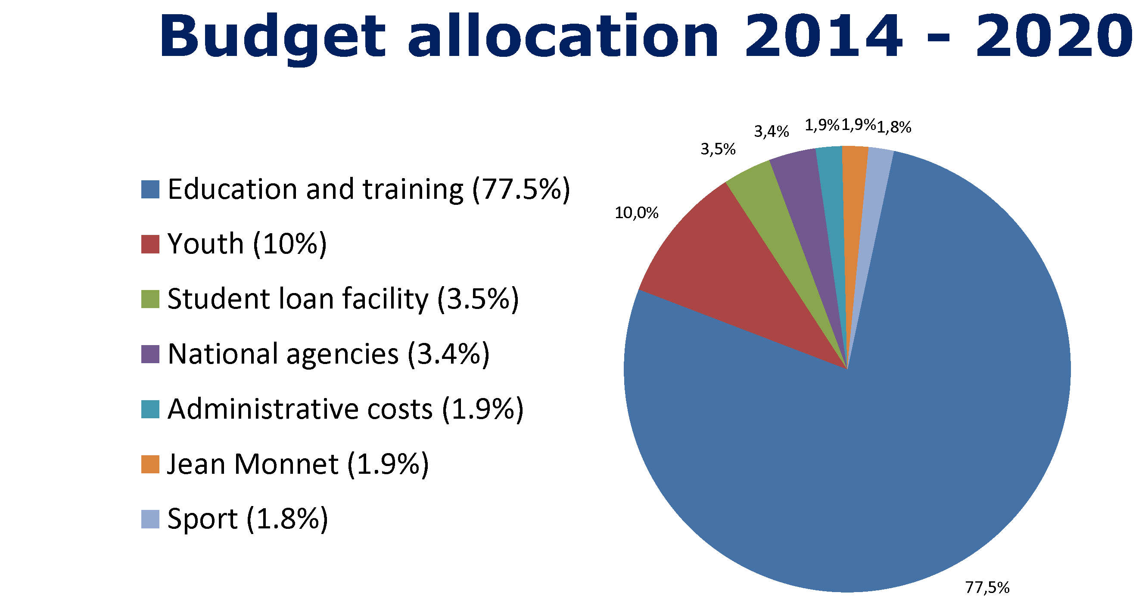
Programme "ERASMUS +“ – budget allocation

Slide 132
Sub-Programme: Jean Monnet Activities
The Jean Monnet Actions aim at promoting excellence in teaching and research in the field of European Union studies worldwide. These Actions also aim at fostering the dialogue between the academic world and policy-makers, in particular with the aim of enhancing governance of EU policies.
The Jean Monnet Activities support:
  • Academic Modules, Chairs, Centres of Excellence in order to deepen teaching in European integration studies embodied in an official curriculum of a higher education institution, as well as to conduct, monitor and supervise research on EU content, also for other educational levels such as teacher training and compulsory education.
  • Policy debate with academic world, supported through: a) Networks to enhance cooperation between different universities; b) Projects for innovation and cross-fertilisation and spread of EU content
  • Support to associations, to organise and carry out statutory activities of associations dealing with EU studies and EU issues, and to publicize EU facts among a wider public enhancing active European citizenship

Slide 133
Sub-Programme: SPORT
Actions in the field of sport support:
Collaborative Partnerships, aimed at promoting the integrity of, supporting innovative approaches to implement EU principles on good governance in sport, EU strategies in the area of social inclusion and equal opportunities, encouraging participation in sport and physical activity
Not-for-profit European sport events, granting individual organisations in charge of the preparation, organization and follow-up to a given event.
Strengthening of the evidence base for policy making through studies; data gathering, surveys; networks; conferences and seminars
Dialogue with relevant European stakeholders, being mainly the annual EU Sport Forum and support to Sport Presidency events organised by the EU Member States holding the Presidency of the EU.

Slide 134
General Call for proposals 2019 – Erasmus+ Programme
The European Commission has announced the new Erasmus+ General Call for proposals in the field of education, training, youth and sports, for the year 2019.
More details on the rules and opportunities for participation can be found in the Erasmus+ Programme Guide for 2019.
The Republic of Serbia has a status of a programme country in Erasmus+ programme, which means that institutions and organizations from Serbia can participate in all parts of the programme, either as coordinators or partners.
For more details about the projects please refer to the page Calendar of Calls.

Slide 135
General Call for proposals 2019 – Erasmus+ Programme
Table of all application deadlines for projects in 2020 and all types of projects.
Type of project | The Role of institutions from Serbia | Deadline for the submission of applications | Applications are submitted to:
Mobility of individuals in school education | Coordinator, Partner** | 5 February 2020.* | NEO
Mobility of individuals in VET and training | Coordinator, Partner** | 5 February 2020.* | NEO
Mobility of individuals in adult education fields | Coordinator, Partner** | 5 February 2020.* | NEO
Mobility of individuals in the field of youth | Coordinator, Partner** | 5 February 2020, 30 April 2020 1 October 2020.* | NEO
Mobility of individuals in the field of higher education (KA103 i KA107) | Coordinator, Partner** | 5 February 2020.* | NEO
Erasmus Mundus Joint Master Degrees | Coordinator, Partner | 13 February 2020*** | EACEA
Capacity building in the field of higher education | Coordinator, Partner | 5 February 2020.*** | EACEA
Capacity building in the field of youth | Coordinator, Partner | 5 February 2020.*** | EACEA
**As coordinator – institutions and organizations from Serbia are submitting applications to Foundation Tempus.
As a partner – institutions and organizations from Serbia can participate in projects that are submitted to the national agency in some other programme country.

Slide 136
General Call for proposals 2019 – Erasmus+ Programme
Table of all application deadlines for projects in 2020 and all types of projects.
Strategic partnerships in the field of education and training | Coordinator, Partner** | 24 March 2020* | NEO
Strategic partnerships in the field of youth | Coordinator, Partner** | 05 February 2020, 30 April 2020 1 October 2020. | NEO
Youth Dialogue projects | Coordinator, Partner** | 05 February 2020, 30 April 2020 1 October 2020. | NEO
Knowledge Alliances | Coordinator, Partner | 26 February 2020. | EACEA
European Universities | Coordinator, Partner | 26 February 2020. | EACEA
Sector Skills Alliances | Coordinator, Partner | 26 February 2020. | EACEA
Jean Monnet | Coordinator, Partner | 20 February 2020. | EACEA
Collaborative partnerships in the field of sport | Coordinator, Partner | 2 April 2020. | EACEA
Small collaborative partnerships | Coordinator, Partner | 2 April 2020. | EACEA
Not-for-profit European sport events | Coordinator, Partner | 2 April 2020. | EACEA

Slide 137
Links; https://ec.europa.eu/programmes/erasmus-plus/node_en
https://eacea.ec.europa.eu/erasmus-plus_en
Serbia Unit: https://erasmusplus.rs/erasmusplus/what-is-erasmus/
https://tempus.ac.rs/
Find a Call;
https://eacea.ec.europa.eu/erasmus-plus/funding_en
Work Programme;
https://ec.europa.eu/programmes/erasmus-plus/resources/documents/2020-annual-work-programme-implementation-erasmus-c2019-5823_en
Regulation:
https://eur-lex.europa.eu/legal-content/EN/TXT/?uri=CELEX%3A32013R1288
Documents for Applicants;
https://ec.europa.eu/programmes/erasmus-plus/resources/documents/applicants_en

Slide 138

Fiscalis 2020

Slide 139
Programme; Fiscalis 2020
It enables national tax administrations to create and exchange information and expertise. It allows developing and operating major trans-European IT systems together, as well as establishing networks by bringing together national officials from across Europe.
The Programme’s objectives are:
  • to implement, improve, operate and support the European Information Systems for taxation;
  • to support administrative cooperation activities;
  • to reinforce the skills and competence of tax officials;
  • to enhance the understanding and implementation of Union law in the field of taxation;
  • to support the improvement of administrative procedures and the sharing of good administrative practices.

Slide 140
Total Budget: €223,37 million
Thematic Categories: Internal Market, Information and Communication Technologies, Education and Training
Beneficiaries: Public Sector, Central Government
Level of Financing (Eu Co-Financing Rate)
100% of the eligible costs where the latter are travel and accommodation costs, costs linked to organisations of events and daily allowances. In addition to grants, Fiscalis provides other types of interventions such as public procurement contracts and reimbursement of costs incurred by external experts.

Slide 141
SUPPORTED ACTIONS
  • Joint actions:
    - seminars and workshops;
    - project groups, generally composed of a limited number of countries, operational during a limited period of time to pursue a predefined objective with a precisely described outcome;
    - bilateral or multilateral controls and other activities provided for in Union law on administrative cooperation, organised by two or more participating countries, which include at least two Member States;
    - working visits organised by the participating countries or another country to enable officials to acquire or increase their expertise or knowledge in tax matters;
    - expert teams, namely structured forms of cooperation, with a non-permanent character, pooling expertise to perform tasks in specific domains, in particular in the European Information Systems, possibly with the support of online collaboration services, administrative assistance and infrastructure and equipment facilities;
    - public administration capacity-building and supporting actions;
    - studies;
    - communication projects;
  • European Information Systems building: the development, maintenance, operation and quality control of Union components of the European Information Systems and new European Information Systems established under Union law, with a view to interconnecting tax authorities efficiently.
  • Common training activities: jointly developed training actions to support the necessary professional skills and knowledge relating to taxation.

Slide 142
Link;
https://ec.europa.eu/taxation_customs/fiscalis-programme_en
Regulation;
https://eur-lex.europa.eu/legal-content/EN/TXT/?uri=OJ:L:2013:347:TOC
Work Programme:
https://ec.europa.eu/taxation_customs/sites/taxation/files/1_awp_2019_f_en.pdf

Slide 143

Custom 2020

Slide 144
Programme; Custom 2020
General objective is to support the functioning and modernization of the customs union in order to strengthen the internal market by means of cooperation between participating countries, their customs authorities and their officials.
The Programme’s objectives are:
  • to support the preparation, coherent application and effective implementation of Union law and policy in the field of customs;
  • to develop, improve, operate and support the European Information Systems for customs;
  • to identify, develop, share and apply best working practices and administrative procedures, in particular further to benchmarking activities;
  • to reinforce the skills and competences of customs officials;
  • to improve cooperation between customs authorities and international organisations, third countries, other governmental authorities, including Union and national market surveillance authorities, as well as economic operators and organisations representing economic operators.

Slide 145
Total Budget: €522,9 million
Thematic Categories: Internal Market, Law Enforcement, Education and Training
Beneficiaries: Public Sector, Central Government
Level of Financing (Eu Co-Financing Rate); For grants, 100% of the eligible costs where the latter are travel and accommodation costs, costs linked to organisations of events and daily allowances. Customs provides other types of interventions as well (not grants) such as public procurement contracts and reimbursement of costs incurred by external experts.

Slide 146
The grant focusses on the implementation of the following priorities for 2019:
– Implement the UCC and develop and deploy the related electronic customs systems,;
– Facilitate legitimate trade and increase the effectiveness and efficiency of customs controls, including the cooperation with other enforcement agencies and bodies involved in the process;
– Reply to the increasing demand for customs to ensure that goods harmful for security, health, safety and the environment are duly controlled when crossing the external border of the European Union taking into account new constraints further to the growing success of e-commerce;
– Implement the European Union Strategy and Action Plan for customs risk management;
– Collaborate with third countries and international organisations;
– Implement the Customs Union Performance (CUP) as a management and communication tool;
– Implement a human competency building framework for customs.

Slide 147
Custom 2020 Programme provide support in the following areas:
  • Joint Actions pursuing the exchange of knowledge and good practice between customs officials of the participating countries.
  • European Information Systems facilitating the exchange of information and access to common data.
  • Training activities leading to human competency building for customs officials across Europe.
This grant will fund activities on:
  – supporting the preparation, coherent application and effective implementation of Union law and policy in the field of customs;
  – improving the European Information Systems for customs;
  – identifying, developing, sharing and applying best working practices and administrative procedures, in particular further to benchmarking activities;
  – reinforcing the skills and competences of customs officials;
  – improving cooperation between customs authorities and international organisations, third countries, other governmental authorities, including Union and national market surveillance authorities, as well as economic operators and organisations representing economic operators.

Slide 148
Link;
https://ec.europa.eu/taxation_customs/business/customs-cooperation-programmes/customs-2020-programme_en
Regulation; https://ec.europa.eu/taxation_customs/sites/taxation/files/resources/documents/taxation/tax_cooperation/fiscalis_programme/legal_texts_docs/customs_2020_regulation.pdf
Work Programme:
https://ec.europa.eu/taxation_customs/sites/taxation/files/awp_2019_en.pdf

Slide 149

EU Civil Protection Mechanism

Slide 150
Programme; EU Civil Protection Mechanism
The overall objective of the EU Civil Protection Mechanism is to strengthen cooperation between Participating States in the field of civil protection, with a view to improving prevention, preparedness and response to disasters. Through the Mechanism, the European Commission plays a key role in coordinating the response to disasters in Europe and beyond.
Program aims to foster cooperation among national civil protection authorities across Europe. The Mechanism was set up to enable coordinated assistance from the participating states to victims of natural and man-made disasters in Europe and elsewhere. The Mechanism currently includes all 28 EU Member States in addition to Iceland, Montenegro, Norway, Serbia, and the Former Yugoslav Republic of Macedonia.

Slide 151
Total Budget: €368.4 million of which €223.7 million inside the EU and €144.6 million for outside the EU
Thematic Categories: Civil Protection, Disaster Prevention, Security, Environment & Biodiversity, Art and Culture
Beneficiaries: State / Region / City / Municipality / Local Authority, International Organization, Small and Medium Sized Enterprises, SMEs (between 10 and 249 employees), Microenterprises (fewer than 10 employees), NGO / NPO, National Government, Enterprise (more than 250 employees or not defined), Public Services, Other, Education and Training Centers

Slide 152
Level of Financing:
Calls for Proposal define the details in details but in general, The EU co-funding rate amounts to 75 % of total eligible costs in the programme, with a maximum EU contribution of EUR 800.000, whereby the EU contributes to the eligible cost of each beneficiary at a 75% rate in Prevention Projects. The beneficiaries need to guarantee that the remaining 25% of the total eligible cost come from sources other than the EU grant, whereby each beneficiary must guarantee that 25% of its eligible cost is funded from sources other than the Union.
In Civil Protection Mechanism Exercises Maximum co-funding rate: 85 % of eligible costs of proposals, with a maximum EU contribution of EUR 1 000 000 for each proposal financed.
For The European Emergency Response Capacity Projects Up to 100% of eligible costs will be covered, provided this does not exceed 30% of the average cost of developing the capacity.
For Preparedness Projects Maximum co-funding rate: 75% of eligible costs, with a maximum EU contribution of EUR 800 000 for each proposal financed.

Slide 153
Grants will be awarded under different headings in the programme. Headings and activities as follow;
PREVENTION PROJECTS;
Track I – single country grants: Supporting Member States with activities aiming to improve disaster risk management at national/sub-national level while promoting coherence between national and European programmes. ;
Track II – cross-border grants: developing tools to assess and/or communicate on EU key risks (e.g. forest fires, floods, Chemical, Biological, Radiological and Nuclear) which are relevant to the needs of national/regional civil protection or marine pollution authorities of Member States. This includes: data collection/analysis, support tools for decision-makers, feasibility studies, risk maps and other science-based communication tools.
UNION CIVIL PROTECTION MECHANISM EXERCISES;
In due coordination with national civil protection authorities, design, planning, conduct and evaluation of exercises with scenarios; design, planning, conduct and evaluation of exercises enhancing Host Nation Support. ; Design, planning, conduct and evaluation of exercises with scenarios addressing the cooperation with non-civil protection actors.; Member States will participate, through the ERCC, following established procedures (e.g. use of CECIS and activation of the Mechanism).

Slide 154
Grants will be awarded under different headings in the programme. Headings and activities as follow;(Continue)
THE EUROPEAN EMERGENCY RESPONSE CAPACITY (EERC) – VOLUNTARY POOL
Financing of adaptation costs of response capacities, so as to make them deployable as part of the EERC, through direct grants, or framework partnership agreements with Member States' authorities. Up to 100% of eligible costs will be covered, provided this does not exceed 30% of the average cost of developing the capacity.
PREPAREDNESS PROJECTS
Projects and studies, which may include: technical specifications and feasibility studies for multi-country response capacities; small scale exercises and training courses aimed at testing innovative disaster preparedness approaches/methodologies, including those supported by other EU-funded projects
PREPAREDNESS ACTION FOR EUROPEAN NEIGHBORHOOD POLICY COUNTRIES
Capacity building activities including the strengthening of situation rooms. Consultation with relevant EU services and international organisations will be ensured throughout planning and implementation of the above activities in order to pursue, where possible, sinergies and efficiencies.

Slide 155
Links;
https://ec.europa.eu/echo/what/civil-protection/mechanism_en
Enquiries to;
echo-info@ec.europa.eu
Work Programme;
https://ec.europa.eu/echo/sites/echo-site/files/work_programme_2019.pdf
Regulation:
https://eur-lex.europa.eu/legal-content/EN/TXT/?uri=OJ:L:2019:077I:FULL

Slide 156
Justice Programme

Slide 157
Programme; Justice
The general objective of the Programme shall be to contribute to the further development of a European area of justice based on mutual recognition and mutual trust, in particular by promoting judicial cooperation in civil and criminal matters. The Programme focuses on the following Specific Objectives:
to facilitate and support judicial cooperation in civil and criminal matters
to support and promote judicial training, including language training on legal terminology, with a view to fostering a common legal and judicial culture
to facilitate effective access to justice for all, including to promote and support the rights of victims of crime, while respecting the rights of the defence
to support initiatives in the field of drugs policy as regards judicial cooperation and crime prevention aspects closely linked to the general objective of the Programme

Slide 158
Total Budget: EUR 378 million
Thematic Categories: Education, Justice, Capacity Building
Beneficiaries: Public authorities, State / Region / City / Municipality / Local Authority, Small and Medium Sized Enterprises, SMEs (between 10 and 249 employees), Microenterprises (fewer than 10 employees), NGO / NPO, Start Up Company, Enterprise (more than 250 employees or not defined), Public Services, National Government, Association, University
Level of Financing (Eu Co-Financing Rate); 90% - 80%

Slide 159
Justice Programme provide support for following actions:
Training activities (staff exchanges, workshops, development of training modules,…)
Mutual learning, cooperation activities, exchange of good practices, peer reviews, development of ICT tools…
Awareness-raising activities, dissemination, conferences,…
Support for main actors (key European NGOs and networks, Member States' authorities implementing Union law,…)
Analytical activities (studies, data collection, development of common methodologies, indicators, surveys, preparation of guides…)

Slide 160
To be eligible, grant applications must comply with all of the following criteria:
a. the applicants must be public entities or private organisations, duly established in one of the countries participating in the Programme, or international organisation. Organisations which are profit-oriented must submit applications in partnership with public entities or private non-profit-oriented organisations;
b. the applications must be transnational and involve organisations from at least two participating countries;
c. For the year 2019, the EU grant applied for cannot be lower than € 75 000. Maximum Possible Rate of Co-Financing Of The Eligible Costs is 90%. For the duration of the project please refer to the specific Call but in most of the cases, the duration of the projects should not exceed 24 months. Depending on the requirements of each topic, the Applicant may submit an application on its own, or in partnership with other organisations, referred to as Partners.
Operating grants;
The Commission will invite Framework Partners in writing to submit their proposal announcing the annual priorities. These grants will fund operating costs and those activities of the network which have EU added value and contribute to the implementation of the objectives of the Programme among others: analytical activities, training activities, mutual learning, cooperation, awareness-raising and dissemination activities. Maximum Possible Rate of Co-Financing Of The Eligible Costs is 80%

Slide 161
Link; https://ec.europa.eu/justice/grants1/programmes-2014-2020/justice/index_en.htm
Find a Call;
https://ec.europa.eu/info/funding-tenders/opportunities/portal/screen/programmes/just
Regulations;
https://eur-lex.europa.eu/legal-content/EN/TXT/PDF/?uri=CELEX:32013R1382&from=EN
Work Programme:
https://ec.europa.eu/research/participants/data/ref/other_eu_prog/justice/wp/justice-awp-2018_en.pdf

Slide 162

Internal Security Fund - Police

Slide 163
Programme; Internal Security Fund - Police
The programme will provide financial support to police cooperation, exchange and access to information, crime prevention and the fight against cross-border as well as serious and organised crime, including terrorism, the protection of people and critical infrastructure against security-related incidents and the effective management of security-related risks and crisis, taking into account common Union policies (strategies, programmes and action plans), legislation, practical co-operation and threat and risk assessments.
Within this general objective, the Funds’ activities focus on two specific objectives:
●Fight against crime: combating cross-border, serious and organised crime including terrorism, and reinforcing coordination and cooperation between law enforcement authorities and other national authorities of EU States, including with EUROPOL and other relevant EU bodies, and with relevant non-EU and international organisations;
●Managing risk and crisis: enhancing the capacity of EU States and the Union for managing effectively security-related risk and crisis, and preparing for protecting people and critical infrastructure against terrorist attacks and other security related incidents.

Slide 164
Total Budget: €1,04 billion. ( ISF Police instrument, of which EUR 662 million will be channelled through shared management and EUR 342 million through direct management.
Thematic Categories: Justice and Security, Law Enforcement, Education and Training
Beneficiaries: Central Government - State and federal authorities, local public bodies, non-governmental organisations and private and public law companies.
Level of Financing (Eu Co-Financing Rate); 90%

Slide 165
Programme will provide a support for following actions;
  • Actions improving police cooperation and coordination between law enforcement authorities, including joint investigation teams and any other form of cross-border joint operation, the access to and exchange of information and interoperable technologies.
  • Networking, mutual confidence, understanding and learning, the identification, exchange and dissemination of know-how, experience and good practices, information sharing, shared situation awareness and foresight, contingency planning and interoperability.
  • Analytical, monitoring and evaluation activities, including studies and threat, risk and impact assessments.
  • Awareness raising, dissemination and communication activities.
  • Acquisition and/or further upgrading of technical equipment, secure facilities, infrastructures, related buildings and systems, especially ICT systems and their components, including for the purpose of European cooperation on cyber- crime, notably with the European Cybercrime Centre.
  • Exchange, training and education of staff and experts of relevant authorities, including language training and joint exercises or programmes.
  • Measures deploying, transferring, testing and validating new methodology or technology, including pilot projects and follow-up measures to Union funded security research projects.

Slide 166
Link; https://ec.europa.eu/home-affairs/financing/fundings/security-and-safeguarding-liberties/internal-security-fund-police_en
Find a Call;
https://ec.europa.eu/info/funding-tenders/opportunities/portal/screen/programmes/isfp
Regulation;
https://eur-lex.europa.eu/legal-content/EN/TXT/PDF/?uri=CELEX:32014R0513&qid=1565345756477&from=EN
Work programme; https://ec.europa.eu/research/participants/data/ref/other_eu_prog/home/wp/isfp-awp-2018_en.pdf

Slide 167

Connecting Europe Facility
"CEF"

Slide 168
Programme "CEF"
Connecting Europe Facility
One instrument – three sectors
Connecting Europe Facility
Transport Guidelines
Energy Guidelines
Telecom Guidelines
The "European Infrastructure Package"
Financing framework 2014-2020
Sectoral policy frameworks
(setting priorities for 2020, 2030, 2050)
Notes:
168

Slide 169
Programme "CEF"
Total Budget: € 28,7 billion (€23.6 billion for Transport, €4.6 billion for Energy, and €0.5 billion for Telecom)
Thematic Categories: Transport, Energy, Telecommunications / Building, Industry, Regional development, Traffic, Technologies
Beneficiaries: Public Services, State / Region / City / Municipality / Local Authority, Small and Medium Sized Enterprises, SMEs (between 10 and 249 employees), Microenterprises (fewer than 10 employees), Start Up Company, Enterprise (more than 250 employees or not defined), International Organization, Non-Profit Organizations, Academic institutions and research Centers
Notes:
169

Slide 170
The aim of the creation of the Connecting Europe Facility (CEF) established by this Regulation is to accelerate investment in the field of trans-European networks and to leverage funding from both the public and the private sectors, while increasing legal certainty and respecting the principle of technological neutrality. The CEF should enable synergies between the transport, telecommunications and energy sectors to be harnessed to the full, thus enhancing the effectiveness of Union action and enabling implementing costs to be optimized.
The Connecting Europe Facility (CEF) is a key EU funding instrument to promote growth, jobs and competitiveness through targeted infrastructure investment at European level. Connecting Europe Facility (CEF) is the mechanism for infrastructure projects of common interest for trans-European transport, energy and telecoms networks. CEF will support the development of high performing, sustainable and efficiently interconnected trans-European networks in the fields of transport, energy and digital services.
Notes:
170

Slide 171
Types of Projects |  | CEF General Budget
(a) Studies (all modes) |  | 50%
(b)Works on
Rail | Cross border | 40% 30% 20% 40% 40% 20% 20% 20% 20% 20% 20% 20% 30% 50/20% 50% 20% 10% 20%
 | Bottleneck
 | Other projects of common interest
Inland waterways | Cross border
 | Bottleneck
 | Other projects of common interest
Inland transport connections to ports and airports (rail and road)
Development of ports
Development of multi-modal platforms
Reduce rail freight noise by retrofitting of existing rolling stock
Freight transport services
Secure parkings on road core network
Motorways of the sea
Traffic management systems | SESAR, RIS & VTMIS
 | ERTMS
 | ITS for road
Cross border road sections
New technologies and innovation for all modes of transport

Slide 172
Link; https://ec.europa.eu/inea/en/connecting-europe-facility
Transport
Find a Call;
https://ec.europa.eu/inea/en/connecting-europe-facility/cef-transport/apply-funding
Work Programme:
https://ec.europa.eu/transport/sites/transport/files/legislation/c2018-6599.pdf
Energy
Find a Call; https://ec.europa.eu/inea/connecting-europe-facility/cef-energy/calls
Work Programme: https://ec.europa.eu/inea/sites/inea/files/cefpub/3.priorities_in_mwp2019_rs.pdf
Telecommunication;
Find a Call: https://ec.europa.eu/inea/en/connecting-europe-facility/cef-telecom/apply-funding
Work Programme: https://ec.europa.eu/inea/sites/inea/files/cef_telecom_work_programme_2019.pdf

Slide 173

How to apply ?
Before applying, organisations seeking EU funding should identify the programme and the body managing it. The European Commission’s departments and agencies as well as the regional and national managing authorities regularly publish information about the funding opportunities they offer.

Slide 174

National Contact Points (NCPs)
Programme | Contact person | Phone | Email/web
Horizon2020 | Zeljka Dukic, MoESTD | +381 11 3616 529 | zeljka.dukic@mpn.gov.rs, http://horizon2020.mpn.gov.rs/
Erasmus | Vladimir Jovanovic, The Foundation Tempus | +381 11 33 42 430 | office@tempus.ac.rs, www.erasmusplus.rs
Creative Europe | Dimitrije Tadic, Ministry of Culture and Information | + 381 11 2927 896 | kreativnaevropa@kultura.gov.rs, http://www.kreativnaevropa.rs/
COSME | Eva Zlatkovic Ristic, Ministry of Economy | +381 11 3334 219 | eva.zlatkovic@privreda.gov.rs
EaSI REC | Danka Cancarevic, MoLEVSP | +381 11 3616 261 | danka.cancarevic@minrzs.gov.rs
Health Programme | Ljubica Pakovic, Ministry of Health | +381 11 3616 630 | ljubica.pakovic@zdravlje.gov.rs
Europe for Citizens | Sanja Atanaskovic Opacic The Office for Cooperation with Civil Society | +381 11 3130 968 | sanja.atanaskovic@civilnodrustvo.gov.rs

Slide 175
The Commission’s calls for tender are published on the websites of its various directorates-general on
the EU’s web portal, Europa (http://www.ec.europa.eu).
They are also published in the Supplement to the Official Journal of the
European Union and its online format, the TED database. (http://www.ted.europa.eu/TED/main/HomePage.do)

Slide 176
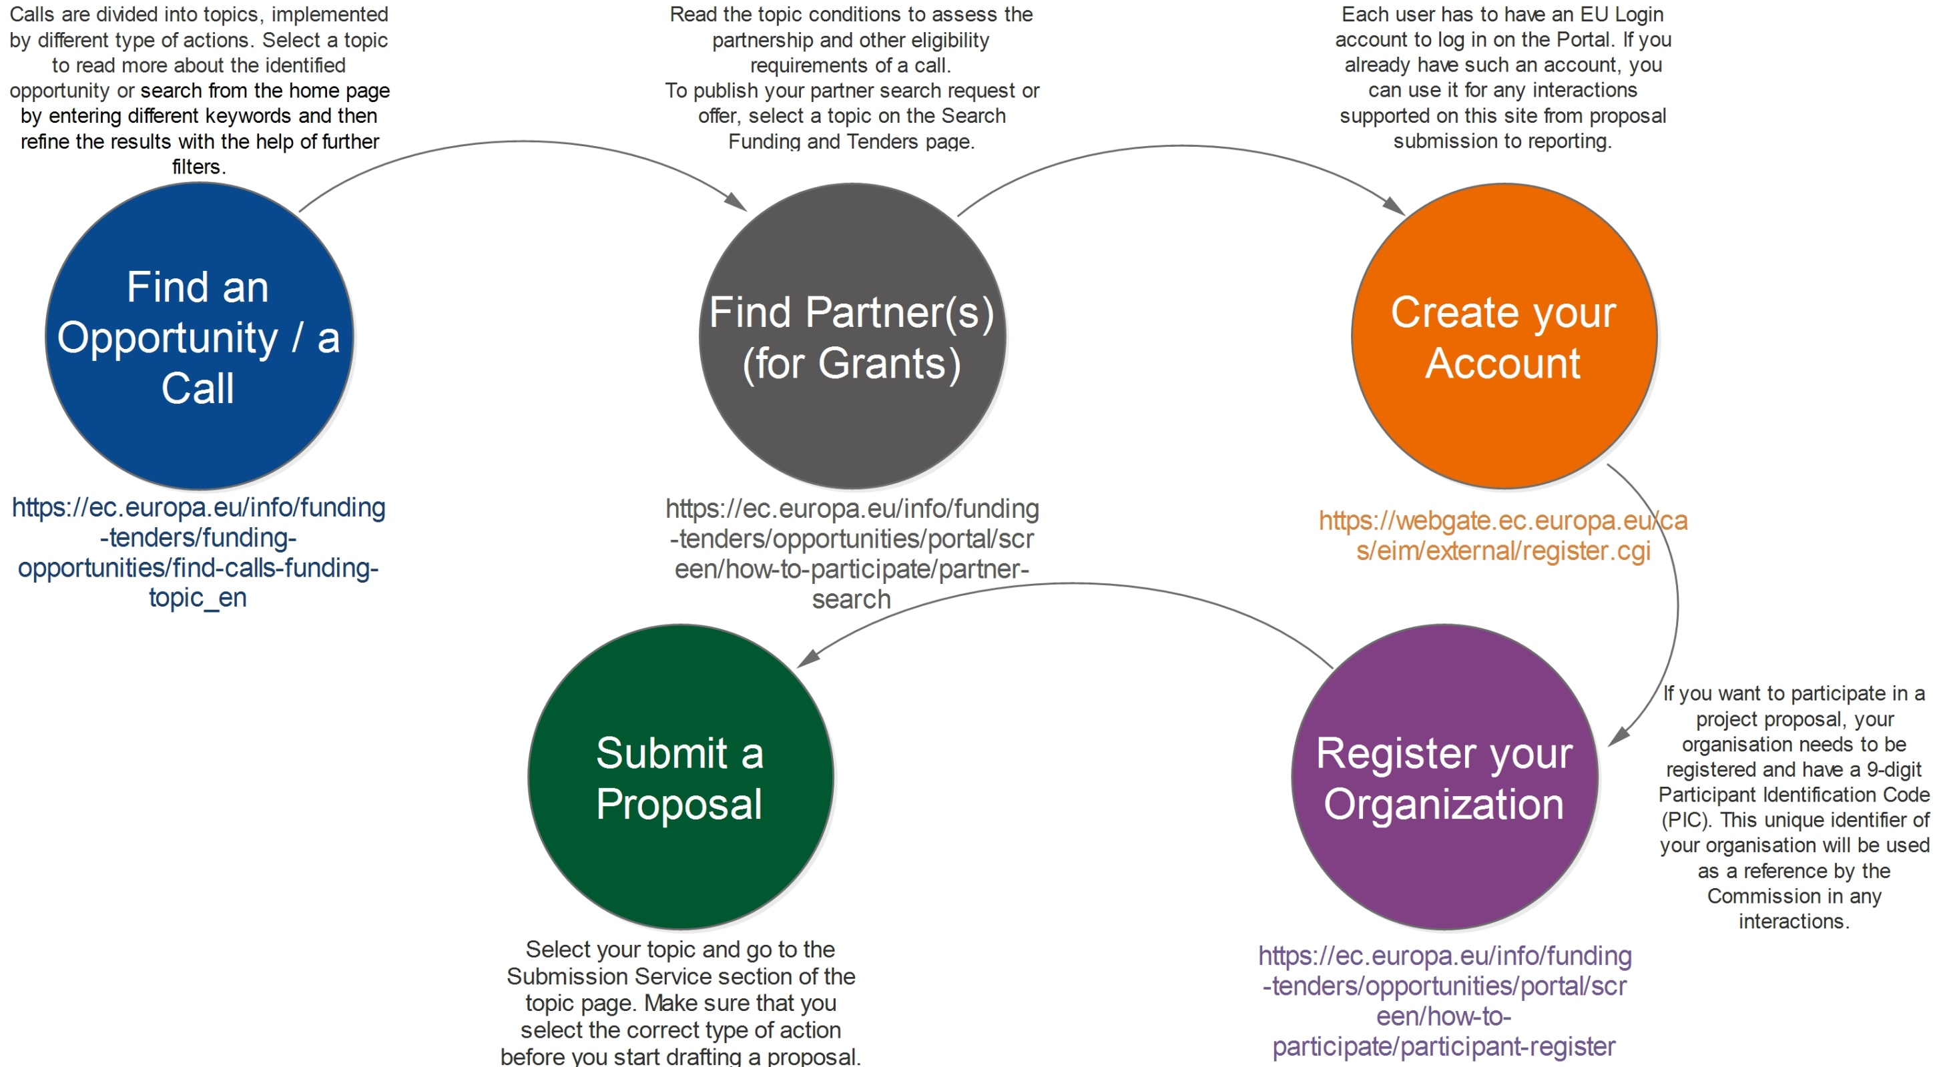

Slide 177
How to apply
Find an Opportunity / a Call ; https://ec.europa.eu/info/funding-tenders/funding-opportunities/find-calls-funding-topic_en
Find Partner(s) (for Grants) ; https://ec.europa.eu/info/funding-tenders/opportunities/portal/screen/how-to-participate/partner-search
Create your Account; https://webgate.ec.europa.eu/cas/eim/external/register.cgi
Register your Organization ; https://ec.europa.eu/info/funding-tenders/opportunities/portal/screen/how-to-participate/participant-register
Submit a Proposal ; Select your topic and go to the Submission Service section of the topic page. Make sure that you select the correct type of action before you start drafting a proposal. The link to the submission system is available, if the status of the call is 'open'. A login with your EU Login account is required.

Slide 178
https://ec.europa.eu/info/funding-tenders/funding-opportunities/find-calls-funding-topic_en; Find calls for funding - by topic
https://ec.europa.eu/eipp/desktop/en/index.html; European Investment Project Portal
https://ec.europa.eu/inea/en/publications-2018 - Publications
https://www.danube-region.eu/ - Danube Region website (including Serbia)
https://www.euro-access.eu/ search for Funding by region
https://cordis.europa.eu/projects/en CORDIS is the primary source of results from EU-funded project
https://ec.europa.eu/budget/euprojects/search-projects_en Examples of EU funded projects
http://ec.europa.eu/budget/fts/index_en.htm - Find funded projects and who has received funding
https://ec.europa.eu/programmes/erasmus-plus/sites/erasmusplus/files/eu-login-information_en.pdf- - EU Login

Slide 179
https://publications.europa.eu/en/home ; For all publications of EU, EU Structure, Official Journal of EU, Project results and EU Dataset
http://www.ec.europa.eu/budget/fts/index_en.htm; For all the programs granted (Financial Transparency System)
https://ec.europa.eu/info/about-european-commission/eu-budget_en ; For EU Budget
http://www.eurodesk.eu ; Abroad Opportunities for Young People
https://europa.eu/youth/_en ; information gateway for young people
https://ec.europa.eu/research/participants/docs/h2020-funding-guide/grants/applying-for-funding/find-a-call_en.htm ; Find a Call – The Online Manual on Grants
https://www.openaire.eu/; Research based Publications and data

Slide 181
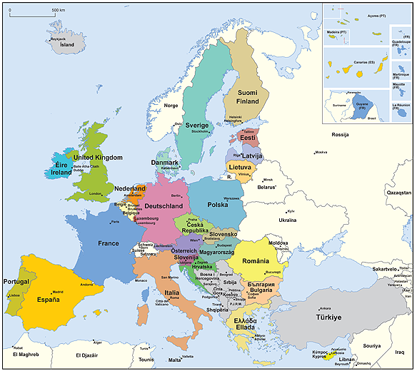
Beyond 2020

Slide 182
Proposals for a
REGULATION OF THE EUROPEAN PARLIAMENT AND OF THE COUNCIL
Establishing;
the Creative Europe programme (2021 to 2027) and repealing Regulation (EU) No 1295/2013 https://eur-lex.europa.eu/legal-content/EN/TXT/?uri=COM%3A2018%3A366%3AFIN
The Horizon Europe – the Framework Programme for Research and Innovation, laying down its rules for participation and dissemination https://eur-lex.europa.eu/legal-content/EN/TXT/?uri=CELEX%3A52018PC0435
The for single market, competitiveness of enterprises, including small and medium-sized enterprises programme (2021 to 2027) (COSME Successor) https://ec.europa.eu/commission/sites/beta-political/files/budget-may2018-single-market-regulation_en.pdf
the 'Erasmus': the Union programme for education, training, youth and sport and repealing https://eur-lex.europa.eu/legal-content/EN/TXT/?uri=COM%3A2018%3A367%3AFIN
the Rights and Values programme https://eur-lex.europa.eu/legal-content/EN/TXT/?uri=COM%3A2018%3A383%3AREV1
the Justice programme https://eur-lex.europa.eu/legal-content/EN/TXT/?uri=COM%3A2018%3A384%3AFIN

Slide 183




http://eu-programmes.euinfo.rs

Slide 184
Q&A

Slide 185


