Slide 1

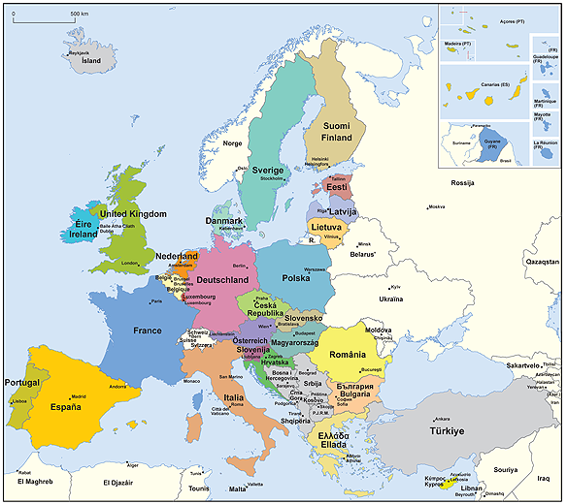

PROJECT PROPOSAL DEVELOPMENT

Slide 2
Work plan
Activites | Time
Presentations of the trainers and participants | 09:15-09:30
1. Project development concept, project cycle management and logframe | 09:30-10:00
2. Stakeholder and problem analysis Exercise – Project summary | 10:00-11:00
Coffee break | 11:00-11:15
Exercise – Key stakeholder matrix 3. Strategy analysis | 11:15-12:45
Lunch break | 12:45-13:30
Exercise - Sustainability 4. Logframe matrix and timetable | 13:30-14:45
Coffee break | 14:45-15:00
Exercise – Developing Logframe matrix | 15:00-15:30
5. Preparation of effective project proposal | 15:30-15:45
Q&A and evaluation | 15:45-16:00

Slide 3

1. Project Development Concept, Project Cycle Management and Logframe
09:30-10:00
Vladimir Todorovic
Mila Marinkovic
Ivan Brkic

Slide 4
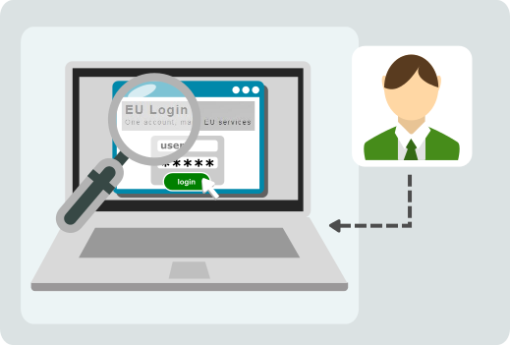
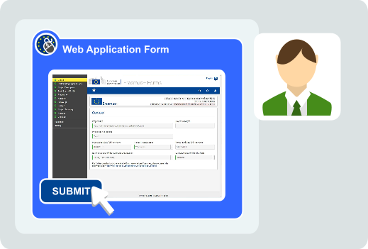
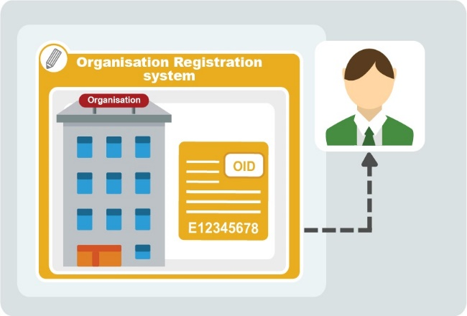
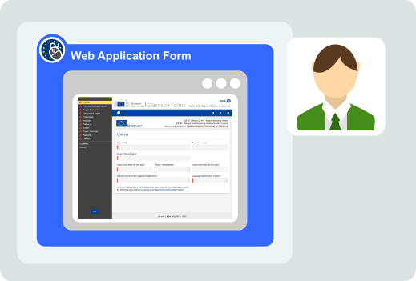

How to apply
1. EU login (access parameters are as for former ECAS)
2. PIC number
3. Selection of call and Aplication Form
4. Submit proposal
M

Slide 5


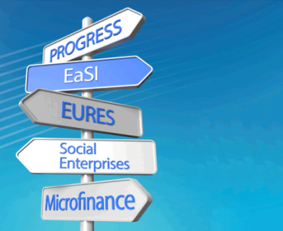








EU Programmes

Slide 6

How to apply
Find an Opportunity / a Call: https://ec.europa.eu/info/funding-tenders/funding-opportunities/find-calls-funding-topic_en
Find Partner(s) (for Grants): https://ec.europa.eu/info/funding-tenders/opportunities/portal/screen/how-to-participate/partner-search
Create your Account: https://webgate.ec.europa.eu/cas/eim/external/register.cgi
Register your Organization: https://ec.europa.eu/info/funding-tenders/opportunities/portal/screen/how-to-participate/participant-register
M

Slide 7
A grant guideline usually includes:
The current status of the grant scheme, the reason that the grant scheme was opened, and what problems are required to be solved through the projects
Objectives of the specific programme and priority areas
Upper and lower limits of the amount and rates of financial assistance to be provided under the Programme
Eligibility requirements for Applicants (Leaders) and Partners
Implementation period of the grant projects
Project types and activities to be supported together with the activities not supported
In which countries, regions and provinces the projects can be implemented
Which costs are eligible for the projects to be implemented
How and where the application should be made,
What documents should be submitted
Evaluation Procedure for applications
Notes:
The European Union is a unique institution where Member States voluntarily cede national sovereignty in many areas to carry out common policies and governance in order to gain strength and the benefits from cooperation.
Single market: The Single Market refers to the EU as one territory without any internal borders or other regulatory obstacles to the free movement of goods and services. A functioning Single Market stimulates competition and trade, improves efficiency, raises quality, and helps cut prices. The European Single Market is one of the EU’s greatest achievements. It has fuelled economic growth and made the everyday life of European businesses and consumers easier. (SM of goods, SM of services, Digital SM, etc.)
Euro: The euro is the most tangible proof of European integration – the common currency in 19 out of 28 EU countries and used by some 338.6 million people every day. The euro was launched on 1 January 1999. Banknotes and coins were introduced on 1 January 2002. The benefits of the common currency are immediately obvious to anyone travelling abroad or shopping online on websites based in another EU country.
6 countries non-EU use the euro: Vatican, San Marino, Monaco, Andorra, Montenegro and Kosovo.
Schengen area: 26 members (22 from the EU, 4 non-EU (Norway, Iceland, Switzerland and Lichtenstein). 3 microstates are de facto members because they do not have borders (Monaco, Vatican and San Marino). 2 EU MS are not in the Schengen area: UK and Ireland. 4 EU MS are working on implementing the Schengen area rules to be full members: Cyprus, Croatia, Bulgaria and Romania.
The EU has exclusive competences in:
-Customs Union
-Competition rules
-Monetary policy for the Eurozone
-Conservation of marine biology
-Concluding international agreements

Slide 8
1. Excellence
1.1 Objectives:
Objectives should be SMART:
Specific: objectives must be precise in order to be understood clearly
Measurable: it should be possible to measure the progress towards the achievement of the objectives based on a pre-defined set of quantifiable indicators
Achievable: objectives must be attainable with the resources allocated, and within the duration of the planned action
Results-focused: the goals should measure outcomes, not activities
Time-bound: objectives must have a clear time-frame, a deadline by which they are to be achieved.
1.2 Relation to the work programme: Indicate why your proposal would fit to the framework defined by the Call / programme / strategies etc.
1.3 Concept and methodology
(a) Concept Explain the overall concept underpinning your proposal. Describe the main ideas, models or assumptions. Highlight trans-disciplinary considerations and the methodology that you intend to follow. Set out your activities; Show the European dimension of your proposal and how it will add value to Europe.
(b) Methodology: Explain how your proposal will lead to market take-up and what will be required to achieve that; Where relevant, describe how sex and/or gender issues are taken into account.
1.4 Ambition: Describe your proposal’s innovation potential / the advance it would provide beyond the state-of-the-art, and the extent it is ambitious / a game-changer. Where relevant, compare with to products and services already available on the market. Please refer to the results of any patent search carried out.
Technical Annexes Content (Example of H2020)

Slide 9
2. Impact
2.1 Expected impacts: Please be specific, and provide only information that applies to the proposal and its objectives. Wherever possible, use quantified indicators and targets. Describe how your action will contribute; Show which user needs or challenge you have identified and how these will be met by your proposal; Describe the type of market you target (e.g. niche or high volume); Show the economic relevance of your solution, in particular for the scale-up of the industry partner(s) in the consortium (turnover, market share, employment creation, longer-term sales expectations, return on investment and profit; In the context of your proposal, elaborate on your capital investment policy for the next three years of operation; Describe any barriers/obstacles, and any framework conditions
2.2 Measures to maximize impact a) Dissemination and exploitation of results; Explain which stakeholders should be involved in the last stretch towards a successful commercial exploitation of your proposal, in addition to those already present in the consortium and/or in the validation process of the proposal; Elaborate on how you intend to position yourself in the market over time; On the basis of your expected result, elaborate on the possible further development strategy for your project to ensure your future competitiveness; Add any other factors of relevance related to dissemination and exploitation of results that could increase impact and explain how. b) Intellectual Property, knowledge protection and regulatory issues c) Communication activities; Describe the communication measures for promoting your work during the period of the grant. Measures should be proportionate to the scale of the activity, with clear objectives. They should be tailored to the needs of various audiences, including groups beyond your own community.
Technical Annexes Content (Example of H2020)

Slide 10
3. Implementation
3.1 Work plan — Work packages, deliverables and milestones; brief presentation of the overall structure of the work plan; timing of the different work packages and their components (Gantt chart or similar); detailed work description. Use ready format tables; graphical presentation of the components showing how they inter-relate (Pert chart or similar).
3.2 Management structure and procedures: Describe the organisational structure and the decision-making; Explain why the organisational structure and decision-making mechanisms are appropriate to the complexity and scale of the action; Describe, where relevant, how effective innovation management will be addressed in the management structure and work plan.
3.3 Consortium as a whole: The individual members of the consortium are described in a separate section 4. There is no need to repeat that information here; Describe the consortium. How will it match the action’s objectives? How do the members complement one another (and cover the value chain, where appropriate)? In what way does each of them contribute to the action? How will they be able to work effectively together?
3.4 Resources to be committed: Please make sure the information in this section matches the costs as stated in the budget table in section 3 of the administrative proposal forms, and the number of person/months, shown in the detailed work package descriptions. Please provide the following: Ready table showing number of person/months required; Ready table showing ‘other direct costs’ for participants
Technical Annexes Content (Example of H2020)

Slide 11

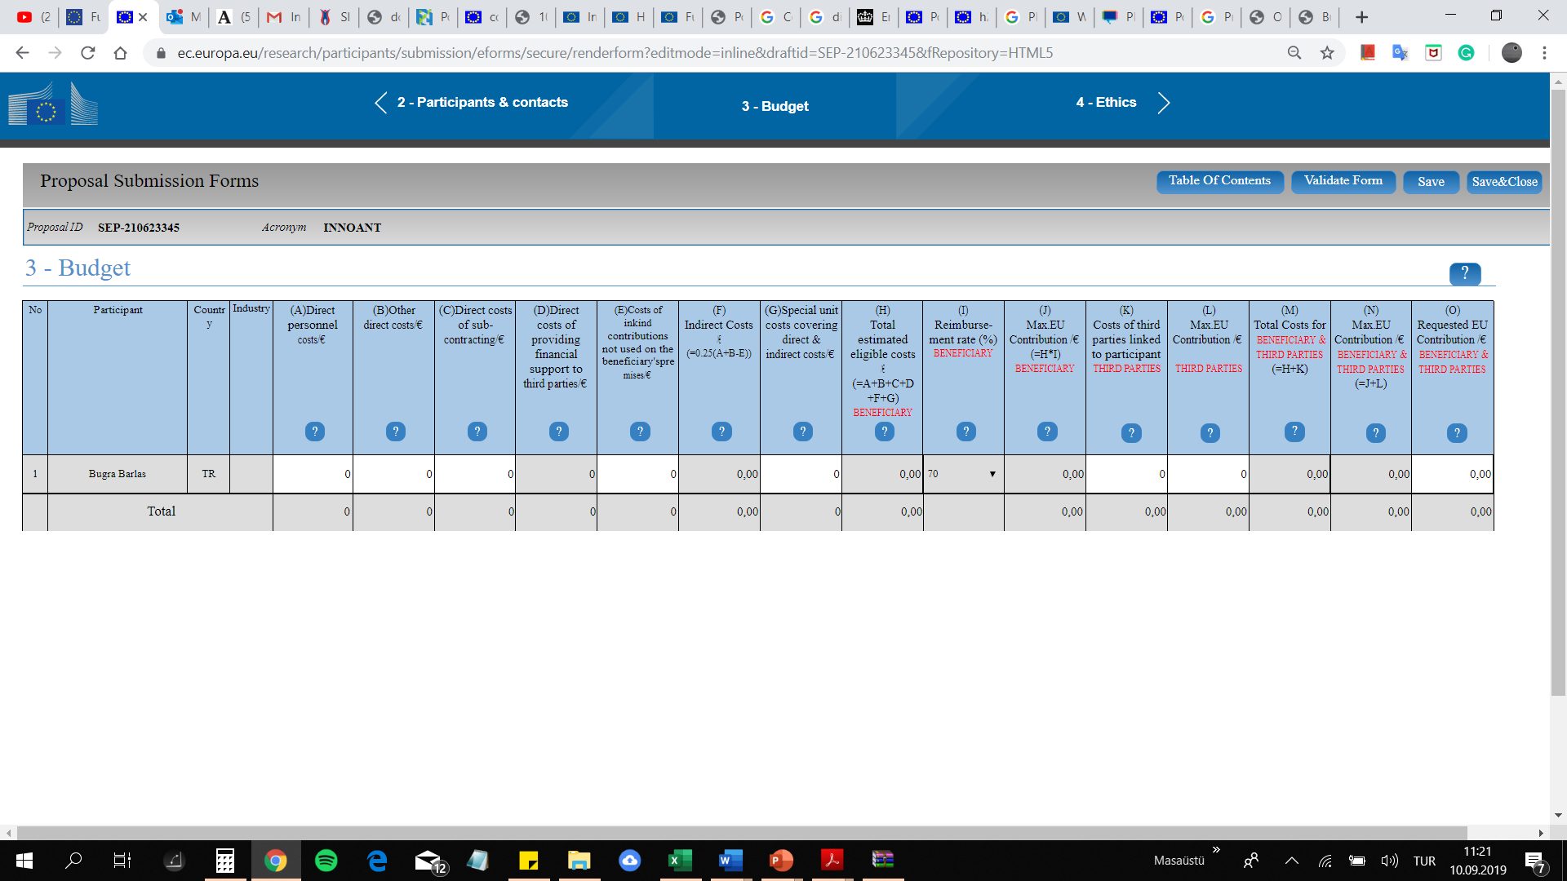
  Direct personnel costs
  Other direct costs
    Travel
    Equipment
    Other goods & services
  Subcontracting
Main Cost Categories
(H2020)

Slide 12

The Project Management Institute defines a project as “a temporary endeavor undertaken to create a unique product or service. Temporary means that every project has a definite end. Unique means that the product or service is different in some distinguishing way from all similar products or services.”
A project is a series of activities aimed at bringing about clearly specified objectives within a defined time-period and with a defined budget.
Common characteristics of all projects:
  Start and a finish
  Life cycle involving a series of phases in between the beginning and end
  Budget
  Set of activities which are sequential, unique and non-repetitive
  Use of resources which may require coordinating
  Centralized responsibilities for management and implementation
  Defined roles and relationships for participants in the project
A project should also have:
Clearly identified stakeholders, including the primary target group and the final beneficiaries
Clearly defined coordination, management and financing arrangements
A monitoring and evaluation system (to support performance management)
An appropriate level of financial and economic analysis, which indicates that the project’s benefits will exceed its costs.

Slide 13
The way in which projects are planned and carried out follows a sequence beginning with an agreed strategy, which leads to an idea for a specific action, oriented to-wards achieving a set of objectives, which then is formulated, implemented, and evaluated with a view to improving the strategy and further action.
Project Cycle Management is an approach to managing projects. It determines particular phases of the Project, and outlines specific actions and approaches to be taken within these phases. The PCM approach provides for planning and review processes throughout a cycle, and allows for multiple project cycles to be supported.
M

Slide 14

In their approach to funding, the EU uses a particular form of Project Cycle Management to enable it to ensure that it funds projects that are consistent with its objectives, and are likely to achieve the desired impact. In particular the EU needs to ensure the following:
  That projects respect and contribute to overarching policy objectives of the EC such as respect of human rights, poverty alleviation and to cross-cutting issues such as gender equality, protection of the environment;
  That projects are relevant to an agreed strategy and to the real problems of target groups and beneficiaries;
  That projects are feasible, meaning that objectives can be realistically achieved within the constraints of the operating environment and the capabilities of the implementing agencies;
  That benefits generated by projects are sustainable.
In 1992 the European Commission adopted “Project Cycle Management” (PCM) as its primary set of project design and management tools (based on the Logical Framework Approach), and a first PCM manual was produced in 1993.

Slide 15
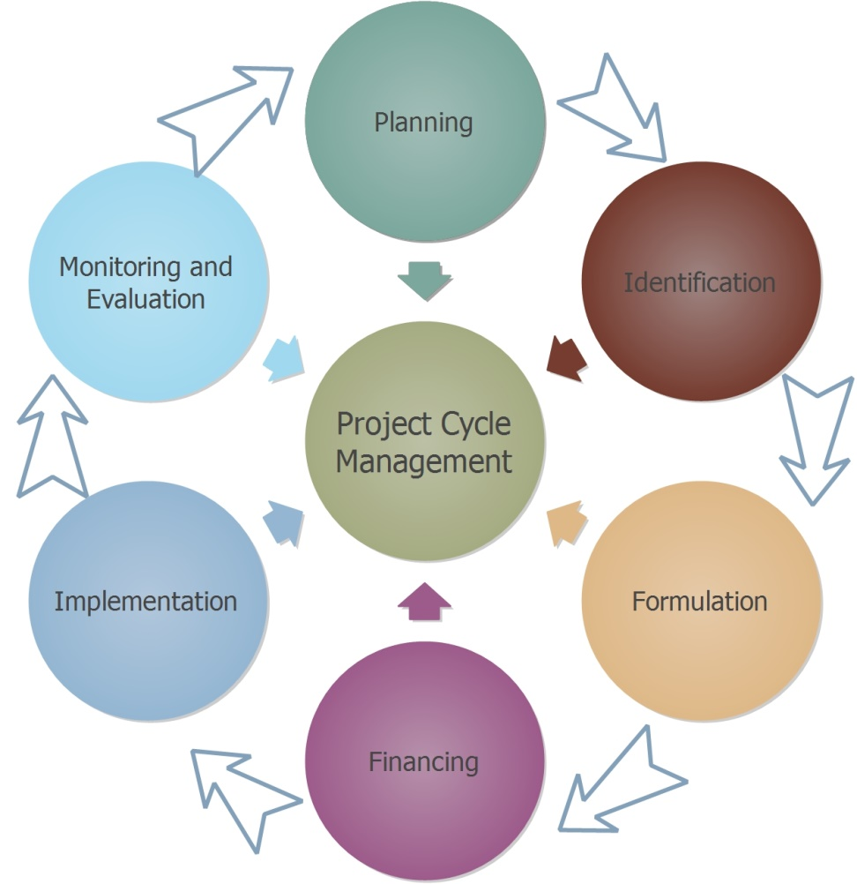
Project Cycle Management is a methodology for the preparation, implementation and evaluation of projects based on the principles of the logical framework approach (LFA)
Planning / Programming –Analysis of situation at national, local and sectorial level - Annual Programme or Grant
Identification – Formulation of project idea and design of Project - pre-feasibility study (including problem analysis), EC decision
Formulation (Appraisal) – Preparation of the project proposal - feas. study, EC decision
Financing – Securing financial resources e.g. Award of the grant and co-funding - EC Financing Agreement
Implementation – Implementation of the activities stated on the project proposal - project launch
Evaluation – Ongoing checks and periodic review of Project - project assessment / Monitoring

Slide 16
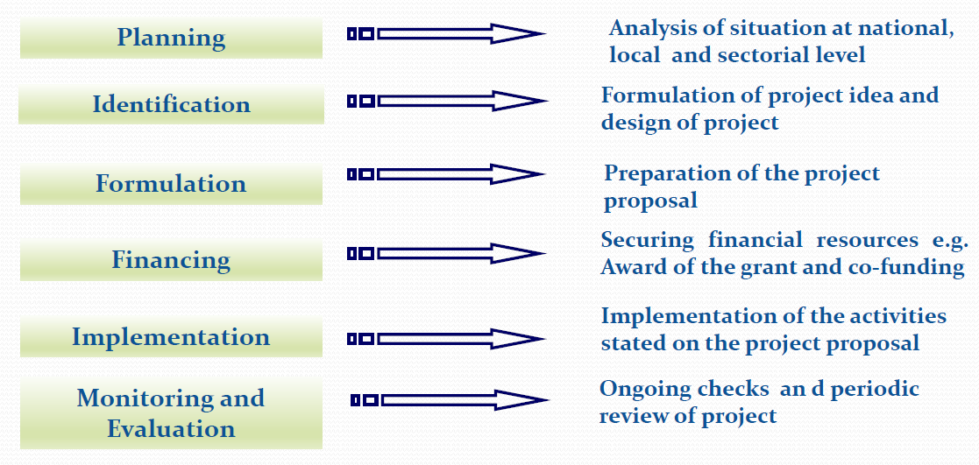

Slide 17
Phase 1- Planning and programming: This is the first point where the ideas about the project are presented and designed.
Phase 2 - Identification: This is the stage where the project is designed in detail in terms of technique and implementation.
Phase 3 - Formulation: This is the stage where the design, completeness, functionality and consistency of the project are evaluated in terms of technical, financial, economic, equality between men and women, social, institutional and environmental factors and the project proposal is written
Phase 4 – Financing: The stage in which the proposal is evaluated by the relevant institutions and the financing is provided.
Phase 5- Implementation: This is the stage of implementation, monitoring, supervision and evaluation of the activities envisaged in the project.
Phase 6 - Evaluation: This is the stage of reviewing and evaluating the project results. These assessments will be the basis for further project preparations.

Slide 18
The information obtained in the process of determining the project idea (Phase 1) forms the basis for the analysis process of the project idea (Phase 2).
Phase 3 reviews the information produced during the previous two phases, and the viability and sustainability of the project.
The first, second and third stages are the stages in which a project is designed. If the design in these stages is accurate and consistent, the subsequent stages can be completed successfully.

Slide 19
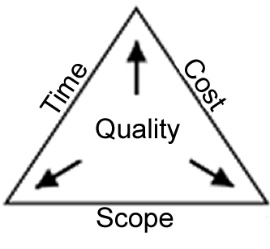
Triple Constraints for the Projects
a. Reaching the predefined objectives and results
b. Within the timeframe targeted
c. Completion of activities within the estimated budget
The Project Cycle consists of mutually connected phases through which the project goes through in its duration, from the initial idea, all the way to the end of the project, when (ideally) the goals are met.
M

Slide 20
EU PCM model emphasizes the following:
Use of the Logical Framework Approach to analyse problems, and work out suitable solutions through project design, and successful implementation.
Producing good-quality key document(s) in each phase, to ensure structured and well-informed decision-making (often called the “integrated approach”).
Consultation with and the involvement of key stakeholders as much as possible.
Clear formulation and focus on one Project Purpose, in terms of sustainable benefits for the intended target group(s).
Incorporation of key quality issues into the project design from the beginning.

Slide 21
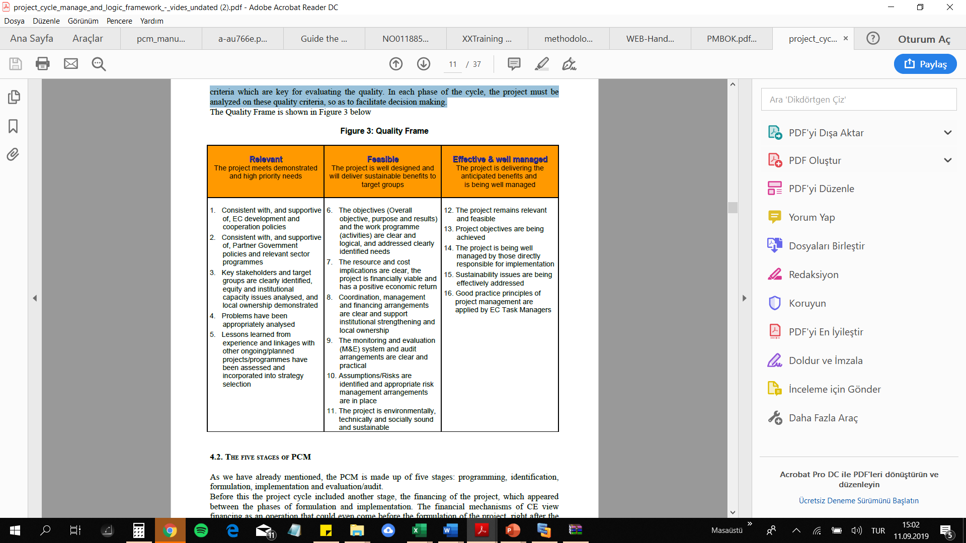
The latest version of the EC’s Guidelines on PCM, when compared with earlier versions, gives more importance to the concept of quality. The quality of a project is measured in terms of relevance, feasibility and effectiveness. In the Quality Frame these three attributes are subdivided into 16 criteria which are key for evaluating the quality. In each phase of the cycle, the project must be analyzed on these quality criteria, so as to facilitate decision making.

Slide 22
Project Cycle Management
The Decision Making and Implementation Process defined by the Organization
Logical Framework
Project Design and Management method and tools
Project Cycle Management
Defines different phases in the project life with well-defined management activities and decision making procedures
Logframe Approach
A methodology for planning, managing and evaluating programmes and projects, using tools to enhance participation and transparency and to improve orientation towards objectives
PCM reflects the decision-making and implementation process;
the methodology applied for planning, managing, evaluating projects is the Logical Framework Approach.
M

Slide 23
Project Objective
The Logframe Approach
Project Purpose
Result
Output
Activity
M

Slide 24
The Logical Framework Approach is an analytical and management tool which is now used (in one form or another) by most agencies, international NGOs and by many partner governments for the management of development projects.
The Logical Framework Approach is an analytical process and set of tools used to support objectives-oriented Project planning and management. It provides a set of interlocking concepts which are used as part of an iterative process to aid structured and systematic analysis of a project or programme idea.
The Logical Framework Approach should be thought of as an ‘help to thinking’. It allows information to be analyzed and organized in a structured way, so that important questions can be asked, weaknesses identified and decision makers can make informed decisions based on their improved understanding of the project rationale, its intended objectives and the means by which objectives will be achieved.

Slide 25
The most important element of PCM is the logical framework which represents a diagram representation of the project.
The logical framework is a tool for analysis and presentation of projects and programs in different phases of the project cycle. In each phase, the information relevant to that phase are added to the logical framework. The logical framework provides all parties included with a concise description of the project.

Slide 26
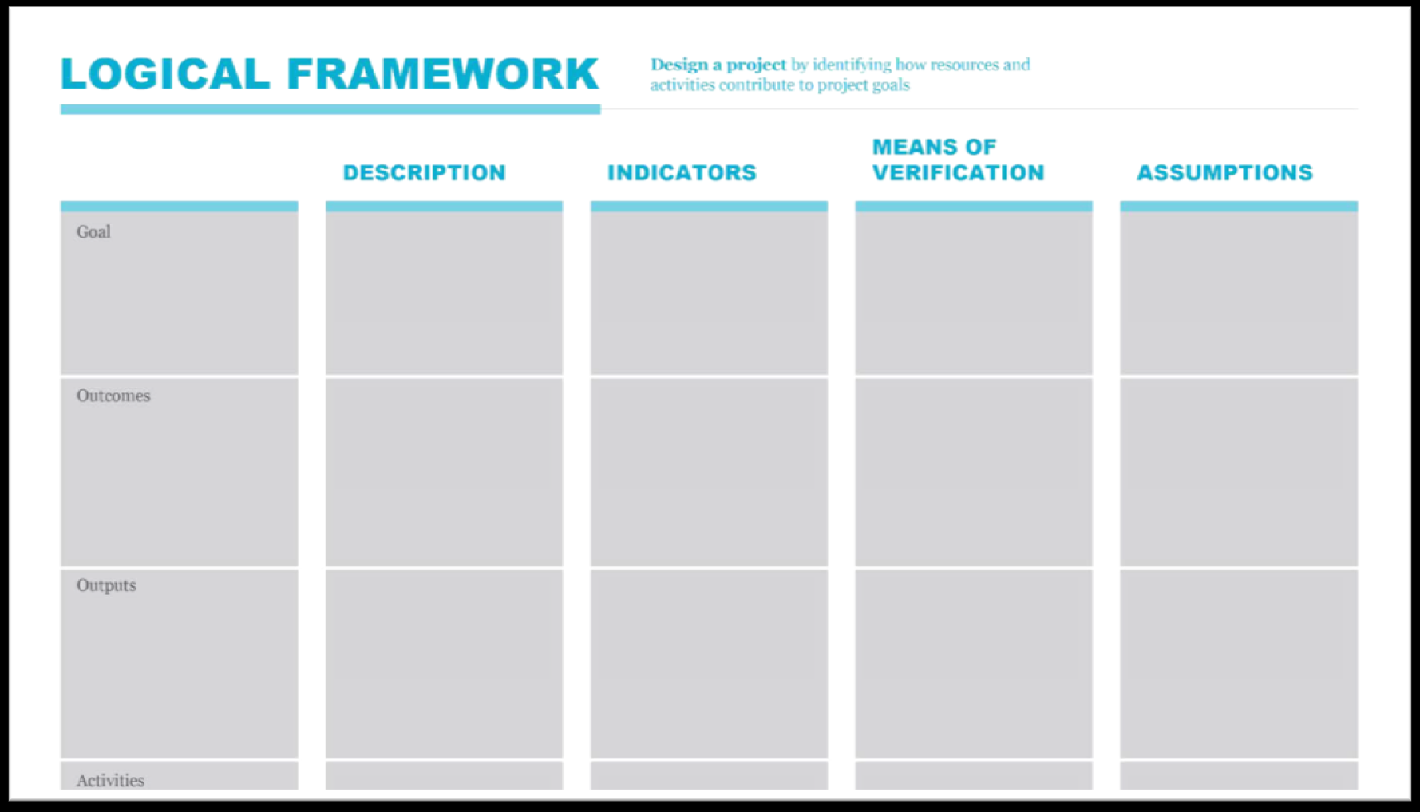
Logical Framework Matrix
The basic matrix consists of four columns and a number of rows (usually three or four rows)
Project Description | Indicators | Source of Verification | Assumptions
Overall objective: The broad development impact to which the project contributes – at a national or sectoral level (provides the link to the policy and/or sector programme context) | Measures the extent to which a contribution to the overall objective has been made. Used during evaluation. However, it is often not appropriate for the project itself to try and collect this information. | Sources of information and methods used to collect and report it (including who and when/how frequently).
Purpose: The development outcome at the end of the project – more specifically the expected benefits to the target group(s) | Helps answer the question ‘How will we know if the purpose has been achieved’? Should include appropriate details of quantity, quality and time. | Sources of information and methods used to collect and report it (including who and when/how frequently) | What conditions external to the project are necessary for achievement of purpose to contribute to the goal? What risks need to be monitored during implementation?
Results/Outputs: The direct/tangible results (good and services) that the project delivers, and which are largely under project management’s control | Helps answer the question ‘How will we know if the results have been delivered’? Should include appropriate details of quantity, quality and time. | Sources of information and methods used to collect and report it (including who and when/how frequently) | What factors outside the control of project management are necessary for progress from outputs to purpose? What risks?
Activities/Tasks: The tasks (work programme) that need to be carried out to deliver the planned results (optional within the matrix itself) | (sometimes a summary of resources/means is provided in this box) Means | (sometimes a summary of costs/budget is provided in this box) Costs | Assumptions (factors outside project management’s control) that may impact on the activity-result linkage What external factors are necessary for activities to generate planned outputs? What risks?
1
8
9
There is a general sequence to completing the matrix, which starts with the project description (top down), then the assumptions (bottom-up), followed by the indicators and then sources of verification (working across).
2
10
11
7
3
12
13
6
4
5
M
Prerequisites

Slide 27
The Logical Framework Approach (LFA) is a core tool used within Project Cycle Management.
It is used during the identification stage of PCM to help analyze the existing situation, investigate the relevance of the proposed project and identify potential objectives and strategies;
During the formulation stage, the LFA supports the preparation of an appropriate project plan with clear objectives, measurable results, a risk management strategy and defined levels of management responsibility;
During project/programme implementation, the LFA provides a key management tool to support contracting, operational work planning and monitoring; and
During the evaluation and audit stage, the Logframe matrix provides a summary record of what was planned (objectives, indicators and key assumptions), and thus provides a basis for performance and impact assessment.

Slide 28
ANALYSIS STAGE
PLANNING STAGE
Stakeholder analysis - identifying & characterising potential major stakeholders; assessing their capacity
Problem analysis - identifying key problems, constraints & opportunities; determining cause & effect relationships
Objective analysis - developing solutions from the identified problems; identifying means to end relationships
Strategy analysis - identifying different strategies to achieve solutions; selecting most appropriate strategy.
Logframe Matrix - defining project structure, testing its internal logic & risks, formulating measurable indicators of success
Activity scheduling – when will the activities be carried out?
Resource scheduling – what resources will be needed?
IMPLEMENTATION
EVALUATION
Indicators which provide management information (monitoring and regular review)
Assumptions which support risk management
Updated activity schedules linked to results
Updated resource schedules and budgets linked to results
A clear situation/problem analysis to help evaluate relevance
Objective structure and indicators against which to evaluate impact and effectiveness
Activity and resource schedules to assist in evaluating efficiency
Main
Stages
M
Project implemented by Eurochambres & TOBB
Notes:
9

Slide 29
The appropriately planned project, which is based on the actual needs of the target groups, must be based on accurate and complete analysis of the current situation. The current situation should be interpreted per the interests and activities of stakeholders.
The value of the analysis increases if prepared jointly by all (as many stakeholders as possible). Alternatively, problem analysis can be performed in a small group, provided that the group will explicitly try to make an inventory of all the problems and their cause-effect relationships from different viewpoints corresponding to the various stakeholders. To ensure that the project corresponds to the real needs of the group it is essential to analyze - it is better to do it together with the different parties - the issues that the appropriate group actually faces.

Slide 30
There are four main elements of the Analysis Stage:
1. Stakeholder Analysis, including preliminary institutional capacity assessment, gender analysis and needs of other vulnerable groups such as the disabled (profile of the main ‘players’)
2. Problem Analysis (profile of the main problems including cause and effect relationships)
3. Analysis of Objectives (image of an improved situation in the future)
4. Analysis of Strategies (comparison of different options to address a given situation)
In the Planning Stage the results of the analysis are transcribed into a practical, operational plan ready to be implemented. In this stage:
• The logframe matrix is prepared, requiring further analysis and refinement of ideas
• Activities and resource requirements are defined and scheduled
• A budget is prepared.
it is important that those involved in the identification or formulation of projects are sufficiently aware of the policy, sector and institutional context within which they are undertaking their work.

Slide 31

2. Stakeholder and problem analysis
10:00-11:00
Vladimir Todorovic
Mila Marinkovic
Ivan Brkic

Slide 32
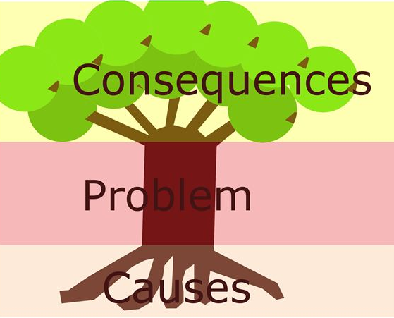
Problem Analysis
Problem analysis is of great importance in terms of project planning because it has great influence over the design of possible intervention. The problem tree establishes cause and effect to ensure that root problems are identified and then addressed.
Projects aim to address a problem or constraint. It is vital to understand the causes of the problem or constraint, how they affect stakeholders, and how to focus on tackling them.
Main steps are:
  Identify one or two (initial) major problem(s) affecting the target group(s)
  Identify related problems/constraints
  Analyze and identify cause and effect relationships
  Check the logic
  Draft the problem tree diagram
M

Slide 33
Problem Analysis
The problem analysis involves three main stages:
Definition of the framework and subject of analysis
2. Identification of the major problems faced by target groups and beneficiaries
(What is/are the problem/s ? Whose problems ?)
3. Visualisation of the problems in form of a diagram, called a “problem tree” or “hierarchy of problems” to help analyse and clarify cause–effect relationships as shown in the figure

Slide 34
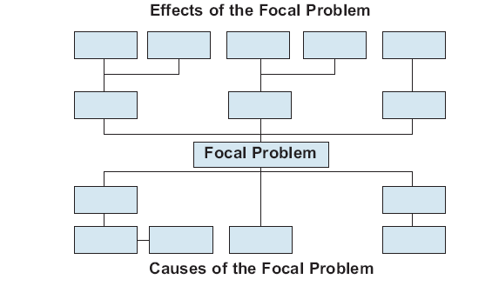

Problem Analysis
In this problem analysis, the cause-effect relations are established between negative situations for an existing one. The analysis aims to identify the bottlenecks with high priority. After identyfing a problem The causes of the problem are then traced back as the ‘roots’ of the problem and provide the causal chain. The effects of the problem are then traced forward as the branches and main effects of a problem on stakeholders.
The Tree allows for many problems to be identified, and to analyze how they relate to each other. These linkages are important in deciding which problems are the ones that a project should focus on and try to address. In addition, the Tree allows for complex problems to be visualized – to be seen in a clearly diagrammatical format that is understood by all.

Slide 35
Problem Analysis
Identify the major problems that the project will address.
State problems in negative manner.
Group problems by similarity of concerns.
Develop the problem tree:
a) Select a focal problem from the list and relate other problems to the focal problem.
  b) If the problem is a cause of the focal problem it is placed below the focal problem
c) If the problem is an effect of the focal problem is goes above

Slide 36

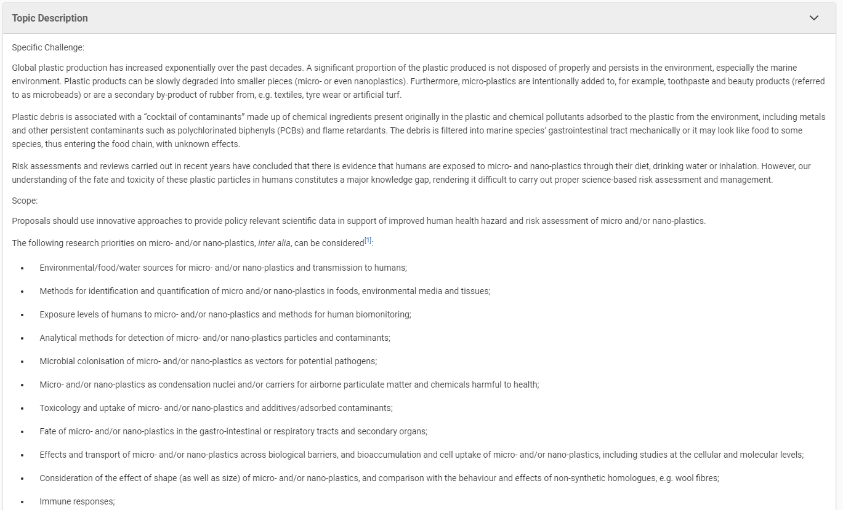
H2020 example

Slide 37
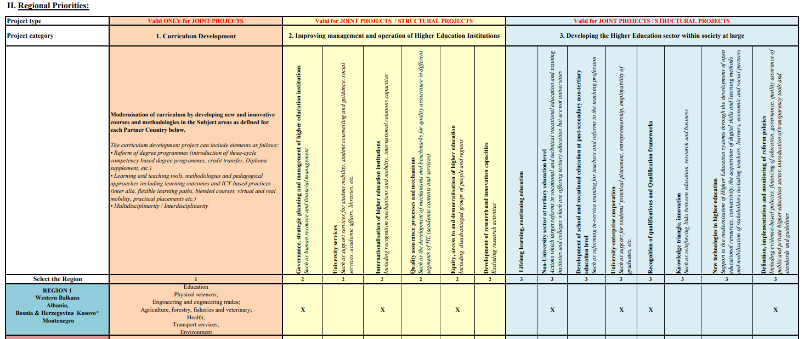
ERASMUS+ example

Slide 38
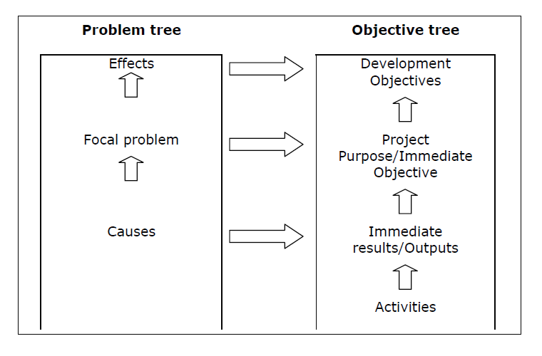
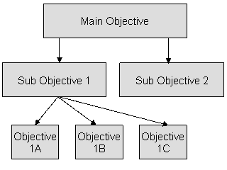
Problem and Objective Analysis

Slide 39
Problem Analysis
Important points about using the problem tree:
The quality of output will be determined by who is involved in the analysis. Involving stakeholder representatives with appropriate knowledge and skills is critical;
A workshop environment is a critical instrument for developing problem tress, analyzing the results and then proposing next steps. Whenever feasible, a LFA workshop should be undertaken in the project area, include representatives of all involved parties, be facilitated by an independent LFA facilitator/moderator. (A note on LFA workshops is attached in annex 2)
It may be appropriate to undertake a number of separate problem tree analysis exercises with different stakeholder groups, to help determine different perspectives and how priorities vary;
The process is as important as the product. The exercise should be treated as a learning experience for all those involved, and an opportunity for different views and interests to be expressed; and
The product of the exercise (the problem tree) should provide a robust but simplified version of reality. If it is too complicated, it is likely to be less useful in providing direction to subsequent steps in the analysis. A problem tree cannot (and should not) contain or explain the complexities of every identifiable cause-effect relationship.

Slide 40
Objective Analysis
The objectives tree should be prepared after the problem tree is completed and stakeholder analysis is performed. In its simplest form, the objectives tree is the same as the problem tree. However, negative problem definitions are converted to positive target definitions.
After the analysis of the problem follows the analysis of objectives. The analysis of objectives is usually based on the analysis of the participants and the number of reports and other documents on the facts and, consequently, a more objective information.
Analysis of objectives is a methodological approach employed to:
  • Describe the situation in the future once identified problems have been remedied;
  • Verify the hierarchy of objectives;
  • Illustrate the means-ends relationships in a diagram.
M

Slide 41
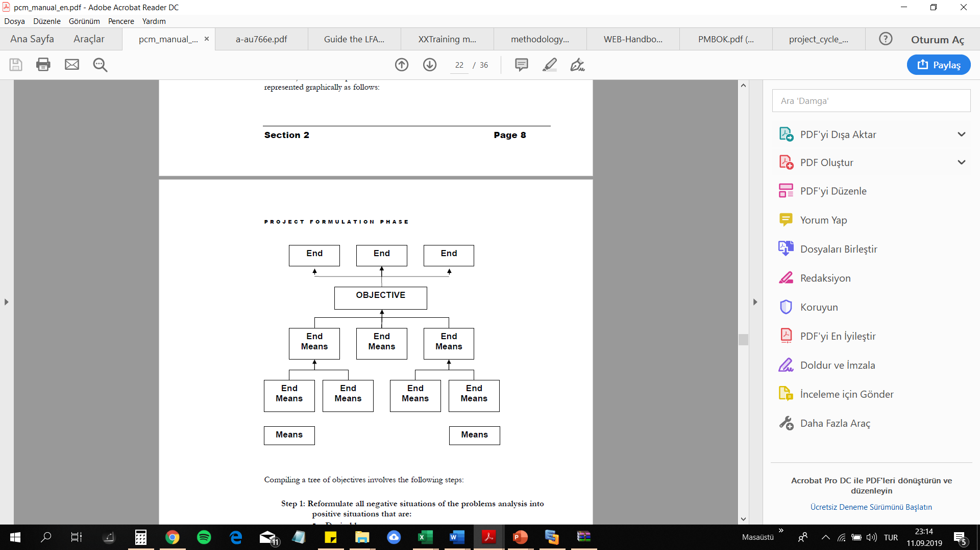
Objective Analysis
The negative situations of the problem tree are converted into solutions, expressed as positive achievements. These positive achievements are in fact objectives, and are presented in a diagram of objectives showing a means/ends hierarchy. This diagram aims to provide a clear overview of the desired future situation.
Often this type of diagram offers some objectives that cannot be fulfilled by the project in question, and must be taken into consideration in other projects. Some objectives may be unrealistic so that alternate solutions must be sought or the efforts to reach them should be dropped.

Slide 42
Objective Analysis
Reformulate all negative situations of the problems analysis into positive situations that are: Desirable and Realistically achievable
Check the means-ends relationships thus derived to ensure validity and completeness of the hierarchy (cause-effect relationships are turned into means-ends linkages)
If necessary: Revise statements; Add new objectives if these seem to be relevant and necessary to achieve the objective at the next higher level; Delete objectives which do not seem suitable / convenient or necessary

Slide 43
Problem Analysis – summary example
The innovation capacity is extremely important for all businesses enabling their growth, productivity and efficiency. The innovation system in six Western Balkans countries (WB6) has gone through a number of improvements. However, EC country Reports 2019 for WB6 identified area for further enhancement.
The capacity for innovation actions is limited in the WB6. Therefore, it is important to work on strengthening the capacity of local business support institutions, such as incubators and techno parks, to provide new services to innovative SMEs and an increase both in the number of high-tech start-ups and investment readiness of the SMEs.
Numerous incubators, techno parks and science parks in the Western Balkans are limited in the support they can provide to their SME clients by lack of qualified staff and funding. While some Business Support Services are provided throughout the Western Balkans by governments and by the private sector, the uptake of these support services is still very low.
In order to further progress, these countries need to raise their innovation capabilities. They are often characterised by ‘’pockets of excellence’’ – very innovative companies and institutions, coexisting in an environment of weak performing firms and a substantial informal economy. These companies have very limited access to funding and require support through technical assistance and advisory services.

Slide 44
Problem Analysis – key steps in analysis example
Analysis of EU Accession progress of WB6 related to innovation
EU Strategic Background related to innovation
WB6 Strategic Background – EU and regional initiatives
Country level background relevant to the project – innovation, start-ups, incubators, techno parks, ongoing national initiatives and projects
Support Mechanisms for Enterprise Innovation
Common challenges for the region – brain drain, framework conditions, division between academia and commerce

Slide 45
Problem Analysis – Critical factors example
Critical factors to overall achievement of the results include:
Building commitment and cooperation between project stakeholders;
Establishing a clear strategic action process for activities, agreed and accepted by the stakeholders;
Establishing effective monitoring and evaluation systems, together with a set of both impact and project-level indicators, to identify improvements needed and ensure achievement of results;
Training receptiveness and absorption capacity of the incubator and/or techno-park expert staff and resident entrepreneurs;
Effective knowledge transfer through the training, information dissemination and awareness raising, and development of tools;
Using project resources to leverage additional resources to encourage sustainability of project actions, through relevant EU programmes.

Slide 46
Problem Analysis – Assumptions example
Assumptions:
Willingness for the effective cooperation of all participating beneficiaries of the project
Sufficient number of staff involved in the activities
Efficient co-operation between recipient institutions and the Contractor is established and ensured
SMEs and entrepreneurs resident of incubators and/or techno-parks willing to participate in the Project
Timely approval of the project outputs from the appropriate authorities
Sufficient number of twinning institutions willing to cooperate
Actions:
Project will design interventions with a view to the engagement framework of potential participants, ensuring that the case for involvement is clear and well communicated
Project seeks to actively convince beneficiaries of the project of the benefits of participation and to publicise benefits as they are achieved
Work with senior management institutions to identify staffing issues, or requirements to reassign any responsibilities
Ensure that activities are planned jointly with partners, so that they are fully aware of the timeline when the outputs will be sent for approval

Slide 47
Problem Analysis – Risks examples
Risks:
Lack of sufficient coordination between all stakeholders involved in the project that could result in delays and poor implementation of the activities;
Lack of qualified and experienced Beneficiary staff involvement due to staff turnover
Lack of interested beneficiaries to fully engage in project activities
Lack of suitable (and suitably qualified) private sector resident entrepreneur project partners
Beneficiaries are not able / interested to absorb the technical assistance
Lack of interested twinning institutions to participate in twinning programme
Actions:
Establish close cooperation and use both formal and informal channels of communication to quickly identify potential problem or delays
Establish communication with staff at high level and at operational level.
Work with a wide range of stakeholders to identify potential participants in the project activities, and build a contact database. Ensure that project activities are fully promoted
Ensure that Training Programme clearly match both individual and organisational capacity building needs and priorities, and agree capacity building plans with the beneficiaries senior management teams

Slide 48

Project Summary Exercise
Develop a concept note/project summary (organisation of one event - training, conference, fair, cultural event, etc.)

Slide 49
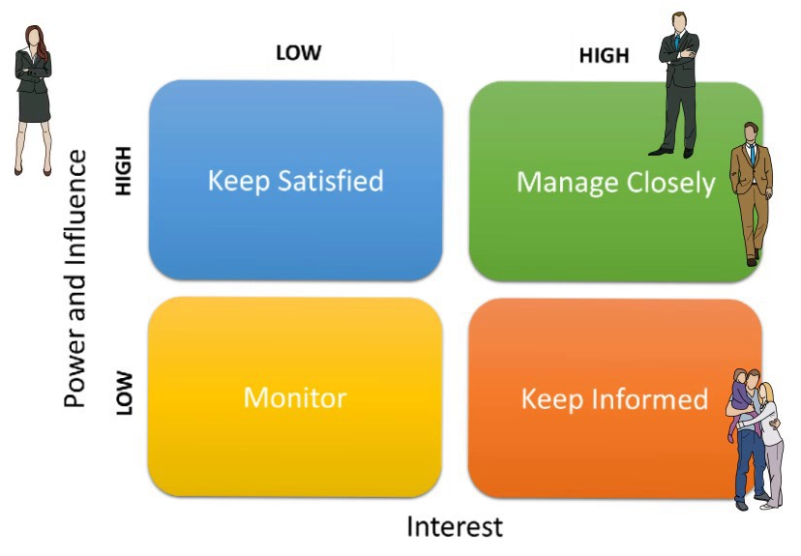
Stakeholder Analysis
Any individuals, groups of people, civil society groups, organizations, institutions or firms that may have a significant interest in the success or failure of a project (either as implementers, facilitators, beneficiaries or adversaries) are defined as ‘stakeholders’. A basic premise behind stakeholder analysis is that different groups have different concerns, capacities and interests, and that these need to be explicitly understood and recognized in the process of problem identification, objective setting and strategy selection.
Stakeholder analysis starts with a list of all possible stakeholders. In the context of development projects, a key purpose of stakeholder analysis is to understand and address distributional/equity concerns, particularly in the context of effectively addressing the needs of vulnerable groups (such as the poor, women and children and the disabled).
M

Slide 50
Stakeholder Analysis
The main steps involved in stakeholder analysis are:
Identify the general development problem or opportunity being addressed/considered
Identify all those groups who have a significant interest in the (potential) project
Investigate their respective roles, different interests, relative power and capacity to participate (strengths and weaknesses)
Identify the extent of cooperation or conflict in the relationships between stakeholders
Interpret the findings of the analysis and incorporate relevant information into Project design to help ensure that (i) resources are appropriately targeted to meet distributional/equity objectives and the needs of priority groups, (ii) management and coordination arrangements are appropriate to promote stakeholder ownership and participation; (iii) conflicts of stakeholder interest are recognized and explicitly addressed in project design
Interpret the findings of the analysis and decide whose interests and views are to be given priority when the analysis of problems is carried out
Incorporate relevant information into project design to help ensure that (i) resources are appropriately targeted to meet distributional/equity objectives and the needs of priority groups, (ii) management and coordination arrangements are appropriate to promote stakeholder ownership and participation; (iii) conflicts of stakeholder interest are recognized and explicitly addressed in Project design.

Slide 51
Stakeholder Analysis
Stakeholder analysis allows key interest groups to be identified & involved, allows different expectations to be identified, allows mobilization of different resources essential for the project( information, financial, human, legitimacy), shows how different stakeholders perceive reality, highlights different needs, helps identify potential conflicts/risks, supports appropriate objective setting, strategy selection and targeting of benefits.
To identify primary stakeholders:
Who will be directly and positively affected by the project?
Who will be directly and negatively affected by the project?
To identify secondary stakeholders:
Who will be indirectly and positively affected by the project?
Who will be indirectly and negatively affected by the project?
To identify project partners:
Who are the people you can / will lead the project together?
With which institutions/organizations will you be able to carry out the project?

Slide 52
Stakeholder Analysis – identified stakeholders example
Primary project stakeholders: incubator and/or techno-park expert staff and resident entrepreneurs
Secondary project stakeholders:
National Policy makers - Policy makers from Ministries with responsibilities for Research, Innovation, entrepreneurship and enterprise competitiveness will be stakeholders in this new project. This will also extend to their implementing Agencies.
Regional Cooperation Council - As the regional organisation with responsibility for over-seeing SEE2020 and the MAP, with associated targets and indicators, the Regional Cooperation Council is an important stakeholder in the project.
WB EDIF Platform Advisory Group (PAG) -The members of the PAG have an interest in any project in the region that could ultimately contribute to the aims and objectives of EDIF.
Investors and ‘follow-on-funding’ - Last, but certainly not least, individual and institutional investors are stakeholders in this project as it should yield a larger and stronger number of investment opportunities for them. This will include seed funds such as the South-Central Ventures, national angel networks, and the wider EU angel networks including EBAN and BAE.
Partners: EBN, IASP

Slide 53
Stakeholder Analysis
Stakeholders are individuals or institutions that may – directly or indirectly, positively or negatively – affect or be affected by the outcomes of projects or programmes.
Beneficiaries are those who benefit in whatever way from the implementation of the project. Here an important distinction may be made between:
  Target group(s) are the group or entity who will be directly positively affected by the project at the Project Purpose level
  Final beneficiaries who are those who benefit from the project in the long term at the level of the society or sector at large, e.g. “children” due to increased spending on health and education, “consumers” due to improved agricultural production and marketing
Project partners are those agencies who implement the projects with the support of the donor directly.
M

Slide 54
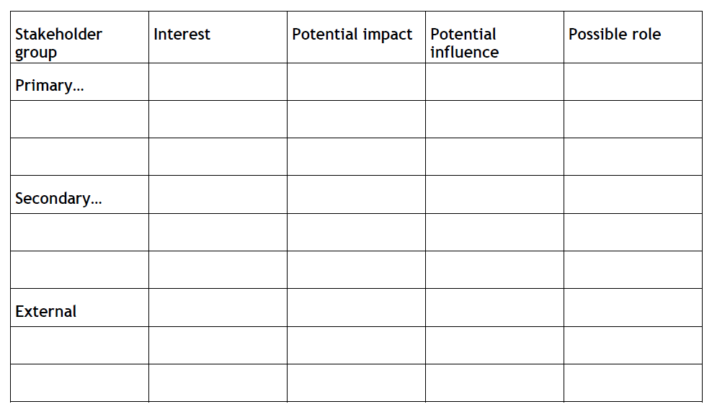
Stakeholder Analysis
Tools for conducting stakeholder analysis: There are a variety of tools that can be used to support stakeholder analysis. Some suggested options are described below, namely:
Stakeholder matrix (interests, roles, capacities etc)
Focus Groups and facilitated discussions
SWOT analysis (strengths, weaknesses, opportunities, threats)
Venn Diagrams (relationships between stakeholders)
Organisation charts (formal lines of authority & responsibility)
Gender analysis (tasks, responsibilities, time allocation)
Sample Matrix for grouping
M

Slide 55
Stakeholder Analysis
As illustrated in the table, the stakeholder analysis matrix describes:
The basic characteristics of the stakeholders
Their interests and how they are affected in the problem/potential project
Their capacity and motivation to bring about change
The possible action to address their interest
Stakeholder and basic characteristics | Problems (How affected by the problem(s) | Interests (and possible actions to address it ) | Potential (Capacity and motivation to bring about change)
Sample Matrix

Slide 56
Stakeholder Analysis – key stakeholders matrix example
Result Areas | Key Stakeholders | Comments (problems, interests, potential...)
Overall | Regional incubators, science and techno-parks and their tenant SMEs | Main project beneficiaries
Task1: Perform mapping exercise of regional incubators, techno and science parks, select beneficiaries for further institutional development and capacity building | Regional incubators, techno and science parks | We anticipate that regional incubators, techno and science parks will collaborate in mapping exercise and assessment of their needs.
Task2: Define scope of training and monitoring programmes, twinning arrangements for Knowledge Transfer and determine match(es) with potential knowledge provider(s) | Regional incubators, techno and science parks | Training and mentoring programmes should be developed in close cooperation with regional incubators, techno and science parks, to meet their training needs and needs of their tenant SMEs
Task 3: Provide trainings and mentorship to beneficiary staff and resident entrepreneurs | Regional incubators, techno and science parks and their tenant SMEs | Trainings and mentorship to beneficiary staff will be organised in close cooperation with beneficiary management and/or their senior staff. The project team will maintain communication with beneficiary staff in order to identify adequate SMEs and entrepreneurs for the training.

Slide 57
Stakeholder Analysis – donor coordination
Emphasize how this project differs from similar and possible collaboration with other projects and initiatives:
Define list of on-going projects that have similar goals
Define list of completed projects which results can be upgraded
Ensuring the cooperation with on-going and planned projects
Achieving the synergy
M

Slide 58
Stakeholder analysis Exercise
Prepare a project key beneficiaries matrix (organisation of one event - training, conference, fair, cultural event, etc.)

Slide 59
Example
Programme priority: Protecting the environment and biodiversity, improving risk prevention and promoting sustainable energy and energy efficiency
Programme priority specific objective: To promote the use of sustainable energy and energy efficiency in public buildings

Slide 60
Project main objective: The main objective of project is to promote energy efficiency and sustainability of high energy demand public buildings by integration of smart energy saving based solutions for building energy management system.
Project specific objectives:
To increase knowledge on energy saving solutions for public buildings with high energy demand by establishing exemplary facilities, improving international cooperation and performing research.
To influence the attitude and raise awareness on energy saving based smart solutions for public buildings with high energy demand
To change the behavior by presenting benefits of energy saving based smart solutions for public buildings with high energy demand

Slide 61
Stakeholders:
Local public authority
Regional public authority
Interest groups including NGOs
Chamber of Engineers
Universities and health centers
Administration personnel representing the relevant countries institutions (Ministry of Energy, Ministry of Health, etc.)
The personnel of sectoral agencies dealing with the subject of energy, energy efficiency, renewable energy sources
Education/training centres a

Slide 62

3. Strategy analysis
11:15-12:45
Vladimir Todorovic
Mila Marinkovic
Ivan Brkic

Slide 63

Strategy Analysis
The strategy analysis is to define the method to be used to achieve the desired objectives.
Strategy analysis is the process of deciding which objectives will be used in the project and which objectives will be excluded.
In this process, the “general objectives” and “project purposes” of the project are also defined.

Slide 64
Strategy Analysis
Step 1: Identify objectives you do not want to pursue (not desirable or not feasible);
Step 2: Group objectives, to obtain possible strategies or components (clustering);
Step 3: Assess which strategy/ies represent(s) an optimal strategy according to the agreed criteria;
Step 4: Determine Overall Objective(s) and Project Purpose

Slide 65

Project Objective
Project Purposes
CHOSEN PATH
Purpose 1
Result 1-1
Result 1-2
Purpose 2
Result 2-1
Result 2-2
Strategy 1
Strategy 2

Slide 66
Strategy Analysis
As Objectives Tree, there are many problems and potential solutions (objectives) for these. How does one choose which problems the project will focus upon and address?
It emphasizes the need to prioritize, and arises from the principle that one project cannot solve all problems. The Strategy Analysis allows for consideration of the different ways that a project can address parts of a problem.

Slide 67
Strategy Analysis
The type of questions that need to be asked and answered at this stage might
include:
Should all the identified problems and/or objectives be tackled, or a selected few?
What are the positive opportunities that can be built on (i.e from the SWOT analysis)?
What is the combination of interventions that are most likely to bring about the desired results and promote sustainability of benefits?
How is local ownership of the project best supported, including development of the capacity of local institutions?
What are the likely capital and recurrent costs implications of different possible interventions, and what can realistically be afforded?
What is the most cost effective option(s)?
Which strategy will impact most positively on addressing the needs of the poor and other identified vulnerable groups?
How can potential negative environmental impacts best be mitigated or avoided?

Slide 68
Strategy Analysis
Criteria that can be used to guide a choice include:
Priorities of and attractiveness to target groups, including time perspective of benefits
Resource availability:
    funds
    expertise required / available
Existing potentials and capacities (of target group/s)
Relevance for sector / agreed strategy between EC and partner country and relevance for contribution to overarching policy objectives
Relationship and complementarity with other action
Social acceptability
Contribution to reduction of inequalities (e.g. gender)
Urgency

Slide 69
Strategy Analysis - Methodology
Define methodology for project actions:
“Ex-ante assessment methodology for financial instruments in the 2014-2020 programming period”
EC twining manual defines several key steps for implementation of twinning programmes
The structure of the investment readiness programme should be based on the model developed by Colin Mason and Jennifer Kwok (2010)
If possible, follow up on the results of previous EU funded projects or initiatives

Slide 70
Strategy Analysis - Methodology
Link project partners and experts experience with activities:
our capacity building for staff of the incubators, techno and science parks will build on the ground experience of two of the most important international associations in this field: EBN and IASP.
Our key expert held high-level senior management positions in UK innovation support organisations over many years, delivering services to business support organisations (like project beneficiaries) and SMEs, and has exceptional experience in managing support teams for direct support to business support organisations (like project beneficiaries) and SMEs.

Slide 71
Strategy Analysis - Sustainability
For all new services developed, project will propose sustainable solution for its implementation in the future:
The project beneficiaries will be trained to apply the methodology for the ex-ante assessment in the future
The project beneficiaries will be trained to successfully provide new support services to innovative resident SMEs

Slide 72
Sustainability Exercise
Define sustainability aspects of your project (for one event -training, conference, fair, cultural event, etc.)

Slide 73
Strategy Analysis - Resources
 | Start Month | End Month | No. of days NKE1 | No. of days NKE2 | No. of days NKE3 | No. of days NKE4 | No. of days NKE5 | No. of days NKE 6
Task 1 | 1 | 3 | 20 | 10 | - | - | - | -
Task 2 | 4 | 12 | - | - | 10 | 6 | 10 | 6
Task 3 | 13 | 18 | 38 | 20 | 20 | 14 | - | -
Task 4 | 19 | 24 | - | - | - | - | 20 | 14
Task 5 | 25 | 36 | 36 | - | - | - | - | -
Total no. of days |  |  | 94 | 30 | 30 | 20 | 30 | 20

Slide 74

4. Logframe matrix and Timetable
13:30-15:30
Vladimir Todorovic
Mila Marinkovic
Ivan Brkic

Slide 75
Logical Framework Matrix
The basic matrix consists of four columns and a number of rows (usually three or four rows)
Project Description | Indicators | Source of Verification | Assumptions
Overall objective: The broad development impact to which the project contributes – at a national or sectoral level (provides the link to the policy and/or sector programme context) | Measures the extent to which a contribution to the overall objective has been made. Used during evaluation. However, it is often not appropriate for the project itself to try and collect this information. | Sources of information and methods used to collect and report it (including who and when/how frequently).
Purpose: The development outcome at the end of the project – more specifically the expected benefits to the target group(s) | Helps answer the question ‘How will we know if the purpose has been achieved’? Should include appropriate details of quantity, quality and time. | Sources of information and methods used to collect and report it (including who and when/how frequently) | What conditions external to the project are necessary for achievement of purpose to contribute to the goal? What risks need to be monitored during implementation?
Results/Outputs: The direct/tangible results (good and services) that the project delivers, and which are largely under project management’s control | Helps answer the question ‘How will we know if the results have been delivered’? Should include appropriate details of quantity, quality and time. | Sources of information and methods used to collect and report it (including who and when/how frequently) | What factors outside the control of project management are necessary for progress from outputs to purpose? What risks?
Activities/Tasks: The tasks (work programme) that need to be carried out to deliver the planned results (optional within the matrix itself) | (sometimes a summary of resources/means is provided in this box) Means | (sometimes a summary of costs/budget is provided in this box) Costs | Assumptions (factors outside project management’s control) that may impact on the activity-result linkage What external factors are necessary for activities to generate planned outputs? What risks?
1
8
9
There is a general sequence to completing the matrix, which starts with the project description (top down), then the assumptions (bottom-up), followed by the indicators and then sources of verification (working across).
2
10
11
7
3
12
13
6
4
5
M
Prerequisites

Slide 76
Logical Framework Matrix
The Logical Framework is a way of representing the substance of the project/programme in a synthesis which includes everything and is easily understood.
The first column of the Logframe matrix summarizes the ‘means-end’ logic of the proposed project (also known as the ‘intervention logic’).
The logical framework is a means for representing the contents of an intervention. Objectives, results, activities, and their causal associations are systematically presented in the first column of the matrix (vertical logic). Establishing a logical framework is possible only after thorough analysis of available information (problems and opportunities).
Apart from the logic between the objectives, the results and the activities, the external factors assumptions that affect the anticipated results of the intervention are included in the fourth column. Objectives, results and activities are more accurately described by indicators - second column. In order to obtain the necessary information to measure performance the sources for verification - third column are also described.
Assets and costs for implementation of activities are presented in order of activity (fourth row). To achieve the intended objectives, results and activities certain prerequisites that exist in the surroundings and which do not depend on us must be met.

Slide 77
Logical Framework Matrix
The matrix should provide a summary of the Project design, and should generally be between 1 to 4 of pages in length. The ‘length’ of the matrix will depend on the scale and complexity of the project, and how many ‘objective’ levels are included in the matrix.
In general, it is recommended that the matrix only includes the project Overall Objective, Purpose and Results, and a brief summary of indicative activities. Nevertheless, indicative activities shall be described/documented separately (i.e. using an activity schedule).
The main reasons for this are:
To keep the Logframe matrix focused on the results, purpose and overall objective (results based);
Activities should be subject to regular review and change (an ongoing management responsibility), and their inclusion in the Logframe matrix means that the matrix must be revised more frequently than is often the case to keep it ‘current and relevant’; and
Indicative activities are often better presented separately, using either a Gantt chart format and/or a narrative description of the activities in accompanying text.
M

Slide 78
Logical Framework Matrix
EU stresses the importance of this tool
Should be considered as a starting point of the project design
Not just a form to fill in…drafting should involve the all team and partners
The Logframe should be drafted before the application form
M

Slide 79
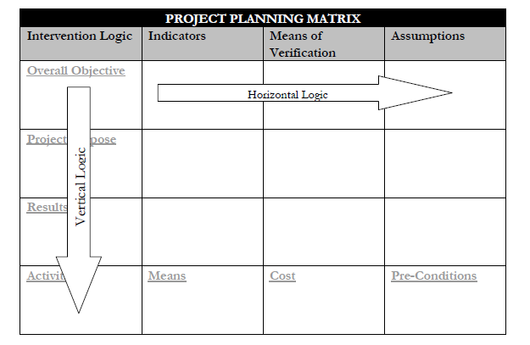
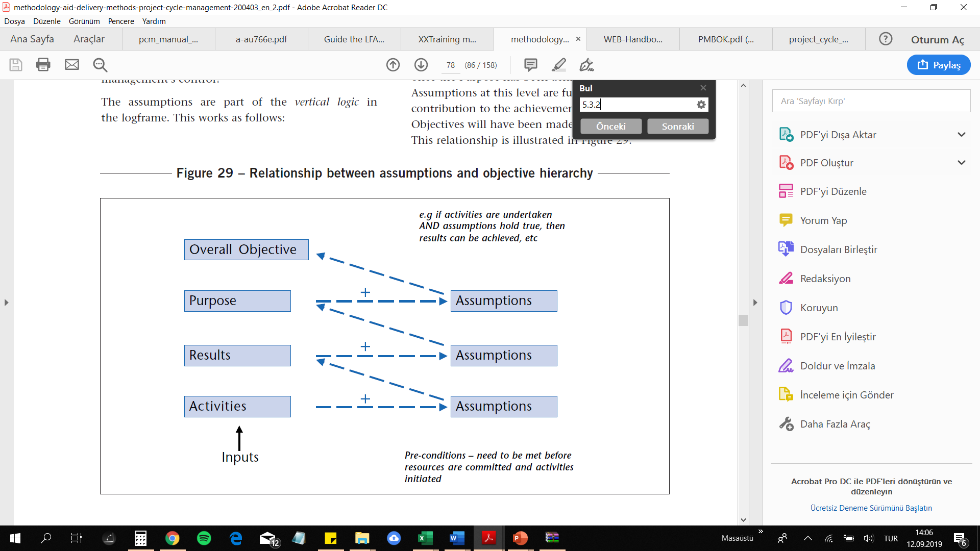
Logical Framework Matrix
The vertical lines identify what the project intends to do, clarifies the relationship of cause and effect, and specifies the presuppositions and important uncertainties which are outside the control of the project manager.
The horizontal lines refer to effects and resources used by the project, making reference to specific key indicators and to the sources from which the indicators can be verified.
M

Slide 80
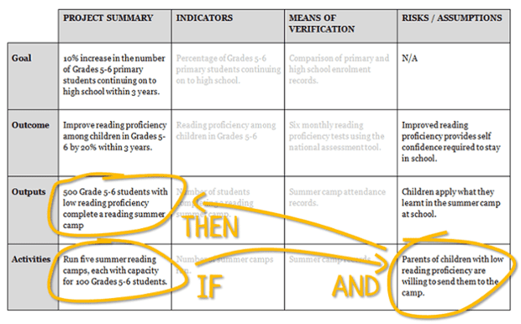
Logical Framework Matrix – IF AND THAN

Slide 81
Logical Framework Matrix
The first column of the Logframe matrix summarises the ‘means-end’ logic of the proposed Project (also known as the ‘intervention logic’).
The fourth line gives the activities to realize;
If these activities are carried out, the desired results should come about;
Collectively, the results should help fulfil the specific objective;
The specific project objective contributes to fulfilling the general objectives.
M

Slide 82
Logical Framework Matrix
Overall Objective: This is a general development objective that refers to the long term benefits to an entire population, but is outside of the Project control, and is what the Project will contribute to. Normally the overall objective relates and links to a national objective.
Project Purpose: This refers to what the specific objective of the project is, and describes the changed situation the Project should result in if it achieves its results. The Project Purpose should define the sustainable benefits for the target group/s. It may reflect a change in the target group's behavior, or the benefits which will accrue to them. There is normally only one project purpose.
Results: The results are a statement of the outcome, or the effects of the activities undertaken. If all of Results are achieved, we would expect that the Project Purpose is achieved as a consequence. Although they are numbered, Results are defined according to logical areas and not sequential (they do not have to happen in order), Results are within the control of the Project - they are what the Project guarantees it can deliver. They describe the effect of the completion of the activities.
Activities: These are the sequential steps necessary to achieve a result. They are the tasks to be carried out according to each result. Each activity needs to be specific and detailed to allow for complete clarity as to what is to be done, and to allow for budgeting. The activities must be numbered in sequence according to the relevant result!
Means: These are the necessary means to undertake the activities. They include personnel, materials, and infrastructure. They describe the resources required for the successful implementation of the project activities. They are also basically a list of items that will need to be budgeted for.
Cost: This states the overall cost of the project, and the expected sources. It is not a detailed budget.
M

Slide 83
Logical Framework Matrix
It is useful to standardize the way in which the hierarchy of project objectives is described.
The Overall Objective/Goal describes the anticipated long term objective towards which the project will contribute (project justification). It is to be expressed as ‘To contribute to…..`;
The Specific Objective/Purpose describes the intended effects of the Project (project purpose), the immediate objective for the direct beneficiaries as a precisely stated future condition. It is to be expressed in terms of benefits to the target group being ‘Increased/improved/ etc
Results/outputs are expressed as the targets which the project management must achieve and sustain within the life of the project. Their combined impact should be sufficient to achieve the immediate objective. They are to be expressed in terms of a tangible result ‘delivered/produced/conducted etc
Activities are expressed as processes, in the present tense starting with an active verb, such as ‘Prepare, design, construct, research …..’. Avoid detailing activities; indicate the basic structure and strategy of the project.

Slide 84
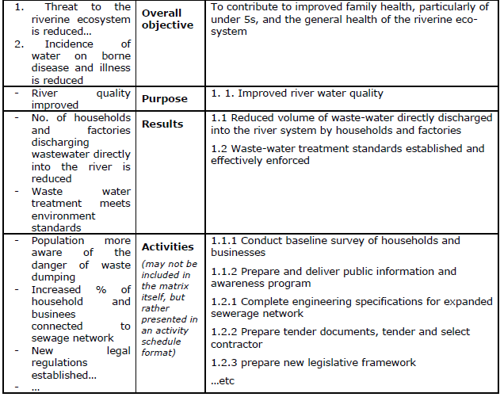

Logical Framework Matrix
Objective Tree
Logframe objective hierarchy column with examples of statement

Slide 85
Logical Framework Matrix
Assumptions: Assumptions are usually progressively identified during the analysis phase. Additional assumptions might also be identified through further consultations with stakeholders, as the hierarchy of project objectives is discussed and progressively analysed in more detail.
Risks: All of the negative external factors which should be considered for the success of the project.
Assumptions: All of the positively expressed external factors which affect or determine the success of the project.
Pre-conditions: The conditions which should be overcome before the implementation of activities.
M

Slide 86
Logical Framework Matrix
An assumption is a condition :
required for project success;
which is not under the control of project management; and
which will need to be monitored
Assumptions are external factors that have the potential to influence (or even determine) the success of a project, but lie outside the direct control of project managers Assumptions are risks, which can jeopardize the success of the Project and are worded positively, i.e. they describe circumstances required to achieve certain objectives

Slide 87
Logical Framework Matrix
Key points in setting Assumption
Should be relevant and probable
If an assumption is not important or almost certain: Do not include
If an assumption is unlikely to occur: Killer assumption – abandon project
M

Slide 88
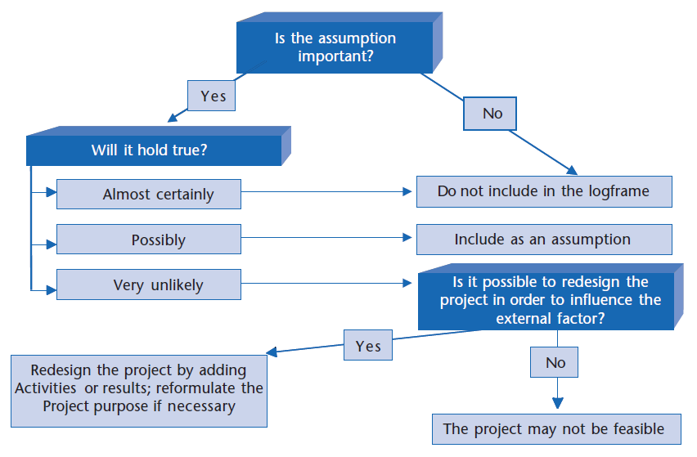
Logical Framework Matrix
Is
the
assumption
important
?
A useful way of assessing the importance of Assumptions during design is with the decision making flowchart
Will it hold true
?
Almost certainly
Possibly
Very unlikely

Slide 89
Logical Framework Matrix
Once the project description and assumptions have been drafted (columns 1 and 4 of the matrix), the next task is to identify indicators that might be used to measure and report on the achievement of objectives (column 2) and the sources of that sources information (column 3).
Indicators are the definition of the results, objectives and objectives of the project in measurable terms. There is no cause-effect relationship between them. However, it shows how we can monitor the successful fulfillment of objectives as a performance measure. Indicators should be appropriate to the needs of the user, easy to collect, use and understand, clear definition, independent of each other and as few as possible. Indicators are generally defined in terms of quantity, quality, location, target group and time.

Slide 90
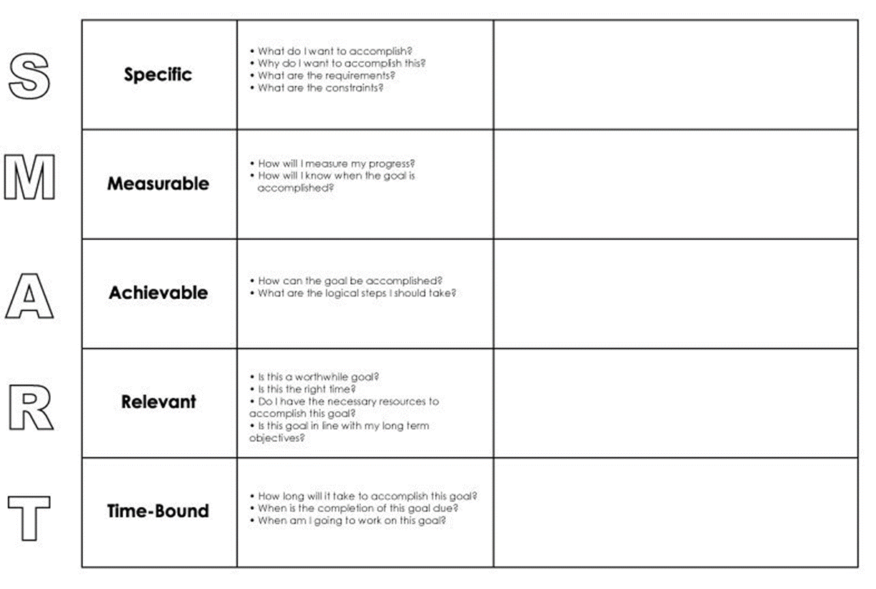
Logical Framework Matrix
Although there are no absolute principles to provide the best indicator of success, it is useful to create an indicator with SMART Specific (S), Measurable (M), Achievable (A), Relevant (R), Time Bound (T)
Objectively Verifiable Indicators describe the project’s objectives in operationally measurable terms (quantity, quality, time – or QQT). Specifying OVIs helps to check the feasibility of objectives and helps form the basis of the project’s monitoring and evaluation system. They are formulated in response to the question “How would we know whether or not what has been planned is actually happening or happened? How do we verify success?”

Slide 91
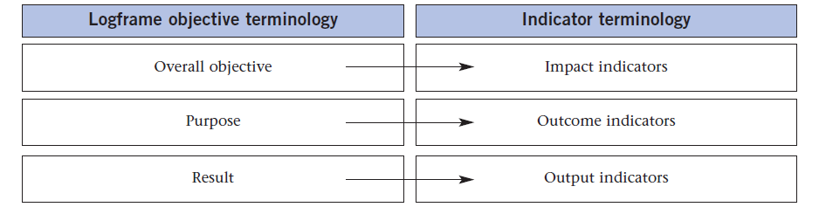
Logical Framework Matrix
For each objective or result to measure, the Indicators must contain the definition:
of the variable (the element to measure: WHAT?)
the recipients (those who will benefit from the project: WHO?)
the quantity (the present situation and the proposed situation: HOW MUCH?)
the time (the time period within which the objective should be reached: WHEN?)
the place (WHERE?)
M

Slide 92
Logical Framework Matrix
The third column contains the sources for verification. The sources for verification show how / when can the achievement of the goal, intent, results and activities (made operational through the indicators) be checked.
The source of verification should be considered and specified at the same time as the formulation of indicators. This will help to test whether or not the Indicators can be realistically measured at the expense of a reasonable amount of time, money and effort.
The SOV should specify:
how the information should be collected (e.g. from administrative records, special studies, sample surveys, observation, etc) and/or the available documented source (e.g. progress reports,
project accounts, official statistics, engineering completion certificates, etc.)
who should collect/provide the information
when/how regularly it should be provided (e.g. monthly, quarterly, annually, etc.)
M

Slide 93
Sources of Verification
Logical Framework Matrix
Specialised
surveys
Cost
Interviews with
beneficiaries
Adapted available
statistics
Available
statistics
Management
reports
Administrative
reports
Complexity
M
Notes:
20

Slide 94
Activity, resource and cost schedules
Activity Schedule: The aim of the project is to plan the works (activities) to be done in order to ensure the determined transformation. It will help to shape the human, technical and other resources that will be necessary for the continuation of the project and to clarify the project budget accordingly.
Activity-Time Schedule: is the planning to see the completion periods of the designed activities, which activities should be performed before, together or after, and by whom. After determining the results to be achieved and the activities that will ensure the achievement of these results, the decision on when, how long and by whom these activities will be performed is placed in the following table.

Slide 95
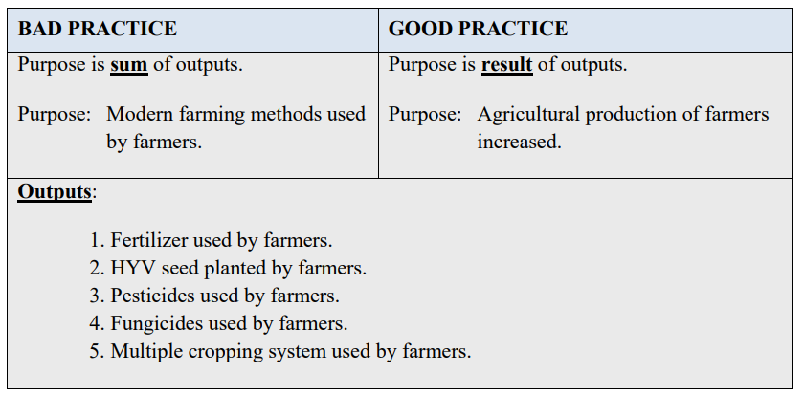
Logical Framework Matrix – GOOD vs BAD

Slide 96
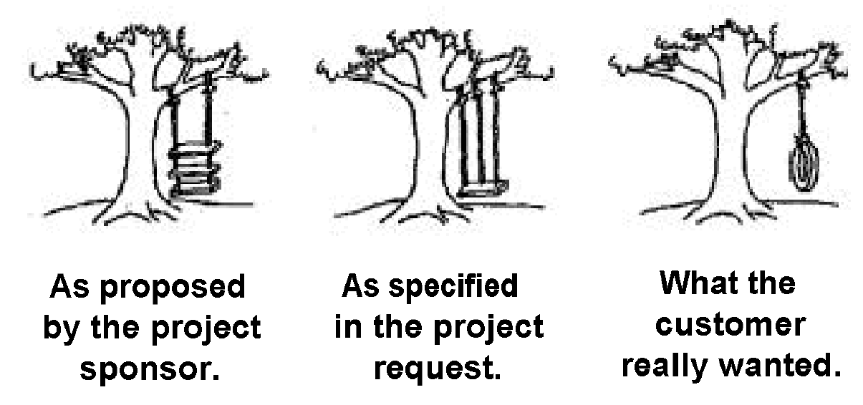
Logical Framework Approach - why?

Slide 97
Logical Framework Matrix – specific objectives
 | Intervention Logic | Objectively Verifiable Indicators | Sources of Verification | Assumptions
Specific Objective | Provision of new support services to innovative resident SMEs and an increase both in the number of high-tech start-ups and investment readiness of the SMEs, | 20 training programmes provided 40 beneficiary employees receiving training 10 new services offered to SMEs Increase in no. of SME employees for 30 employees | The SME Policy Index and SBA Fact Sheets; EIB Reports; Beneficiary annual reports; Project Reports

Slide 98
Logical Framework Matrix – Activities
 | Intervention Logic | Means | Sources of Verification
Phase 1 | Task 3: Provide trainings and mentorship to beneficiary staff and resident entrepreneur |  | Project Reports Beneficiary annual reports; EIB Reports;
Assumptions

Slide 99
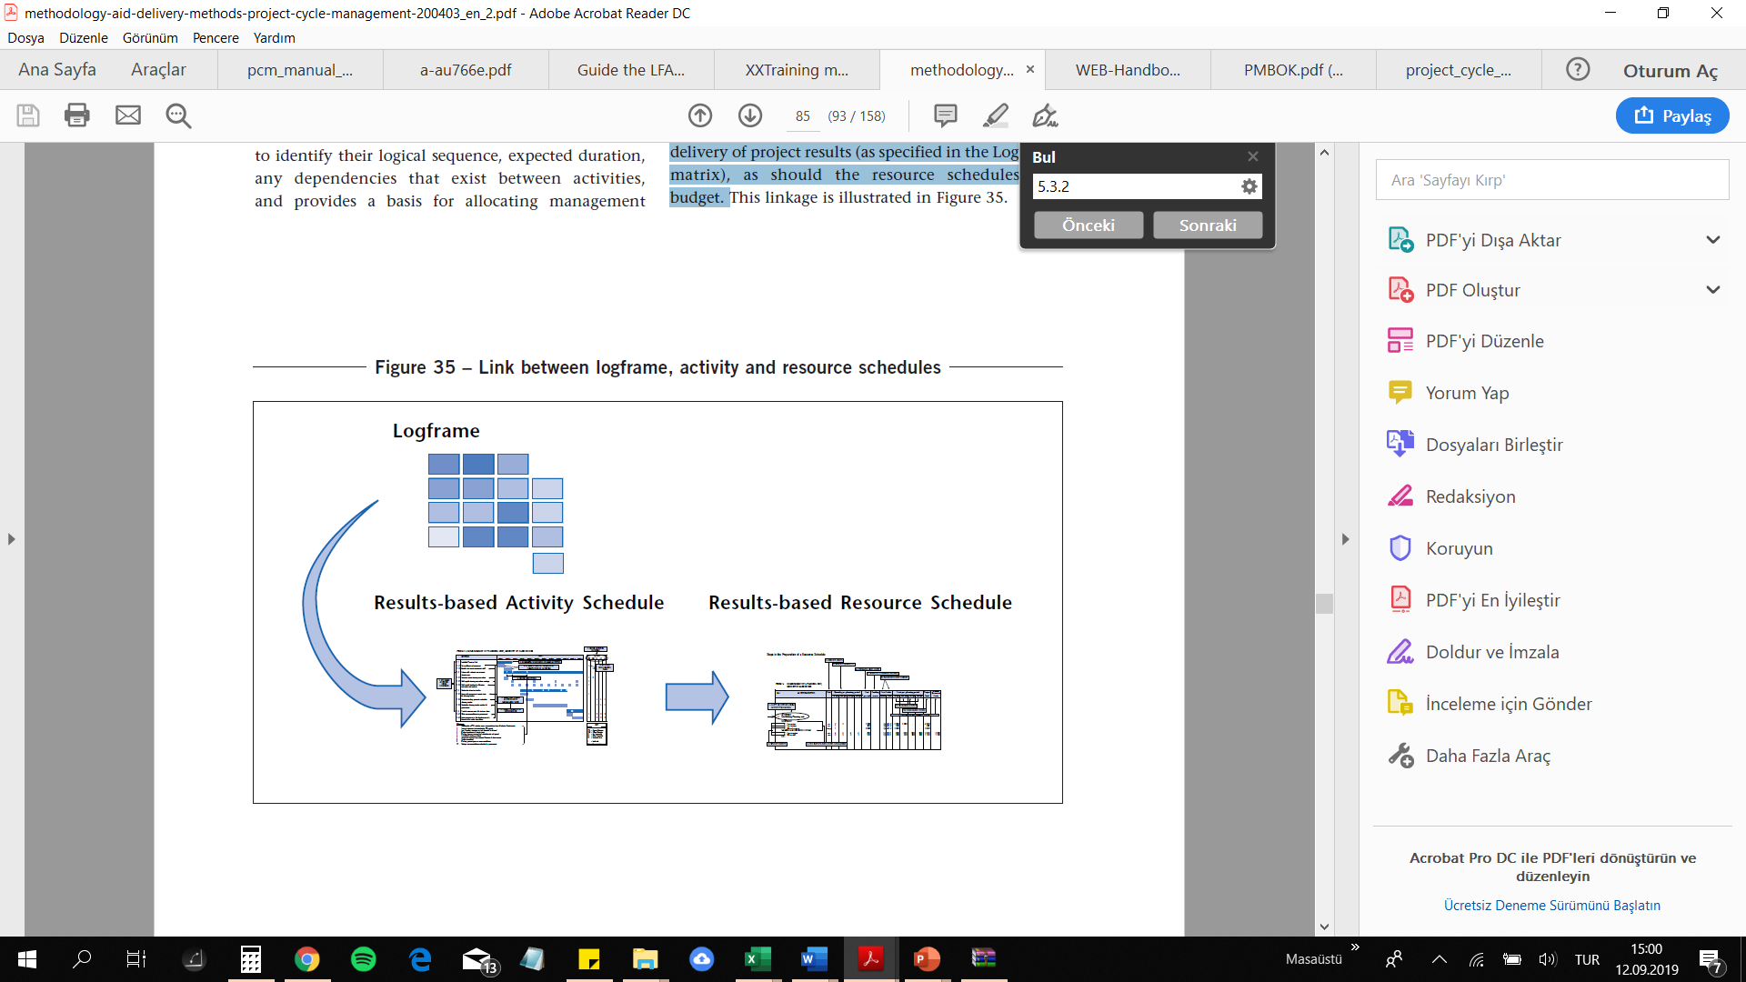
Activity, resource and cost schedules
The level of detail required will depend on the nature and scale of the project, its stage in the Project cycle, and expected implementation modalities.
Activity Schedules should be clearly linked to the delivery of project results (as specified in the Logframe matrix), as should the resource schedules and budget.

Slide 100
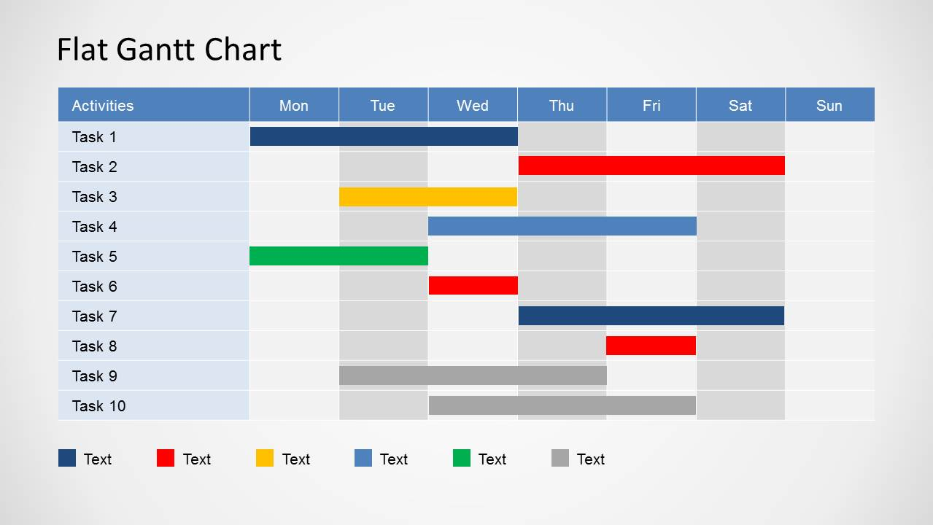
Activity, resource and cost schedules
Once the Logframe matrix itself is complete, it is then possible to use the identified Activities (which may or may not be actually included in the matrix itself) to further analyse issues of timing, dependency and responsibility using an activity scheduling (or Gantt chart) format
The format can be adapted to fit with the expected duration of the project in question and to the level of detail that it is useful and practical to provide.
The specific Gantt Chart for each project may vary according to the nature of the project, but should convey the following information:
The specific activity to be conducted, organized sequentially according to results
A specific time when this activity is to be undertaken and for how long
Who is to take responsibility for this activity

Slide 101
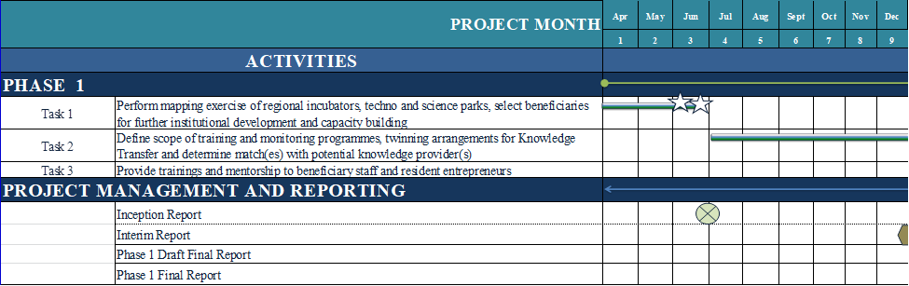
Timetable - example

Slide 102
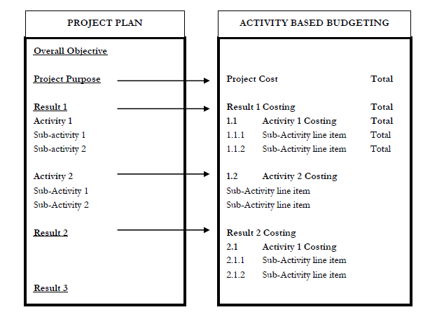
Activity, resource and cost schedules
Project budgeting in logical framework follows a detailed activity based costing framework. In essence the budget needs to directly correspond to the Project Logframe or plan.
Each project result, activity, and sub-activity need to be clearly identified and costed for the purpose of budgeting.

Slide 103
Once the Activities have been entered into the schedule, the resources necessary to undertake the Activities must be specified. As there will be a need to aggregate or summarise the cost information, the resources should be allocated to agreed cost categories.
It is now possible to schedule cost per planning period using simple formulae to multiply the annual quantity by the unit cost. Once Total Costs have been calculated, it is important to remember that the implementing agency will be required to meet any recurrent costs of maintaining service provision beyond the life of the project. Recurrent Costs may be covered (fully or partly) through increased revenue that has been generated through project Activities
Resource planning and budget preparation is a three-level process:
1. Resource planning and preparing a draft budget
2. Conducting market research
3. Finalizing budget preparation

Slide 104
Logframe Exercise
Develop a logframe matrix for one event (training, conference, fair, cultural event, etc.)

Slide 105

5. Preparation of Effective Project Proposal
15:30-15:45
Mila Marinkovic

Slide 106
Aspects to consider before embarking in the drafting of a proposal:
Relevance: check that your intended proposal does indeed address the Topic indicated in the call for proposals. Proposals falling out of scope of the call for proposals will be rejected due to not reaching the threshold level for the relevant award criterion.
Completeness: check that your intended proposal includes all relevant information and covers all aspects described in the award criteria, proposal template and this guide, as it will be evaluated only on the basis of the submitted content. Follow closely the format of the template of Part B and ensure that all the requested information is uploaded. Do not forget that quantity does not mean quality: good proposals are clearly drafted and are easy to understand and follow; they are precise, concise and focus on substance. Bear in mind that there is a page limit for Part B of your proposal and that any text after this limit will be watermarked and evaluators will not take those pages into consideration.
Orientation towards results and impact: good proposals should clearly show the results that will be achieved as well as include a sound and credible evaluation study – to be undertaken by an independent external body – not only focusing on process evaluation, but looking in particular at impact, as described in the additional information on award criteria
M
Notes:
The European Union is a unique institution where Member States voluntarily cede national sovereignty in many areas to carry out common policies and governance in order to gain strength and the benefits from cooperation.
Single market: The Single Market refers to the EU as one territory without any internal borders or other regulatory obstacles to the free movement of goods and services. A functioning Single Market stimulates competition and trade, improves efficiency, raises quality, and helps cut prices. The European Single Market is one of the EU’s greatest achievements. It has fuelled economic growth and made the everyday life of European businesses and consumers easier. (SM of goods, SM of services, Digital SM, etc.)
Euro: The euro is the most tangible proof of European integration – the common currency in 19 out of 28 EU countries and used by some 338.6 million people every day. The euro was launched on 1 January 1999. Banknotes and coins were introduced on 1 January 2002. The benefits of the common currency are immediately obvious to anyone travelling abroad or shopping online on websites based in another EU country.
6 countries non-EU use the euro: Vatican, San Marino, Monaco, Andorra, Montenegro and Kosovo.
Schengen area: 26 members (22 from the EU, 4 non-EU (Norway, Iceland, Switzerland and Lichtenstein). 3 microstates are de facto members because they do not have borders (Monaco, Vatican and San Marino). 2 EU MS are not in the Schengen area: UK and Ireland. 4 EU MS are working on implementing the Schengen area rules to be full members: Cyprus, Croatia, Bulgaria and Romania.
The EU has exclusive competences in:
-Customs Union
-Competition rules
-Monetary policy for the Eurozone
-Conservation of marine biology
-Concluding international agreements

Slide 107
The preparation of a good proposal should be seen as an investment in increasing the chances of an application being successful. Without sufficient internal resources the preparation of successful proposals is impossible.
Human resources
Time
Financial resources
Project preparation takes money (for staff, travel, meetings and possibly for additional expert assistance).
Partners - and the lead partner organisation in particular - will need to have sufficient staff to prepare the application, including the coordinator, field- experts (and, in some cases, external consultants). Partner organisations need to make a serious commitment at an early stage and give staff time to work on the application. You should consider whether partners who are unwilling to do this will be good contributors to the main project.
The preparation of applications is often time-consuming. The preparation of a good project will require approximately 1 year. It is not particularly time-consuming to fill in the application form (approx. 1-2 months) but developing the information required to do this will take time.
M
Notes:
The European Union is a unique institution where Member States voluntarily cede national sovereignty in many areas to carry out common policies and governance in order to gain strength and the benefits from cooperation.
Single market: The Single Market refers to the EU as one territory without any internal borders or other regulatory obstacles to the free movement of goods and services. A functioning Single Market stimulates competition and trade, improves efficiency, raises quality, and helps cut prices. The European Single Market is one of the EU’s greatest achievements. It has fuelled economic growth and made the everyday life of European businesses and consumers easier. (SM of goods, SM of services, Digital SM, etc.)
Euro: The euro is the most tangible proof of European integration – the common currency in 19 out of 28 EU countries and used by some 338.6 million people every day. The euro was launched on 1 January 1999. Banknotes and coins were introduced on 1 January 2002. The benefits of the common currency are immediately obvious to anyone travelling abroad or shopping online on websites based in another EU country.
6 countries non-EU use the euro: Vatican, San Marino, Monaco, Andorra, Montenegro and Kosovo.
Schengen area: 26 members (22 from the EU, 4 non-EU (Norway, Iceland, Switzerland and Lichtenstein). 3 microstates are de facto members because they do not have borders (Monaco, Vatican and San Marino). 2 EU MS are not in the Schengen area: UK and Ireland. 4 EU MS are working on implementing the Schengen area rules to be full members: Cyprus, Croatia, Bulgaria and Romania.
The EU has exclusive competences in:
-Customs Union
-Competition rules
-Monetary policy for the Eurozone
-Conservation of marine biology
-Concluding international agreements

Slide 108
Programme sources:
Programme manual and handbooks: Most programmes draft a manual or series of guidance factsheets to support applicants during the application process, explaining rules and procedures.
Programme management: Officers can advise on harmonising project content with programme priorities, necessary links between the project idea and other programme requirements, guidance with setting the indicators and drawing links to those used by the programme, and technical advice on the requirements of the application form (e.g., some programmes have special events where technical questions related to filling in the application are discussed).
Project assessment criteria: These tell you what the programme will be looking for when it considers your project. Compare the assessment criteria with the application form to decide where you should include the information required. Make sure you provide enough information to allow the programme to make a decision on all criteria: a common reason for project rejection is that programmes feel unable to make a judgement on the basis of the information in the application.
National/regional contact points: These are set up for the purpose of helping project developers with any questions related to the programme or its requirements (including the requirements related to the application procedures). Make sure that contacts are established well before application submission.
The involvement of external experts is considered useful by some projects when developing the content of the application - especially for less-experienced project developers.

Slide 109

Make sure – before you start:
  Start early – a good proposal needs time and evolution
  Clear unique project objective?
  Clear set of partners – are they THE voice of the market?
  Check your target audience
  Check your priority areas (one or more)
  Check the timetable and budget of your project
  Fill in the application form + annexes and remember to sign and date them!
  Make sure to send your proposal before the end of the deadline (check if the post is clearly stamping the date on it and keep the receipt!)
Define your specific objective & target group
What would you like to achieve?
Whom do you want to address?
Make sure you know the current (market) situation and your starting point
Take a reality check before you invest your time; investigate the interest amongst target group and major stakeholders
Notes:
The European Union is a unique institution where Member States voluntarily cede national sovereignty in many areas to carry out common policies and governance in order to gain strength and the benefits from cooperation.
Single market: The Single Market refers to the EU as one territory without any internal borders or other regulatory obstacles to the free movement of goods and services. A functioning Single Market stimulates competition and trade, improves efficiency, raises quality, and helps cut prices. The European Single Market is one of the EU’s greatest achievements. It has fuelled economic growth and made the everyday life of European businesses and consumers easier. (SM of goods, SM of services, Digital SM, etc.)
Euro: The euro is the most tangible proof of European integration – the common currency in 19 out of 28 EU countries and used by some 338.6 million people every day. The euro was launched on 1 January 1999. Banknotes and coins were introduced on 1 January 2002. The benefits of the common currency are immediately obvious to anyone travelling abroad or shopping online on websites based in another EU country.
6 countries non-EU use the euro: Vatican, San Marino, Monaco, Andorra, Montenegro and Kosovo.
Schengen area: 26 members (22 from the EU, 4 non-EU (Norway, Iceland, Switzerland and Lichtenstein). 3 microstates are de facto members because they do not have borders (Monaco, Vatican and San Marino). 2 EU MS are not in the Schengen area: UK and Ireland. 4 EU MS are working on implementing the Schengen area rules to be full members: Cyprus, Croatia, Bulgaria and Romania.
The EU has exclusive competences in:
-Customs Union
-Competition rules
-Monetary policy for the Eurozone
-Conservation of marine biology
-Concluding international agreements

Slide 110
Produce a first outline of your idea
  • Write a preliminary 2-3 pages about your:
    objectives
    target group
    major steps (work planning)
    intended consortium (countries, types of organisations)
  • Internal reality check: Use it as first base to discuss with potential partners
  • External reality check: Consult with related actors – check their understanding and interest.
Your consortium
Be consistent – remain relative to your objective & target group • Be adaptable - be ready to renounce a country if you do not secure the right partner • Involve partners in the preparation – avoid surprises after submission • Keep consortium motivated - agree a working method for the proposal phase, make a plan for their contributions
M
Notes:
The European Union is a unique institution where Member States voluntarily cede national sovereignty in many areas to carry out common policies and governance in order to gain strength and the benefits from cooperation.
Single market: The Single Market refers to the EU as one territory without any internal borders or other regulatory obstacles to the free movement of goods and services. A functioning Single Market stimulates competition and trade, improves efficiency, raises quality, and helps cut prices. The European Single Market is one of the EU’s greatest achievements. It has fuelled economic growth and made the everyday life of European businesses and consumers easier. (SM of goods, SM of services, Digital SM, etc.)
Euro: The euro is the most tangible proof of European integration – the common currency in 19 out of 28 EU countries and used by some 338.6 million people every day. The euro was launched on 1 January 1999. Banknotes and coins were introduced on 1 January 2002. The benefits of the common currency are immediately obvious to anyone travelling abroad or shopping online on websites based in another EU country.
6 countries non-EU use the euro: Vatican, San Marino, Monaco, Andorra, Montenegro and Kosovo.
Schengen area: 26 members (22 from the EU, 4 non-EU (Norway, Iceland, Switzerland and Lichtenstein). 3 microstates are de facto members because they do not have borders (Monaco, Vatican and San Marino). 2 EU MS are not in the Schengen area: UK and Ireland. 4 EU MS are working on implementing the Schengen area rules to be full members: Cyprus, Croatia, Bulgaria and Romania.
The EU has exclusive competences in:
-Customs Union
-Competition rules
-Monetary policy for the Eurozone
-Conservation of marine biology
-Concluding international agreements

Slide 111
The detailed proposal – Work Plan
Fine-tune your aim objectives and your target group
Take your time to decide the best methodology to be applied – can it deliver? Think impact!
Define your main working steps
Follow the guide on number of pages
Final polishing: The technical annex must give a detailed description of the project idea and work plan, which:
divides the planned work into work packages
assigns the related responsibilities and resources within the consortium
sets out a project time schedule, main milestones and deliverables
describes the project management structure
describes the communication and exploitation plans
Notes:
The European Union is a unique institution where Member States voluntarily cede national sovereignty in many areas to carry out common policies and governance in order to gain strength and the benefits from cooperation.
Single market: The Single Market refers to the EU as one territory without any internal borders or other regulatory obstacles to the free movement of goods and services. A functioning Single Market stimulates competition and trade, improves efficiency, raises quality, and helps cut prices. The European Single Market is one of the EU’s greatest achievements. It has fuelled economic growth and made the everyday life of European businesses and consumers easier. (SM of goods, SM of services, Digital SM, etc.)
Euro: The euro is the most tangible proof of European integration – the common currency in 19 out of 28 EU countries and used by some 338.6 million people every day. The euro was launched on 1 January 1999. Banknotes and coins were introduced on 1 January 2002. The benefits of the common currency are immediately obvious to anyone travelling abroad or shopping online on websites based in another EU country.
6 countries non-EU use the euro: Vatican, San Marino, Monaco, Andorra, Montenegro and Kosovo.
Schengen area: 26 members (22 from the EU, 4 non-EU (Norway, Iceland, Switzerland and Lichtenstein). 3 microstates are de facto members because they do not have borders (Monaco, Vatican and San Marino). 2 EU MS are not in the Schengen area: UK and Ireland. 4 EU MS are working on implementing the Schengen area rules to be full members: Cyprus, Croatia, Bulgaria and Romania.
The EU has exclusive competences in:
-Customs Union
-Competition rules
-Monetary policy for the Eurozone
-Conservation of marine biology
-Concluding international agreements

Slide 112
Create the budget
Design your budget “bottom-up”
Wait until the tasks are sufficiently specified and agreed – then design define the budget
Check consistency regularly while advancing on with your Work Plan - share of resources, appropriate levels between partners, appropriate weight of person-months between major work steps
Last check: consistency / language
Ask an “informed outsider” for critical reading and feedback
Check consistency of your description of activities and budget
If you have the chance, have a native speaker check the English
M
Notes:
The European Union is a unique institution where Member States voluntarily cede national sovereignty in many areas to carry out common policies and governance in order to gain strength and the benefits from cooperation.
Single market: The Single Market refers to the EU as one territory without any internal borders or other regulatory obstacles to the free movement of goods and services. A functioning Single Market stimulates competition and trade, improves efficiency, raises quality, and helps cut prices. The European Single Market is one of the EU’s greatest achievements. It has fuelled economic growth and made the everyday life of European businesses and consumers easier. (SM of goods, SM of services, Digital SM, etc.)
Euro: The euro is the most tangible proof of European integration – the common currency in 19 out of 28 EU countries and used by some 338.6 million people every day. The euro was launched on 1 January 1999. Banknotes and coins were introduced on 1 January 2002. The benefits of the common currency are immediately obvious to anyone travelling abroad or shopping online on websites based in another EU country.
6 countries non-EU use the euro: Vatican, San Marino, Monaco, Andorra, Montenegro and Kosovo.
Schengen area: 26 members (22 from the EU, 4 non-EU (Norway, Iceland, Switzerland and Lichtenstein). 3 microstates are de facto members because they do not have borders (Monaco, Vatican and San Marino). 2 EU MS are not in the Schengen area: UK and Ireland. 4 EU MS are working on implementing the Schengen area rules to be full members: Cyprus, Croatia, Bulgaria and Romania.
The EU has exclusive competences in:
-Customs Union
-Competition rules
-Monetary policy for the Eurozone
-Conservation of marine biology
-Concluding international agreements

Slide 113

Ensure your proposed objectives and work plan meets the challenges addressed by the call
Follow exactly the structure given in the guide for applicants
Be as concise and precise as possible. Avoid general statements
The consortium of partners must be excellent and appropriate for the tasks
Do not overcrowd objectives and show how you achieve them
Have the evaluator and the evaluation criteria at the forefront when writing the proposal
Select the best partners and have an experienced coordinator
Treat each section as if it is the most important section
M
Notes:
The European Union is a unique institution where Member States voluntarily cede national sovereignty in many areas to carry out common policies and governance in order to gain strength and the benefits from cooperation.
Single market: The Single Market refers to the EU as one territory without any internal borders or other regulatory obstacles to the free movement of goods and services. A functioning Single Market stimulates competition and trade, improves efficiency, raises quality, and helps cut prices. The European Single Market is one of the EU’s greatest achievements. It has fuelled economic growth and made the everyday life of European businesses and consumers easier. (SM of goods, SM of services, Digital SM, etc.)
Euro: The euro is the most tangible proof of European integration – the common currency in 19 out of 28 EU countries and used by some 338.6 million people every day. The euro was launched on 1 January 1999. Banknotes and coins were introduced on 1 January 2002. The benefits of the common currency are immediately obvious to anyone travelling abroad or shopping online on websites based in another EU country.
6 countries non-EU use the euro: Vatican, San Marino, Monaco, Andorra, Montenegro and Kosovo.
Schengen area: 26 members (22 from the EU, 4 non-EU (Norway, Iceland, Switzerland and Lichtenstein). 3 microstates are de facto members because they do not have borders (Monaco, Vatican and San Marino). 2 EU MS are not in the Schengen area: UK and Ireland. 4 EU MS are working on implementing the Schengen area rules to be full members: Cyprus, Croatia, Bulgaria and Romania.
The EU has exclusive competences in:
-Customs Union
-Competition rules
-Monetary policy for the Eurozone
-Conservation of marine biology
-Concluding international agreements

Slide 114
The first half page shows your selling points and the ‘why’, the ‘what’ & the logic behind why you are doing this. The rest of the proposal supports this emphasize your experience.
Mention your previous experience with the proposed activities. If this is the first time you’ll be undertaking such an activity, explain with concrete steps how you’ll manage the activity in order to show the Evaluator/Assessor how you’ll overcome your lack of experience and whether you can establish a balance between your institutional strengths and weaknesses.
Partner are part of this process to bring different experiences and knowledge to the table and they should add a substantial value to the proposed project. Explain how they will reinforce your proposed action and how they have already contributed. They’re a part of this process to bring different experiences and knowledge to the table and they should add a substantial value to the proposed project. Explain how they will reinforce your proposed action and how they have already contributed.
Pay more attention to monitoring and evaluation. Show the Evaluator/Assessor that you have already thought about and planned the monitoring and evaluation tools that you’ll use during project implementation
Give a strong argument on sustainability. Show the Evaluator/Assessor that you have already given considerable thought about how you will ensure the sustainability of your action. Make your argument realistic and do make it dependent on external factors, but within your responsibility and capacity.
M
Notes:
The European Union is a unique institution where Member States voluntarily cede national sovereignty in many areas to carry out common policies and governance in order to gain strength and the benefits from cooperation.
Single market: The Single Market refers to the EU as one territory without any internal borders or other regulatory obstacles to the free movement of goods and services. A functioning Single Market stimulates competition and trade, improves efficiency, raises quality, and helps cut prices. The European Single Market is one of the EU’s greatest achievements. It has fuelled economic growth and made the everyday life of European businesses and consumers easier. (SM of goods, SM of services, Digital SM, etc.)
Euro: The euro is the most tangible proof of European integration – the common currency in 19 out of 28 EU countries and used by some 338.6 million people every day. The euro was launched on 1 January 1999. Banknotes and coins were introduced on 1 January 2002. The benefits of the common currency are immediately obvious to anyone travelling abroad or shopping online on websites based in another EU country.
6 countries non-EU use the euro: Vatican, San Marino, Monaco, Andorra, Montenegro and Kosovo.
Schengen area: 26 members (22 from the EU, 4 non-EU (Norway, Iceland, Switzerland and Lichtenstein). 3 microstates are de facto members because they do not have borders (Monaco, Vatican and San Marino). 2 EU MS are not in the Schengen area: UK and Ireland. 4 EU MS are working on implementing the Schengen area rules to be full members: Cyprus, Croatia, Bulgaria and Romania.
The EU has exclusive competences in:
-Customs Union
-Competition rules
-Monetary policy for the Eurozone
-Conservation of marine biology
-Concluding international agreements

Slide 115
Carefully read the programme rules, especially the eligibility rules, and make sure that all partners can reach their national contact point to clarify specific matters.
Do not underestimate the efforts necessary to explain the descriptive parts. You need to support your case with competence and convincing arguments.
Create your own Word files for drafting descriptive sections; this will make it easier for the partners to comment and review.
Test the application form template well in advance of the deadline. Make sure you know which parts fill in automatically; this will help you trace eventual mistakes.
Allow yourself and the partners several rounds of review, and make an overall consistency check prior to submitting the application form.
Notes:
The European Union is a unique institution where Member States voluntarily cede national sovereignty in many areas to carry out common policies and governance in order to gain strength and the benefits from cooperation.
Single market: The Single Market refers to the EU as one territory without any internal borders or other regulatory obstacles to the free movement of goods and services. A functioning Single Market stimulates competition and trade, improves efficiency, raises quality, and helps cut prices. The European Single Market is one of the EU’s greatest achievements. It has fuelled economic growth and made the everyday life of European businesses and consumers easier. (SM of goods, SM of services, Digital SM, etc.)
Euro: The euro is the most tangible proof of European integration – the common currency in 19 out of 28 EU countries and used by some 338.6 million people every day. The euro was launched on 1 January 1999. Banknotes and coins were introduced on 1 January 2002. The benefits of the common currency are immediately obvious to anyone travelling abroad or shopping online on websites based in another EU country.
6 countries non-EU use the euro: Vatican, San Marino, Monaco, Andorra, Montenegro and Kosovo.
Schengen area: 26 members (22 from the EU, 4 non-EU (Norway, Iceland, Switzerland and Lichtenstein). 3 microstates are de facto members because they do not have borders (Monaco, Vatican and San Marino). 2 EU MS are not in the Schengen area: UK and Ireland. 4 EU MS are working on implementing the Schengen area rules to be full members: Cyprus, Croatia, Bulgaria and Romania.
The EU has exclusive competences in:
-Customs Union
-Competition rules
-Monetary policy for the Eurozone
-Conservation of marine biology
-Concluding international agreements

Slide 116
GENDER ASPECT
By integrating concept of gender mainstreaming into EU projects, the Commission aims to ensure that gender aspects are taken into consideration during the whole project, from its inception to delivery, and to ensure that the Project addresses women's needs, as much as men's needs, to eliminate gender discrimination.
ETHICAL ISSUES
Ethical issues are getting tough. Do not forget to tackle ethical issues when relevant. Make sure that you monitor ethical issues throughout the whole project duration
Notes:
The European Union is a unique institution where Member States voluntarily cede national sovereignty in many areas to carry out common policies and governance in order to gain strength and the benefits from cooperation.
Single market: The Single Market refers to the EU as one territory without any internal borders or other regulatory obstacles to the free movement of goods and services. A functioning Single Market stimulates competition and trade, improves efficiency, raises quality, and helps cut prices. The European Single Market is one of the EU’s greatest achievements. It has fuelled economic growth and made the everyday life of European businesses and consumers easier. (SM of goods, SM of services, Digital SM, etc.)
Euro: The euro is the most tangible proof of European integration – the common currency in 19 out of 28 EU countries and used by some 338.6 million people every day. The euro was launched on 1 January 1999. Banknotes and coins were introduced on 1 January 2002. The benefits of the common currency are immediately obvious to anyone travelling abroad or shopping online on websites based in another EU country.
6 countries non-EU use the euro: Vatican, San Marino, Monaco, Andorra, Montenegro and Kosovo.
Schengen area: 26 members (22 from the EU, 4 non-EU (Norway, Iceland, Switzerland and Lichtenstein). 3 microstates are de facto members because they do not have borders (Monaco, Vatican and San Marino). 2 EU MS are not in the Schengen area: UK and Ireland. 4 EU MS are working on implementing the Schengen area rules to be full members: Cyprus, Croatia, Bulgaria and Romania.
The EU has exclusive competences in:
-Customs Union
-Competition rules
-Monetary policy for the Eurozone
-Conservation of marine biology
-Concluding international agreements

Slide 117
Q&A

Slide 118


