Slide 1




EU Entry/Exit System start of operations
EU Delegation to Serbia - Technical Media Briefing
Thursday, 9 October 2025, 10:00-11:30

Slide 2


EES - in a nutshell….
The EES, once fully deployed, will be one of the world’s most modern border management system
It enhances the efficiency of border checks, detecting security risks and ensuring that only authorised travellers cross the external borders
It strengthens the security of EU/Schengen area borders – by reducing identity fraud and making it easier to identify over stayers.
It enables automated border checks which will reduce waiting times once fully deployed.
It will NOT change visa free regime with EU that Serbian citizens benefit from.
Official information in Serbian language: europa.rs/sistem-ulaska-i-izlaska
#TravelToEurope

Slide 3




What is the EES?
Automated IT system
Registers non-EU nationals
Applies to short-stay travelers
crossing external borders
Includes both visa and visa-free travelers
It will record entry refusals
#TravelToEurope

Slide 4
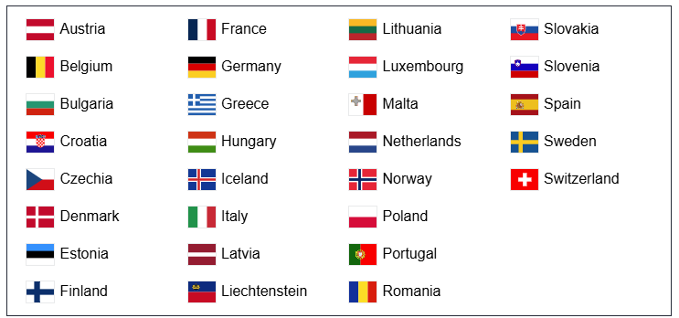
What countries will implement the EES?
2
#TravelToEurope

Slide 5
Who the EES applies to?
The system applies to you if you are a non-EU national who either:
need a short-stay visa to travel to European countries using the EES
or
do not need a visa to travel for a short stay in the European countries using the EES.
Your entries and exits, or entry refusals, will be electronically registered in the EES.
The following data will be recorded in the EES file:
data listed in travel document (full name, date of birth, nationality)
date and place of each entry and exit
biometric data such as facial image and fingerprints
refusal of entry
#TravelToEurope

Slide 6

When will the EES start?
12 October 2025 - date of the start of operations of the EES.
EU Regulation: https://eur-lex.europa.eu/eli/reg/2017/2226/oj/eng
#TravelToEurope

Slide 7
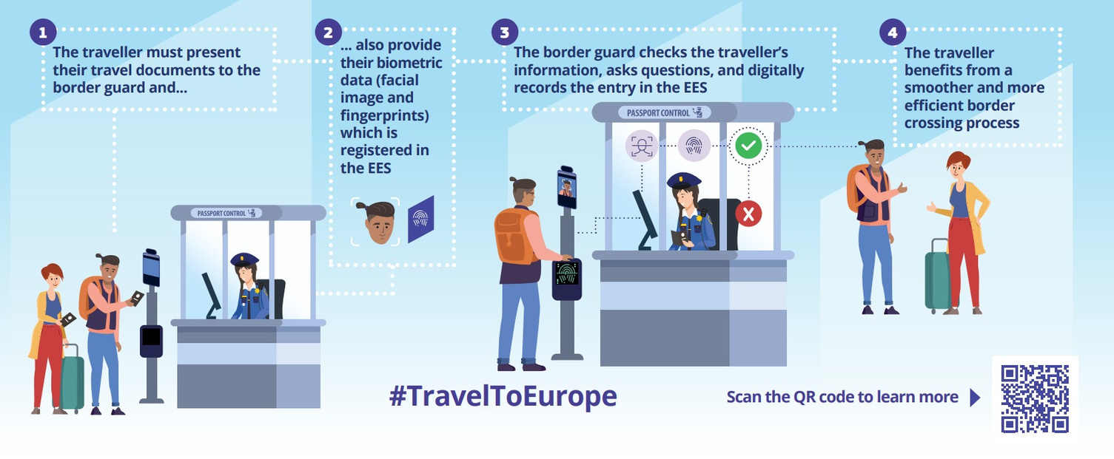

How does the EES work?

Slide 8









Benefits of the EES
Fighting identity fraud
Identification of over-stayers
Reinforced security
Reduced waiting times once fully operational
Simplified, automated border procedures
Real-time information sharing

Slide 9



What does the
progressive start
mean?
Over 6 months, Schengen area countries will progressively & according to their national implementation plans
deploy the EES across their border crossing points (air, land, sea)
introduce biometric functionalities across their border crossing
points
record all third-country nationals in the scope of the EES
By the end of 180 days period, the EES shall be fully used in all border crossing points
and all travelers shall be recorded.
For details on individual EU Member States, please contact them directly through Embassies and Consulates.
#TravelToEurope

Slide 10
What to expect during the next 6 months?
Border authorities will continue to stamp all passports at all border crossing points.
This is needed to keep a track of the short stay rule (no more than 90 days in any 180-day period).
In practical terms, travellers may experience differences in border check procedures depending on how the EES is progressively implemented in different countries AND at different border crossing points within the same country.
Therefore, during this six-month period, at some border crossing points traveller’s passport data, biometric data and entry or exit data will be registered in the EES, whereas at others, it will not.
Once the progressive period finishes (at the end of the 180 days – on 9 April), manual stamping of passports will be abolished.
7
#TravelToEurope

Slide 11
European Travel Information and Authorisation System
!!EES should not be confused with ETIAS!!
ETIAS travel authorisation will be an entry requirement for visa-exempt nationals travelling to one of 30 European countries. It is linked to a traveller’s passport. It is valid for up to three years or until the passport expires, whichever comes first.
ETIAS will NOT be a visa requirement.
Estimated date of implementation – Late 2026.
EU Delegation to Serbia will provide a similar technical media briefing on ETIAS next year, before its implementation, to cover in details.
7
#TravelToEurope

Slide 12
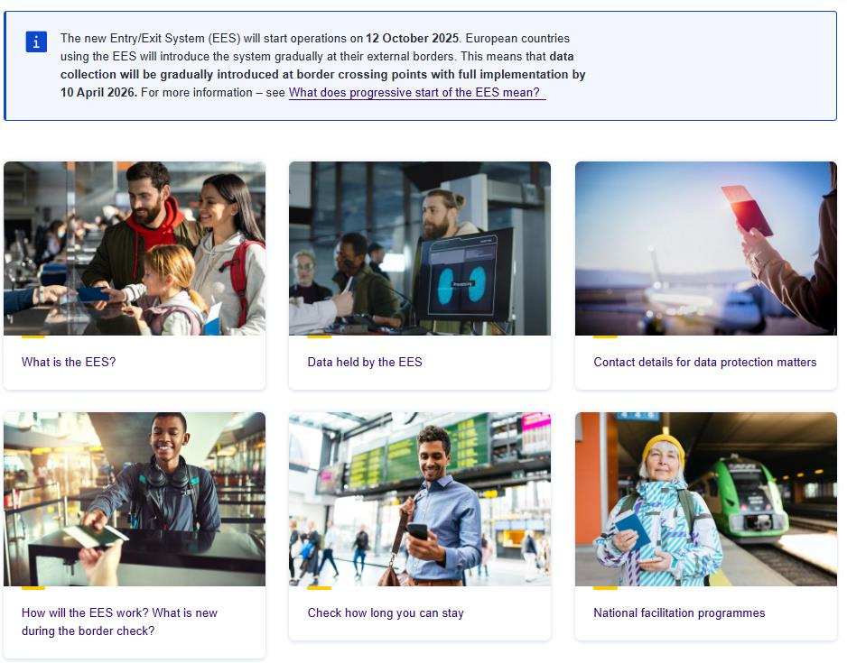

Official website – European Commission
travel-europe.europa.eu/ees
#TravelToEurope

Slide 13
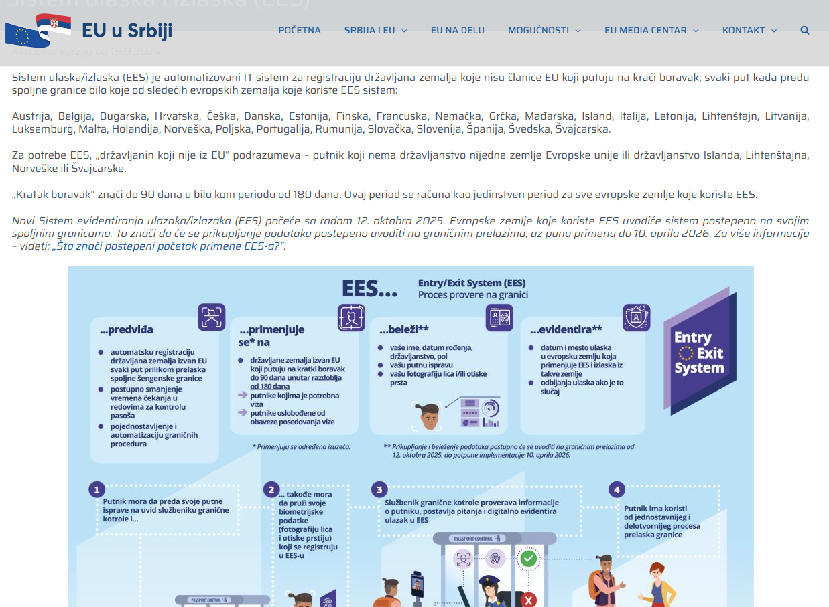
In Serbian – EU Delegation to Serbia
europa.rs/sistem-ulaska-i-izlaska
#TravelToEurope

Slide 14

Thank you!
Any questions?
#TravelToEurope

